Slide 1
The first part of this presentation refers to a paper
about self reference
Tsvi Tlusty
Ulsan IST Korea
The second part refers to experiments in my lab.

Slide 2
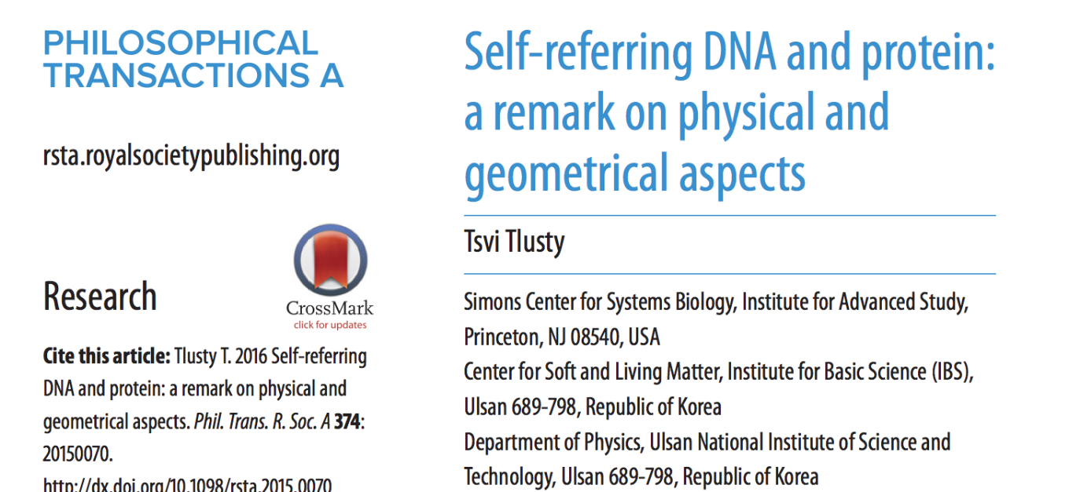

Slide 3
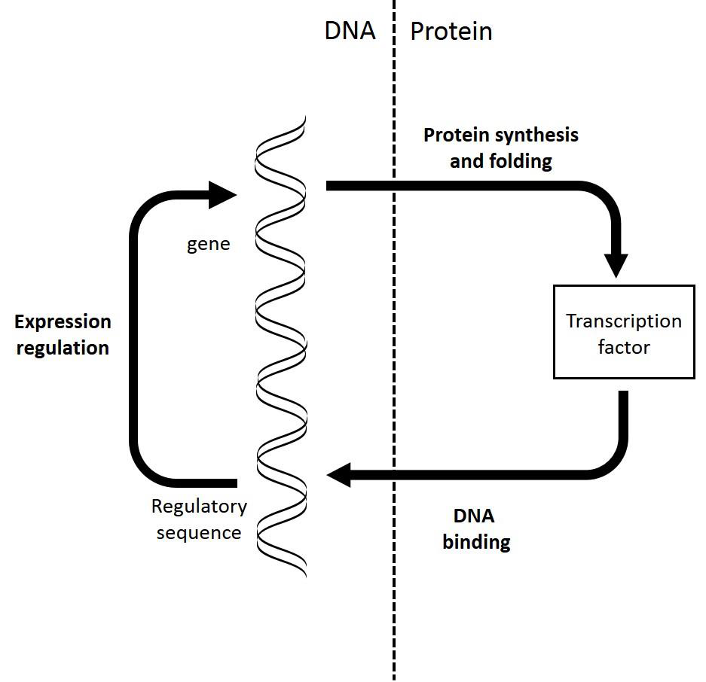
Self reference

Slide 4
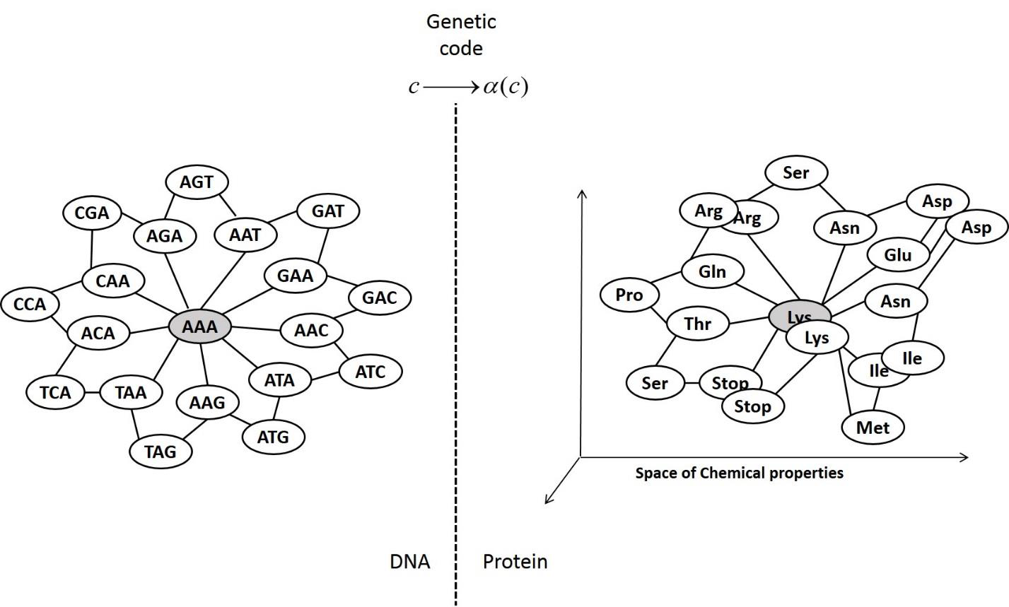

Slide 6
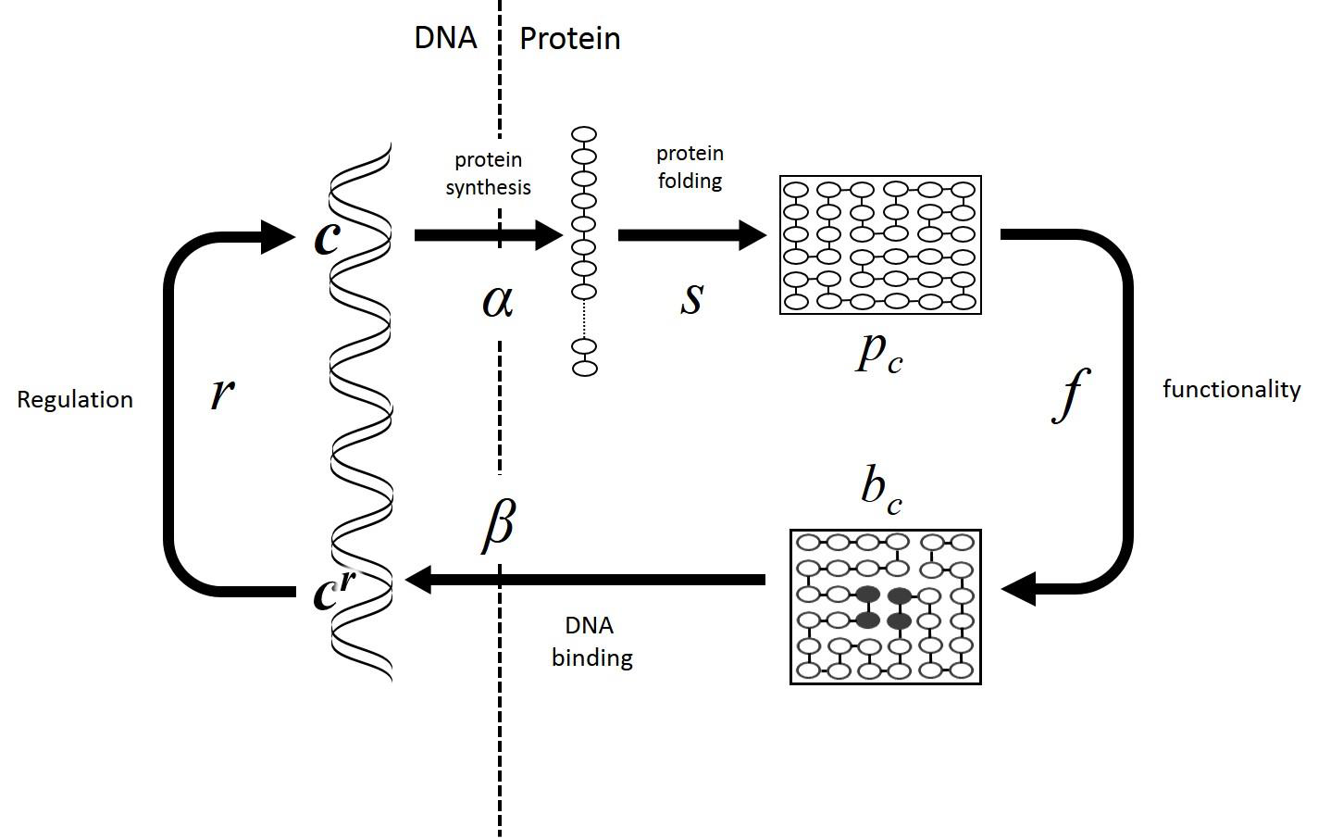

Slide 7
