Slide 1
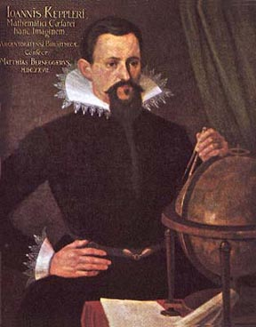
Fundamental problems of 17th-Century Physics: The Nature of Light
Alan E. Shapiro, University of Minnesota
Notes:
Thank Lee & Board. I was a member for about 10 years.

Slide 2
Light Is Not the Only Fundamental Problem in 17th Century Natural Philosophy
Cosmology: structure of the universe
Motion: Celestial and Terrestrial
Matter theory: atoms and void, or a continuum

Slide 3
Features of Keplerian Optics
Pencils of rays. All rays from object reassembled or converge at image
Eye is like an optical instrument. All processes are optical, not perceptual
Real images. ‘Pictura’ projected on to the retina
Optics stops at the retina.

Slide 4
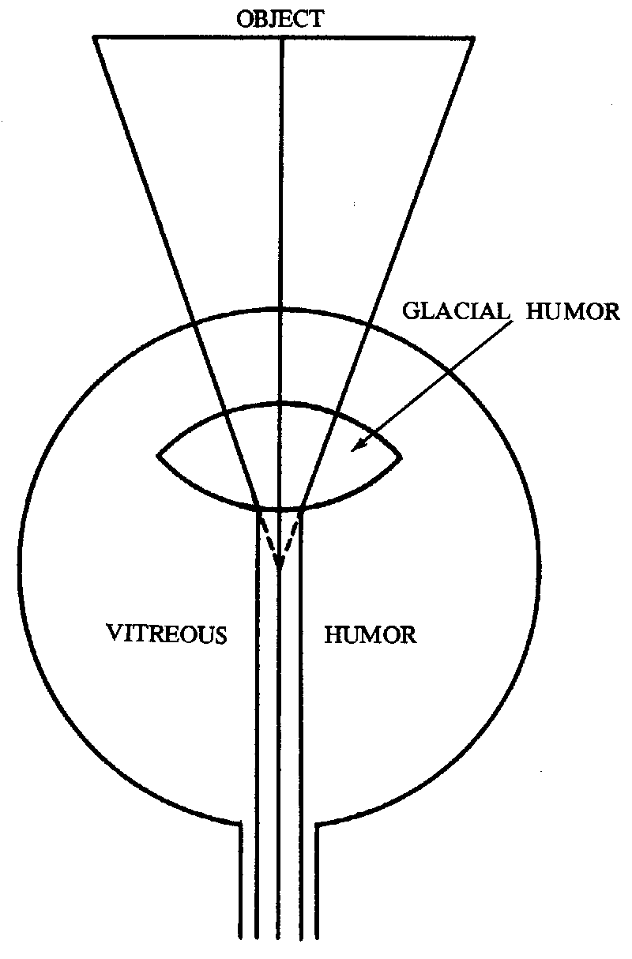
Alhazen, Eye
(Lindberg, p. 166)
Notes:
11th century Alhazen, Ibn al-Haytham, 965-1039.

Slide 5
Kepler, Anatomy of the Eye, Following Felix Platter

Slide 6
Optics after Kepler
Perspectivist (medieval)
• Vision: Form or species of an object transmitted directly to brain Provides true knowledge of external world
• Included geometrical optics. Primarily reflection, including spherical mirrors. Little on refraction
• After Kepler Two Branches of Optics Evolve
• Geometrical Optics. Refraction & Lenses central
• Physical Optics. Experimental & Mathematical

Slide 7
Contemporary Changes in Science
Rise of Experimental Science
• Mechanical Philosophy: all physical phenomena can be explained by matter in motion
• Primary Qualities (size, shape & motion of bodies) & Secondary Qualities (e.g. sensations of color, taste, sound), or or Objective and Subjective Qualities
• Mathematization
Notes:
Stimulated by ancient atomism

Slide 8
Unreliability of the Senses & Vision
Our sensations are unlike or do not resemble external objects
Fundamental tenet of modern philosophy
• Offer Gal & Raz Chen-Morris, Baroque Science (2013)
• Kepler’s theory of vision origin of fundamental tenet
• Buchwald & Feingold (2013)
• Mechanical philosophy origin of fundamental tenet
• Eye is an instrument & instruments are intrinsically unreliable
• Largely a philosophical problem. Scientists abandoned knowledge of essence of things and critically accept the reports of the senses

Slide 9
New Properties of Light
• Diffraction, Grimaldi 1665
• Interference, Colors of Thin Films, Hooke 1665
• Periodic, Newton 1675, 1704
• Double Refraction, Erasmus Bartholin, 1669
• Polarization, Huygens, 1690
• Chromatic Dispersion & Nature of White Light and Colors, Newton, 1672

Slide 10
Nature of Light
Wave, mediumistic, or continuum (transport of a disturbance)
Descartes, 1637
Hobbes, 1644
Hooke, 1665
Pardies, 1673
Huygens, 1690
• Projectile, corpuscular, or atomistic (transport of matter)
• Gassendi, 1649
• Charleton, 1654
• Newton, 1672-1704
Notes:
Olivier: “Neo-atomist theories’

Slide 11
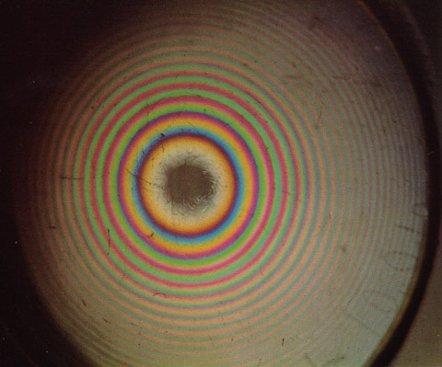
Newton’s Rings, White Light
Notes:
d = D²/8R = mI/2n, m = 1, 2, 3, . . .
Where d is the thickness of the film, D is the diameter of a ring, R the radius of the lens, I the “interval of the fits” [half of the wave length], and m is an integer; when m is odd the ring is bright, and when it is even it is dark.

Slide 12
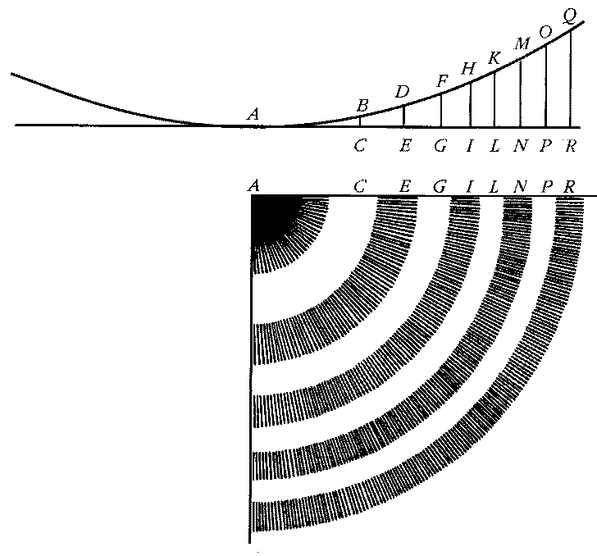
The Formation of ‘Newton’s Rings’ (After Newton, ‘Hypothesis,’ 1675)

Slide 13
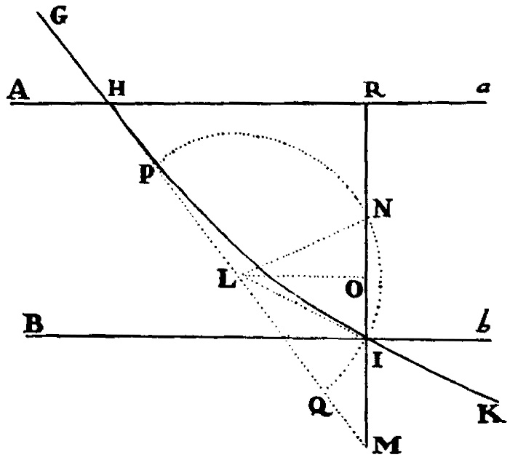
Law of Refraction, Principia, 1687

Slide 14
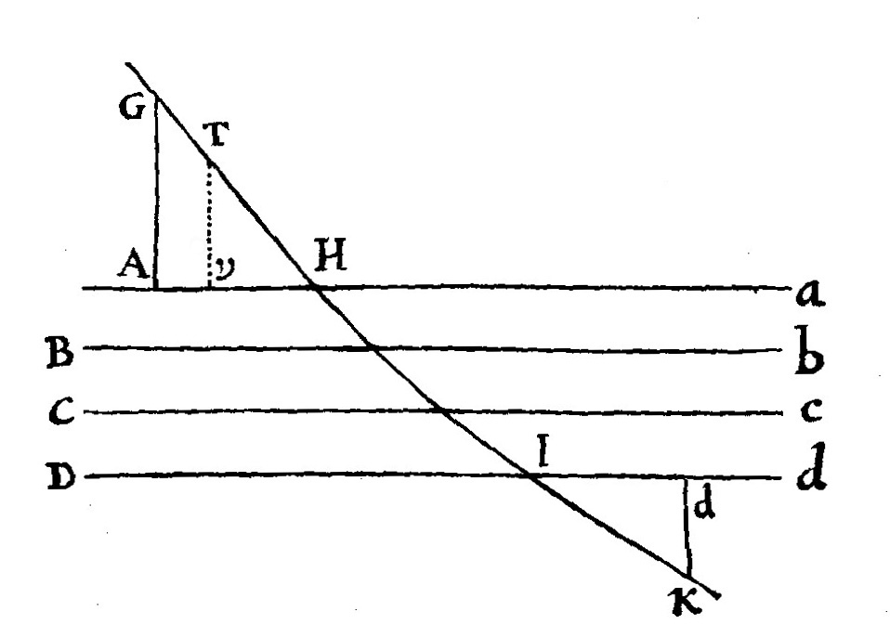
Refractive force acts in an insensibly small region bounding the interface of two media
Notes:
Path a parabola from “what Galileo hath shown.”

Slide 15
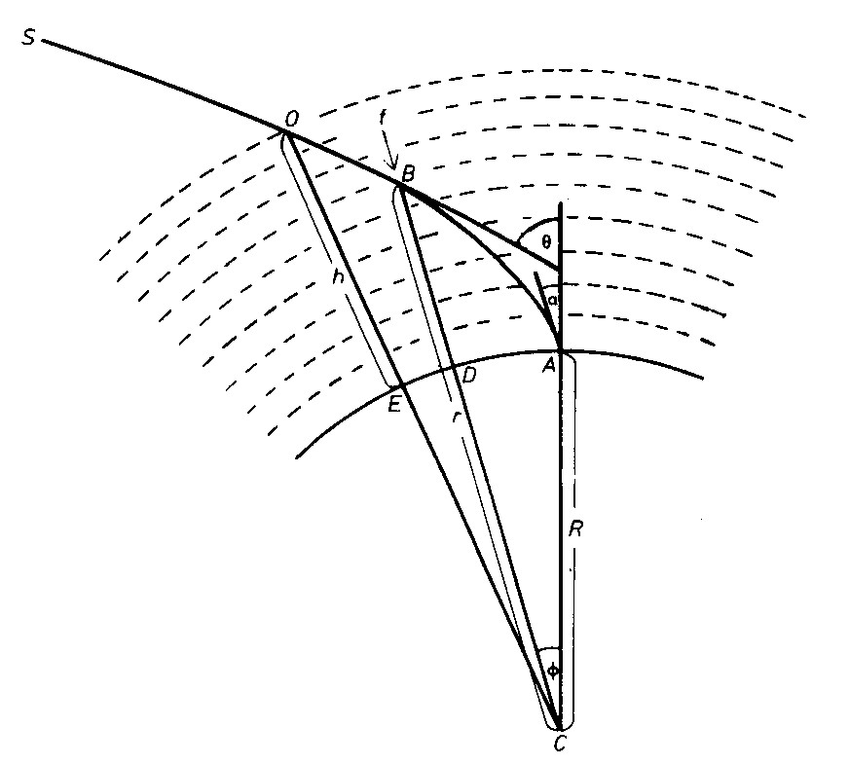
Newton’s model for calculating atmospheric refraction, 1694

Slide 16
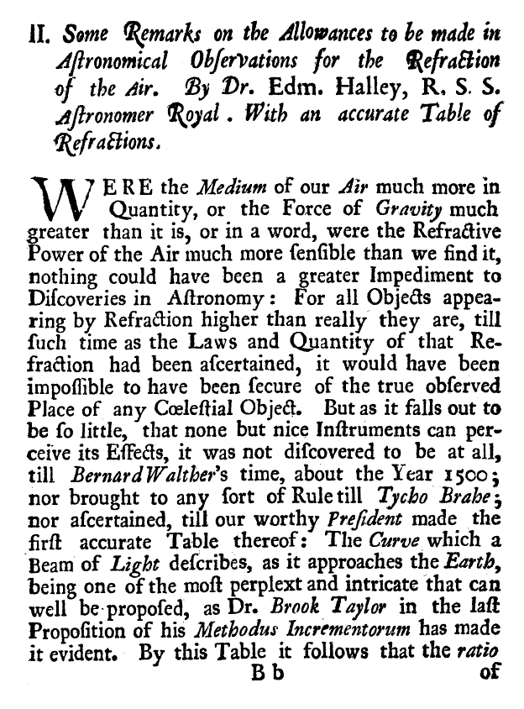
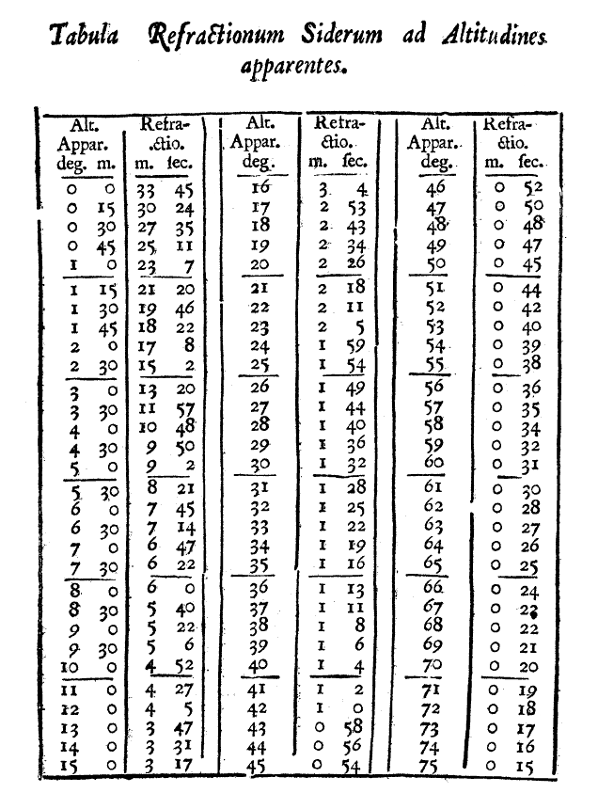
Newton’s Table of Atmospheric Refraction. Philosophical Transactions, 1721

Slide 17
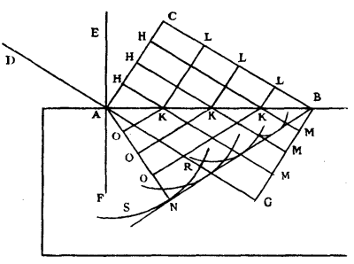
Huygens

Slide 18
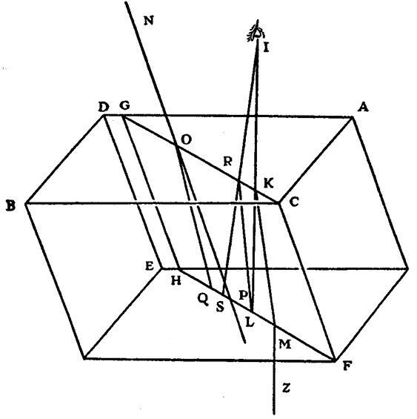
Double Refraction

Slide 19
Newton on the Reliability of the Senses -1
The certainty of his theory of thin films can be established by the evidence of the senses:
"For confirmation of all this I need alledg no more then that it is mathematically demonstrable from my former Principles. But yet I shall add that they w^{ch} please to take the paines may by the testimony of their senses be assured that these explications are not Hypotheticall but infallibly true & genuine.” (1672)
Notes:
(Observations, 1672)

Slide 20
Reliability of the Senses -2
In "New Theory of Colors" he states that his theory of color is "evinced by y^{e} mediation of experiments concluding directly & w^{it}hout any suspicion of doubt." (1672)
We judge something to be a body from “the evidence of our senses (which constitute our sole judges in this matter)” (c. 1675-85)
Throughout his career Newton switches back forth between the evidence of sense and experiment
Notes:
2nd quote from De gravitatione

