Slide 1
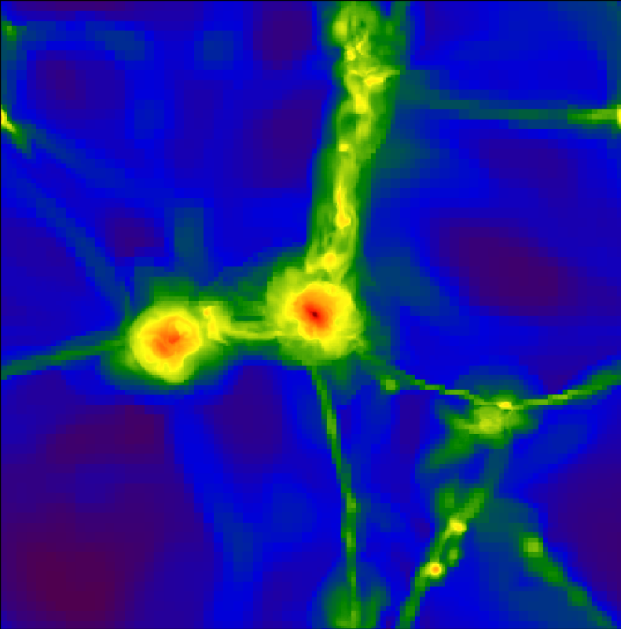
Tracing black hole growth over cosmic time
Volonteri+; Johnson+; Park+; Ricotti+; Khochfar+; Di Matteo+; Yoshida+; Haiman+; Tanaka+;
Schneider+ Dubois+; Bournoud+; Loeb+; Ferrara+; Milosavljevic+; Narayan+ Ricotti+; Abel+; Sijacki+; Springel+; Somerville+; Holz+, Hopkins+; Hernquist+; Bromm+; Latif+;
Blandford+; Small+; Tremaine+; Yu+; Murray+; Quataert+; Wise+; Whalen+
Priyamvada Natarajan
Yale University
Notes:
Honor and privilege to be here and have this opportunity to speak and give you a brief update on the status and current challenges, open questions in understanding the mass assembly history of black holes over cosmic
time. This phenomenological approach, where we have been using multi-wavelength data to guide us to build models with the LCDM framework, i.e. one is which structure builds up heirachically, mergers of DM halos drive
the growth of galaxies – we have been constructing models using these observed populations – and explain the properties as an ensemble...
IAs part of my thesis more than 15 years ago now, where an early attempt was made to integrate the formation, fueling and feedback from BHs into the standard paradigm for structure formation – here I list many people who have made valuable contributions that have greatly refined our current understanding. Many of these folks are in this room. My goal today is give you a brief overview of how this machinery works, the assumptions and inputs as well as lead
you through some recent refinements that I believe have sharpened our understanding...Of course many open fundamental
questions still remain and that is the beauty of this subject, given the copious amounts of data

Slide 2
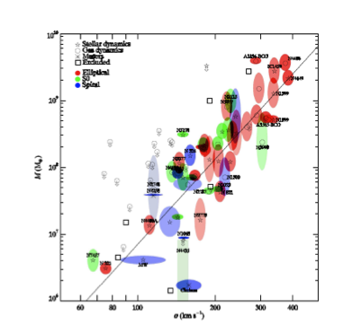
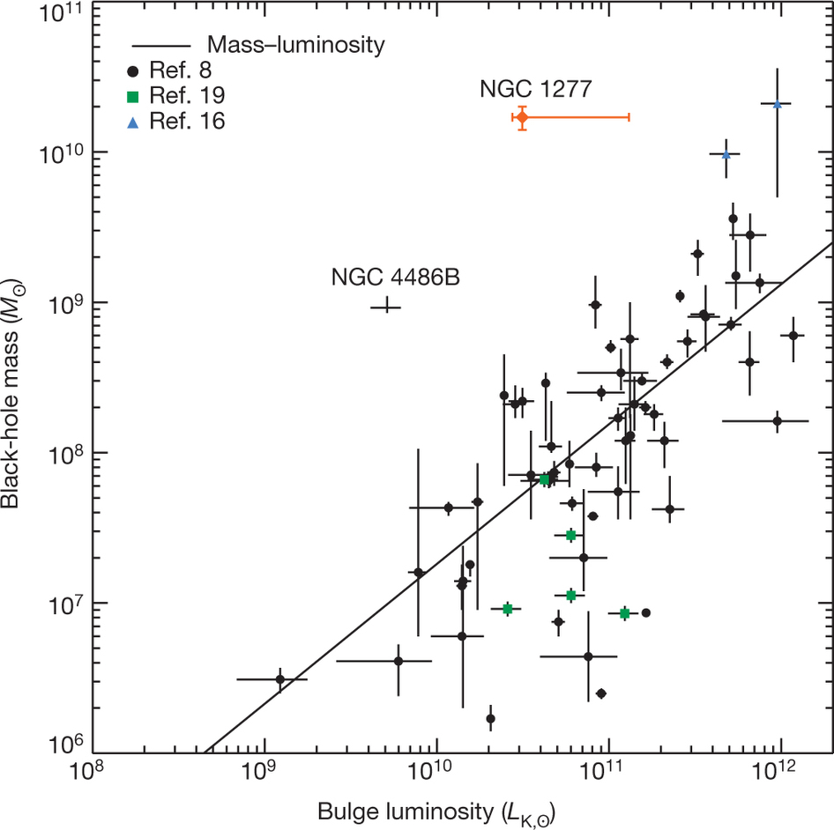
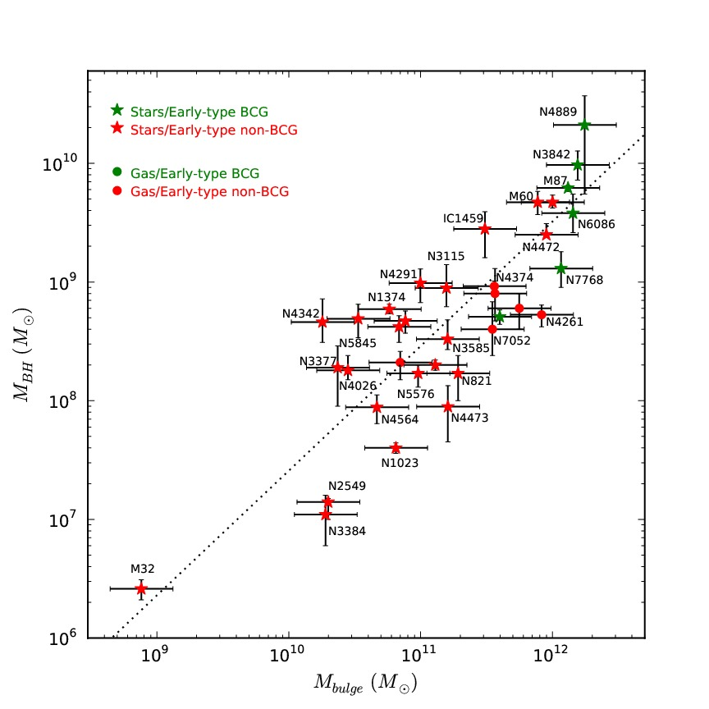
Local Correlations Between M_{BH}-Host Galaxy Properties
How fundamental are these?
Galaxy bulge mass [M_{BH}~10⁻³ M_{bulge} ] Dressler 89; Magorrian+ 98
Galaxy bulge luminosity [M_{BH}-L^{1.0±0.1} ] Kormendy 93; Kormendy & Richstone 95
Stellar velocity dispersion [M_{BH}~σ⁴ ]Tremaine+ 99; Ferrarese & Merritt 00
Gultekin+ 2010; Greene & Ho 2009, Greene+ 2011;
Reines+ 2011; Lauer+ 2007; Gebhardt+ 2011; McConnell+ 2011;
Bogdan+ 2012; van den Bosch+ 2012
van den Bosch et al.+12
McConnell & Ma+13
Notes:
Empirically we see indirect evidence for the presence of dead (as in barely accreting BHs like the one
in the center of our Galaxy and our neighborhood as well as rapidly accreting BHs that are detected as AGN of various types – unobscured bright quasars.
obscured black holes. Local demography reveals some interesting correlations between the mass of the BH and properties of the host galaxy – more precisely the stellar content of the inner regions of galaxies. There is a relation but there are also ample outliers but at the high and low mass ends. The first key question is HOW THIS growth in tandem OCCURs IN INVIDIVIDUAL GALACTIC NUCLEI & for THE POPULATION
How do BHs and the host galaxy know about each other – is this merely a consequence of the merging that is the hallmark of LCDM or does this coupling encode some deeper physics that involves accretion physics, gas supply and environment
When are these correlations set up
Do these scaling relations evolve through cosmic time
Initial conditions? accretion physics? merger dynamics?
self-regulated feedback?
How and when do seeds form and grow and evolve...
all of course in the context of LCDM

Slide 3
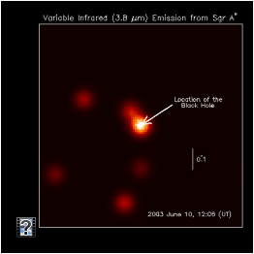
MULTI-WAVELENGTH DATA FOR ACTIVE & QUIESCENT BHs
M_{BH} ~ 10⁶ ⁻⁹ M_{sun}
even 10¹⁰ M_{sun}
z ~ 0 – 7
z=7 660 Myr
550 Myr after
the Big Bang
Urry+; Treister+;
Scoville+;
Sanders; Faber+;Wu+; Wang+;
Ferguson+;
Harrison+;
Hasinger+; Fan+
Comastri+; Gilli+
Notes:
Multli wavelength data – X-ray bgd, individual accreting sources particularly incredibly bright quasars. Interesting all nearby BHs lke the MW seem to
be barely accreting, and in a radiatively inefficient mode while higher z sources appear to be accreting at high rates at Eddington rate or even above.
We will be choosing to model these with thin disk accretion for the radiatively efficient case and with slim disk accretion for the inefficient case.
In the case of the MW the accretion is 10^-7 Eddington rate....for such a trickle which appears to be ubiqiuitous locally
Ubiquitous: it is sufficeint to be fed by stellar winds,
“hot” T_{ion}~T_{vir} quasi-spherical flow
WHILE THE RADIATIVELY EFFICIENT MODE WITH 10% efficiency, feeding mechanism unclear, rare in the local
universe, and accretion from a thin disk is adopted fed with gas supply from mergers and BH coaelescences.

Slide 4
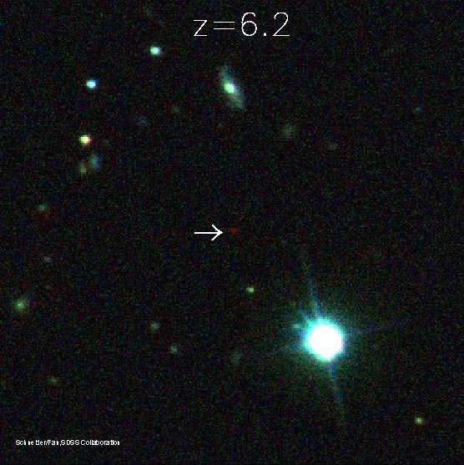
HIGH-z QUASARS & THE TIMING PROBLEM TO ASSEMBLE SMBHs
Bright quasars host 10⁹ - 10¹⁰ M_{sun} BHs
Age of the universe 1 Gyr
Eddington limit growth rate of mass
PLANCK RESULTS: first stars
form even later!
Fan+; Wu+ 15; Robertson+ 15; Planck+ XIII 15
Notes:
The first big challenge came with the discovery of the brightest quasars at the highest redshifts, SDSS started turning up a
populaiton of birght quasar at z > 6.5 powered by SMBHs with M > 10^9 and above at increasingly earlier epochs in the universe
a time when it was less than 10 % of the current age. Now this posed a problem as we believed that the remnants of the first
stars were the initial seeds and their masses were sufficiently low in order to be able to produce the required SMBHs so early on.
Once again given the nature of LCDM a theory where small initial fluctuations are gaussian, we can always explain a few outliers but there
is tension when its an entire population....In fact recent Planck results have pushed the limits on the epoch of reionization to lower redshifts.

Slide 5
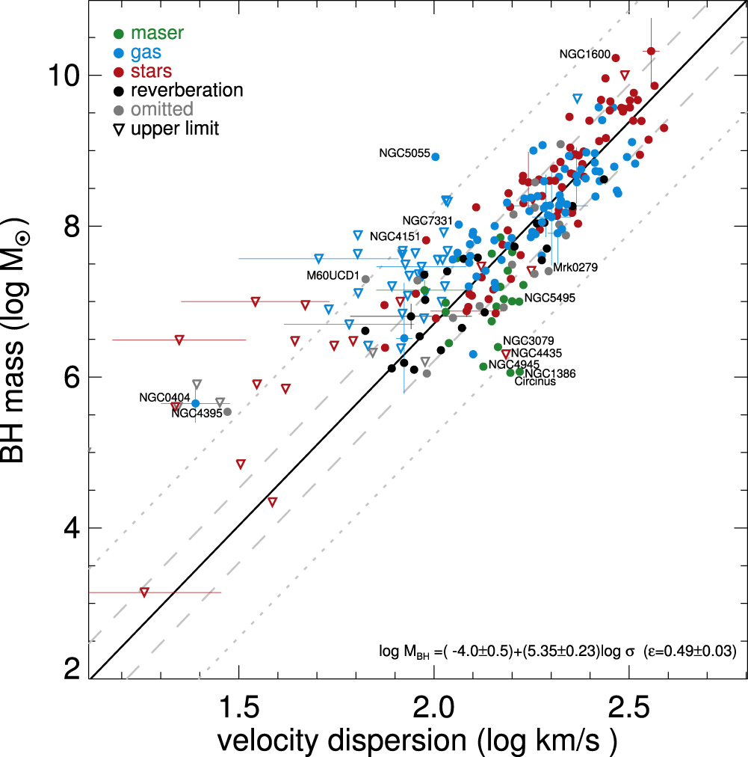
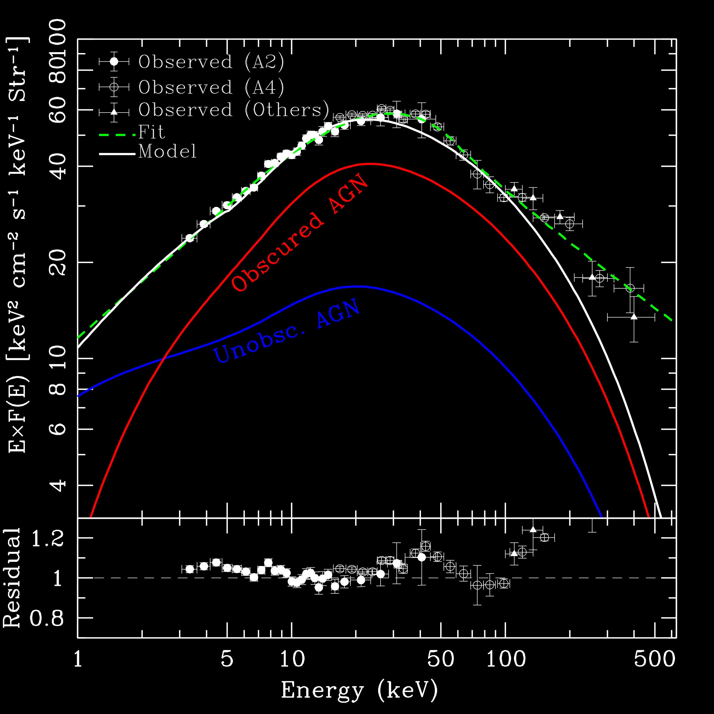
OBSERVATIONAL CONSTRAINTS FOR DEMOGRAPHIC MODELS
z=0
Abundance & LF of
high & low z quasars
XRB
Lauer+ 05, 06; Bernardi+ 06; PN & Treister 09; McConnell+ 11,12; PN & Volonteri 13; Marziani & Sulentic 12; Mortlock+ 14;
Wu+ 2015; Kulier+15; Thomas+ 16; van den Bosch+ 16; Reines+ 14; McConnell+ 13; Jiang, Greene & Ho 11; Gultekin+09
Ferrarese+ 2006; Ferrarese & Merritt 2002; Tremaine+ 2002; Kaspi+ 2005
Census from SDSS and 2dF Fan+ 2007; Croom+ 2004; Comastri+ 1995; Ueda+ 2003; Treister & Urry 2005; Merloni+ 2004;
Notes:
heirarchical, merger driven paradigm for assembly of structure, halos are seeded, they merge, their central BHs merge (instantaneously), accompanied by an accretion episode, BH mass growth is capped proportional to sigma^x, not delving into the details of the microphysics of accretion, Both LF and abundances of quasars. A large number of extremely bright Qs at high z, roughly 2 Gyrs after the BB powering by accretion requires 10^9 solar masses in place by that juncture.

Slide 6
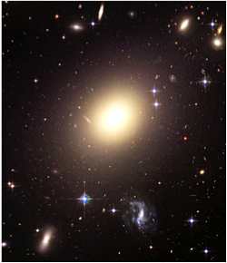
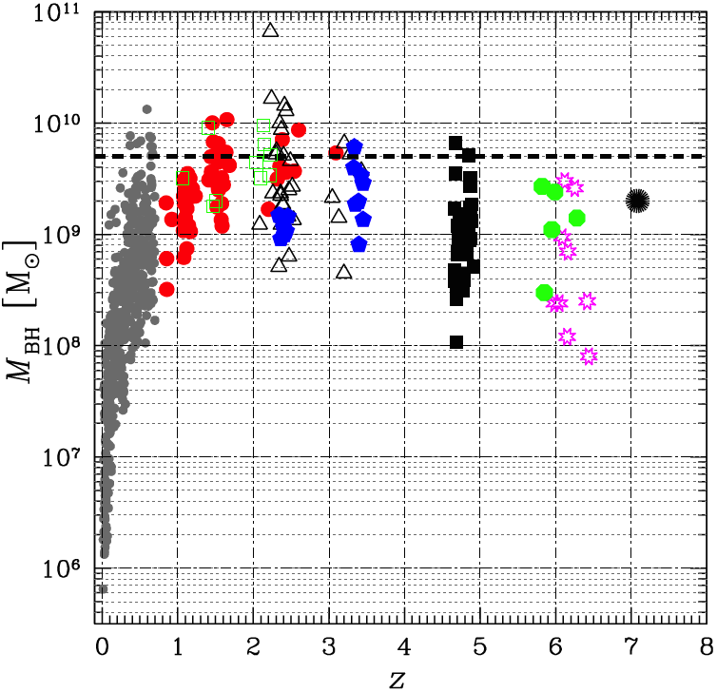
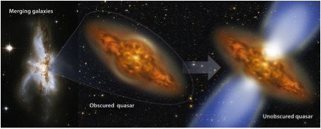
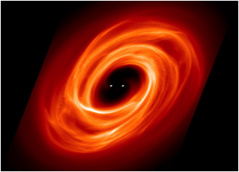
The Most Massive Black Holes in the Universe
Lauer+ 05, 06; Bernardi+ 06; PN & Treister 09; McConnell+ 11,12; PN & Volonteri 13
Marziani & Sulentic 12; Mortlock+ 14; Wu+ 2015; Kulier+15; Thomas+ 16
Notes:
Using broad emission lines as the diagnostic to measure BHs, can push out further, as with color-color selection from optical surveys
like the SDSS....Ultra massive BHs are not anomalies, these appear to exist at all redshifts...and from the modeling of the growth history
of this population. Reproducing the observed massive end of the BHMF at all epochs has greatly challenged and required refinements
rethinking the role of mergers...A KEY ELEMENT INTHE MODELING WERE MERGERS and merger triggered accretion. TO EXPLAIN THESE
AT HIGH REDSHIFT THE FIRST REFINEMENT WAS INTRODUCED – FORMATION OF MORE MASSIVE BH SEEDS FROM THE GET=GO IN THE
EARLY UNIVERSE. Before I discuss this modification and its implications – I would like to outline the modeling procedure to give you a flavor of what
all goes into it.

Slide 7
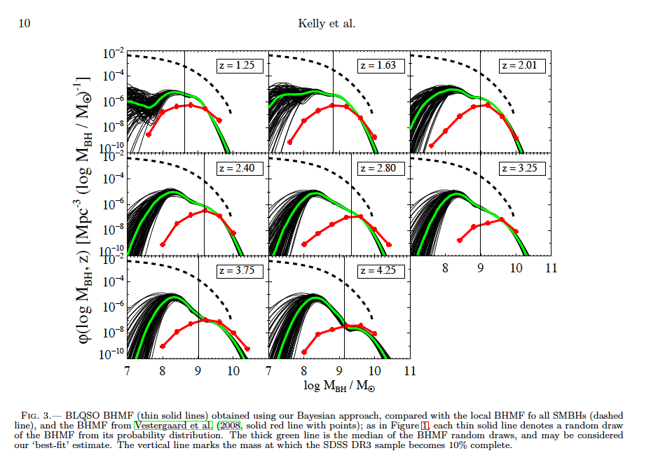
BHMF FOR BLQSOs FROM SDSS 1 < z < 4.5
Kelly, Shen+ 10; 11
Notes:
Observationally derived BHMF >10^45-46 erg/s quasars - 10,000 quasars, masses estimated from the width FWHM of the broad emission lines (MgII and CIV) line profiles are fit and the scaling relations between them, the continuum luminosity and BH mass. Most careful analysis that takes into account incompleteness, and this is imp if we are to focus on the massive end - power law distribution of eddington ratios.

Slide 8
Tracing the growth history of black holes in the universe
Ricarte, PN+ 16

Slide 9

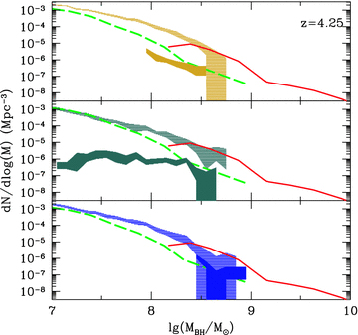

Challenges for demographic models at the high mass end
Missing Broad Line Quasars
PN & Volonteri +12
Notes:
Ingredients in the model: eddington ratios distributions, seeding….
MH08 —- XRB synthesis models, used the Xray LF to derive an Eddington ratio distribution f(Mdot, Mbh), various seeding & accretion models - PopIII +edd, Massive +MH, Massive -Edding
FAIL TO REPRODUCE THE HIGH MASS END - RED SDSS BLQSOs, green MH all BHs, MODELS ALL BHs & f * All = BLQSOs

Slide 10
New elements to model growth of massive BHs
INCLUSION OF MORE REALISTIC INPUTS FROM SIMULATIONS
STOCHASTIC ACCRETION: sampling the Eddington ratio distribution - test is the bright end of the LF (Volonteri’s talk)
SHORT-TIMESCALE VARIABILITY: flickering, sub Myr variability - test is the overall shape of the LF (Haiman’s talk)
SEEDING PRESCRIPTIONS: light and massive initial BH seeds
DISCRIMINATING SEEDING MODELS - testing for predicted populations at high redshift with JWST observations & CXRB-CIRB cross correlations

Slide 11
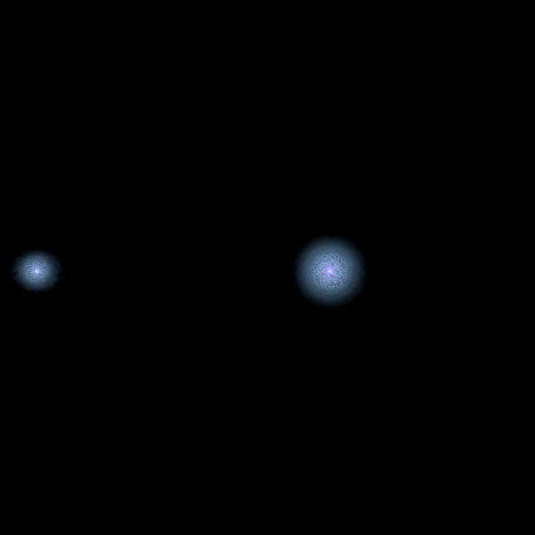
How significant are black hole mergers and merger triggered accretion
over cosmic time
Example from the FiBY simulation
Khochfar; Agarwal
Hopkins+; Hernquist+; Capelo+ 15

Slide 12
LIGHT SEEDS
MASSIVE SEEDS
Direct collapse
PopIII
Nuclear star cluster
Supermassive Star
Quasi star
~10¹⁻² Msun
~10³ Msun
~10⁴⁻⁶ Msun
Uncertainity in the masses of the first stars
In protogalaxies: need to avoid fragmentation and star formation, need to centrally concentrate mass
Metal-free gas
Prevent molecular H-cooling
A challenge to grow monster BHs seen by t < 2 Gyrs
New Planck results
push first stars to later even ~550 Myrs after
the Big Bang
Notes:
LETS LOOK AT THE SEEDS -- MANY WAYS TO MAKE SEEDS
LOOKS LIKE WE NEED MULTIPLE WAYS

Slide 13
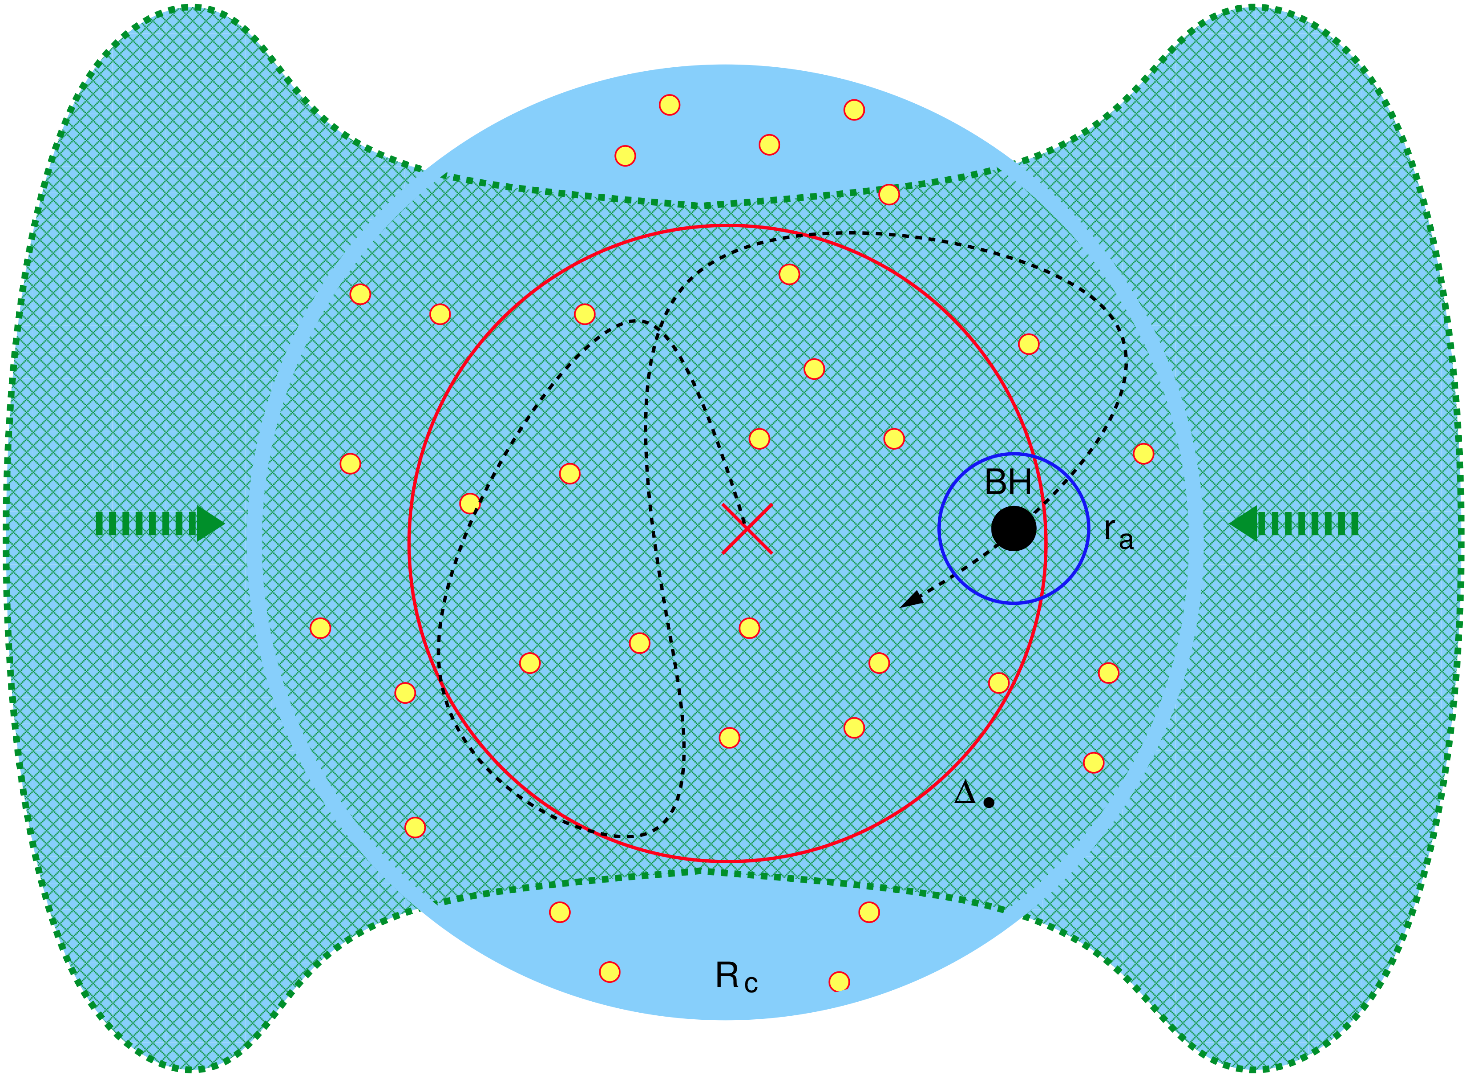
DISCRIMINATING BH SEEDING SCENARIOS
JWST FINDING OBGs/DCBH CANDIDATES AT 6<z<10
Imaging and Spectroscopy (broad lines)
+X-RAY Surveyor?
MASSIVE SEEDS
DCBHs
Pre-galactic disk
Bars within bars
supress H₂ cooling
Super-Eddington growth
Quasi-star?
10⁴ – 10⁶ Msun
@ z ~ 10 - 12
Super-Eddington growth
Notes:
Pop III remnants : Simulations suggest that the first stars have a range of masses (Bromm+ 02 ; Abel+ 02; Abel+ 00; Alvarez+ 08; Hirano+ 14) Metal free Pop III stars leave remnant BHs Supra-exponential early growth boost: Super-Eddington growth in nuclear star clusters at high-z (Alexander & PN 14) Direct Collapse – efficient viscous transport, H2 cooling suppressed, Lyman-Werner radiation, formation of central concentration (Eisenstein & Loeb 95; Koushiappas+ 04)+ proper dynamical treatment of disk stability (Lodato & PN 06, 07)
Supermassive star (Haehnelt & Rees 93)
Quasi-star - Bar unstable self-gravitating gas + large quasi-star (Begelman 08; 10; 12)
ONLY LIMITATION FOR SUPER_EDD GROWTH IS GAS SUPPLY – 2 other issues whether there are enuf DM halos at the highest z’s and the angular momentum problem
low mass stellar BHs in very dense, low-angular momentum cold flows at redshifts z > 15 can be launched by stellar dynamical processes into a phase of supply- limited, supra-exponential accretion and can grow rapidly in ∼ few×107 years into 􏰀 104 M⊙ BH seeds. Subsequent slower Eddington-limited growth by disk accretion suffices to produce the supermassive BHs that power the brightest early quasars. Resembles a red giant
Radiation-supported convective envelope, central temp 10^6 K radius 100 AU
Photospheric temperature drops as black hole grows

Slide 14
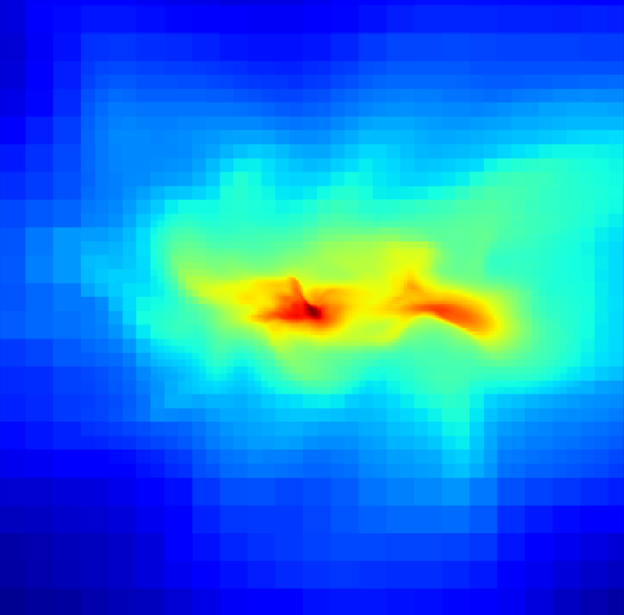
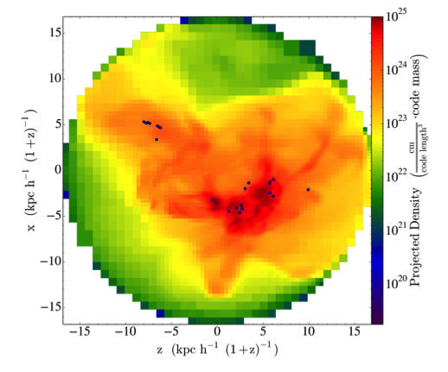
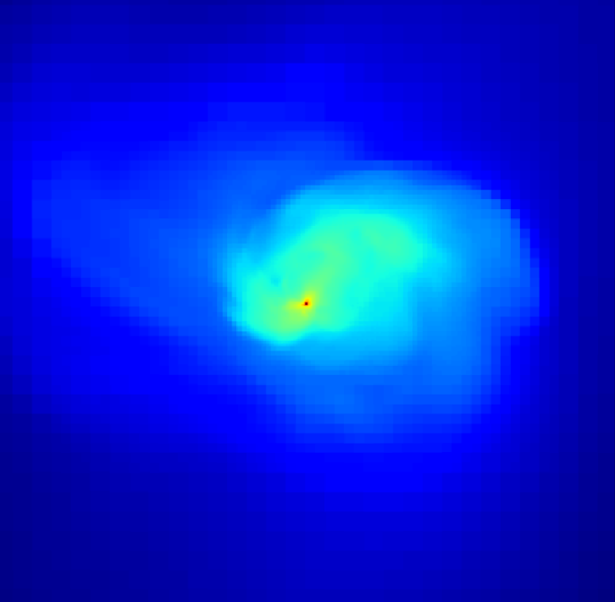
Massive BH seed formation simulations
Davis & PN 14; Bournaud+; Habuzit+ Regan+ 08; 13; Hirano+ 14; Shi+ 14
Choi, Shlosman & Begelman 13
Notes:
Collapse generates supersonic turbulence, which inhibits fragmentation
Dynamical loss of angular momentum through nested global gravitational instabilities
snapshot with 20 BH seeds, 300 Mpc³ box, ENZO AMR 12 level
refinements ~ 19 comoving pc, DM resolution ~ 3 X 10⁴ M_{sun}
DM halos where Pop III star clusters formed at z = 15

Slide 15
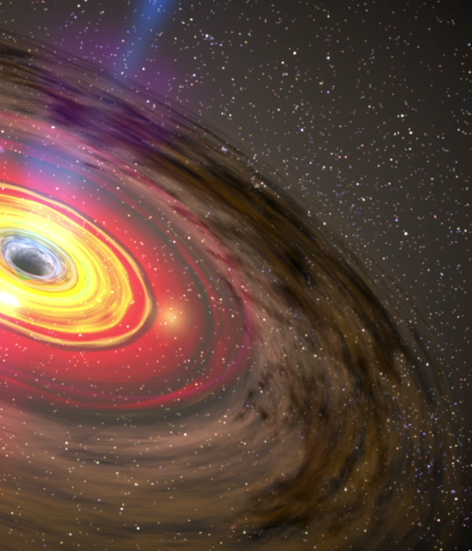
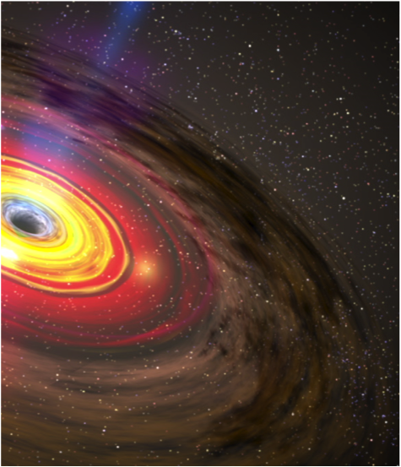
Standard Accretion
Slim Disk Accretion
Steady trickle throughout cosmic time
Notes:
In our code, we implemented two different accretion models. An accretion model is the relation between the accretion rate, the amount of mass accreted per unit time, and the luminosity emerging from the accretion disk.
In a standard geometrically thin, optically thick disk, formed at moderate rates up to the Eddington rate, the emission of radiation is radiatively efficient. Most of the luminosity produced in the inner regions of the accretion disk is able to escape from the inflowing material and the relation is linear. In a super-Eddington accretion environment, modeled for instance by the slim disk solution, the structure of the accretion disk is expected to be geometrically and optically thick and radiatively inefficient. In this case, a fraction of the emitted photons is advected into the central object and it is unable to escape. Consequently, the efficiency of the radiative feedback in disturbing the gas inflow is dramatically reduced.

Slide 16
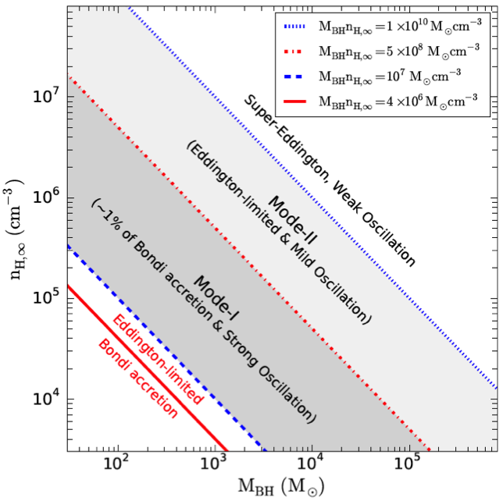
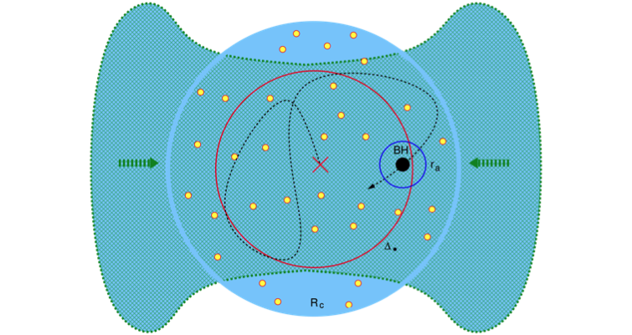
Understanding what limits growth rates by accretion
Growth is faster
for larger
black hole masses
due to the structure of the
accretion flow
FEEDBACK LIMITED
GAS SUPPLY LIMITED
Alexander & PN 14; Park+15; Pacucci+15
Notes:
This conclusion has been arrived at independently by several groups in the last year. The reasons for this behavior are essentially that , but the result is the same: growth is faster for larger black hole masses. For instance, this plot taken from Park 2015 shows that keeping the number density of the gas fixed and increasing the black hole mass leads to an accretion regime with weak oscillations, which means a very high duty cycle. This situation is equal to the one we investigated in our work. FEEDBACK LIMITED VS. GAS SUPPLY LIMITED. SLIM DISK ACCRETION IS SUPPLY LIMITED, WHEREAS IN THIN DISK ACCRETION MOST OF THE GAS RESERVOIR GETS EJECTED DUE TO FEEDBACK FROM THE GROWING BH- TRANSITION RADIUS PROP to Mbh at which raidative feedback becomes important, and the larger this transition radius the more rapid the growth. ESSENTIALLY MORE MASSIVE BHS HAVE A DIFFERENT ACCRETION HISTORY
Circumventing the Eddington limit -- We propose a dy- namical mechanism that can trigger supra-exponential accretion in the early universe, when a BH seed is bound in a star cluster fed by the ubiquitous dense cold gas flows. The high gas opacity traps the accretion radiation, while the low-mass BH’s random motions suppress the formation of a slowly-draining accretion disk. Supra-exponential growth – GAS AND STARS VIRIALIZED, BH TEST PARTICLE IN THIS EXTERNAL POTENTIAL In EQUIPARTITION WITH STARS LOWER RADIATIVE EFFICIENCY, subsonic motion. Physical flows, where gravitational energy is released as radiation, are not strictly adiabatic. As the mass accretion rate grows, the local luminosity can far exceed the EddingtonluminosityLE =4πcGM•/κ=M ̇Ec2 (κisthegasopacity),forwhichradiationflux pressure balances gravity. However, radiation produced inside the photon-trapping radius rγ ∼ (M ̇ /M ̇ E )rg is carried with the flow into the BH, because the local optical depth τ (r) ∼ κρ(r)r makes photon diffusion outward slower than accretion inward (32) [which is a manifestation of the O(v/c) effect of relativistic beaming (33)]. The luminosity L∞ that escapes to infinity from r 􏰀 rγ translates to a lowered radiative efficiency ηγ = L∞/M ̇ c2 ∼ min(rg/rγ,rg/rISO

Slide 17
Implementing Stochastic Accretion
Current Models
Our implementation
Specific Accretion Rate
MAJOR MERGER
Time
Ricarte & PN 17
Notes:
Model ingredients: Monte-Carlo merger trees, Mhalo-> v_c, v_c -> sigma , no time delay between halo mergers and BH mergers, minor mergers don't trigger accretion continue the random walk thru the Edd ratio distribution step size guided from simulation ~ 10 Myr for Edd ratio to change by one order of mag, GW recoil Lost et al - 20% of seeds ultimately ejected, unresolved AGN variability 10^2-10^6 yr no strong constraints, here simulations guide us (earlier work with Phil Armitage studying the role of gas in merging BHs, Zoltan’s & collaborators simulations we saw yesterday), Schawinski et al have argued from the light echos, we adopt 10^5 yr, convolve the LF with a kernel to implement this

Slide 18
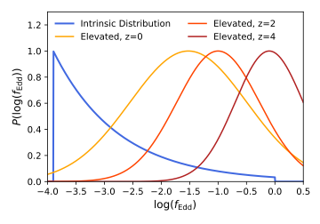


Sampling the Eddington Ratio Distribution
Mergers bump a SMBH here.
Random walk through this.
Intrinsic Distribution: Derived from Type II AGN (Jones+ 2016)
Elevated Distributions: Derived from broad-line quasars (Kelly & Shen 2013)

Slide 19
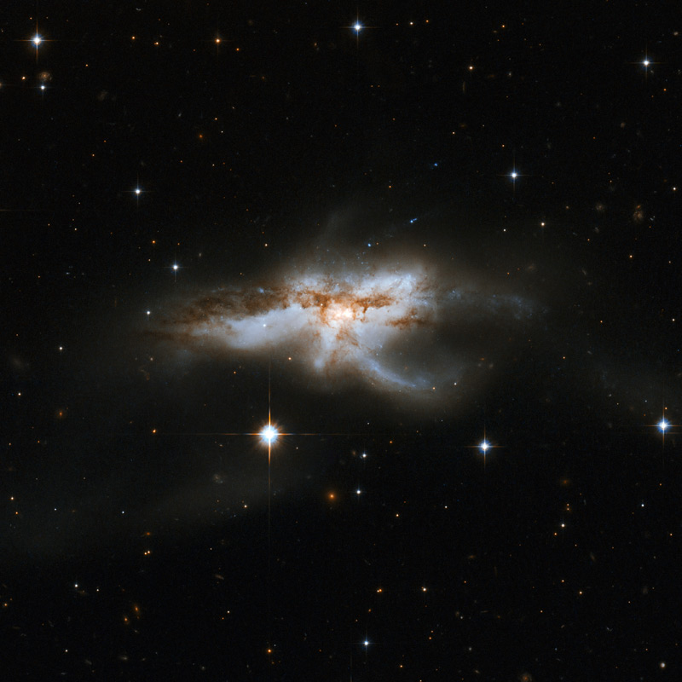
dynamic range
nuclear dynamical
time much shorter
AGN time scale
days-years-kyr
dynamical time tdyn ~ 10⁸ yrs
stellar population
ages ~ 10⁶ -10⁹ yrs
NGC 6240; credit: NASA/ESA HST

Slide 20
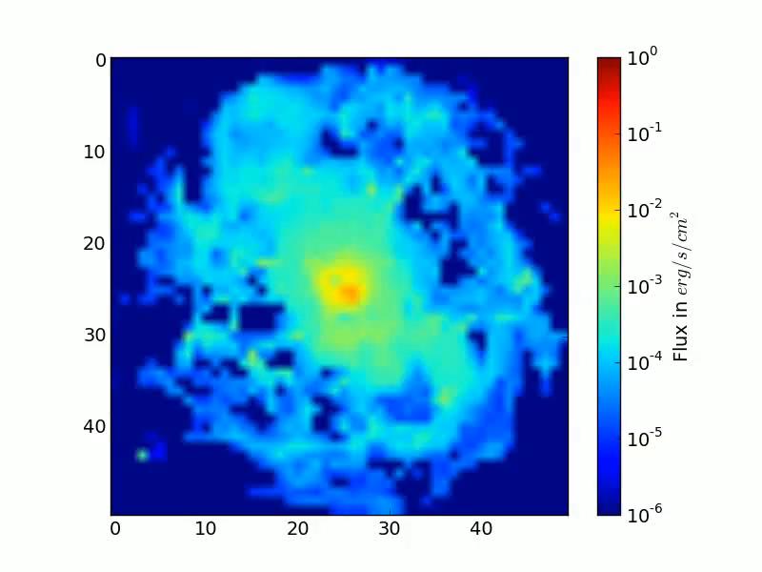
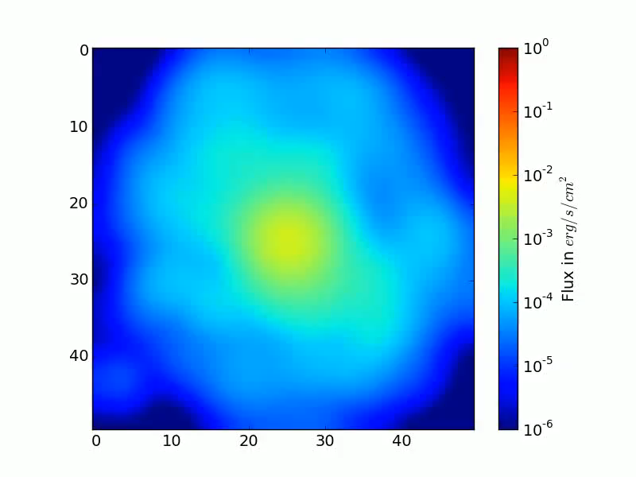
simulations of “flickering” AGN
Philipp Bernhard Master thesis, w/ Romain Teyssier
intrinsic resolution
ground-based seeing
LAGN 10⁴⁶ erg/s, total time 42 kyr

Slide 21
Schawinski+15
host galaxy
ionization cone
light echo
active black hole
Central emission
(X-rays)
on
on
off
Extended emission
(photoionized regions)
not yet
generated
on
still
visible
Classification
normal
galaxy
normal AGN
light echo/
Voorwerpje
Duration
10⁴ years
10⁵ years
10⁴⁻⁵ years
(if screen is present)

Slide 22
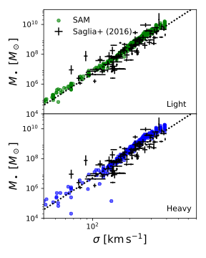
Predicted local M-sigma relation including new elements

Slide 23
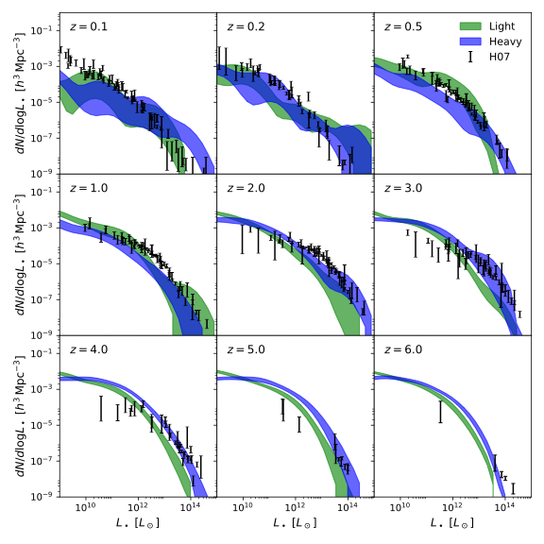
Implementing a sub-Myr Flicker + Stochasticity
Notes:
Light seed models do better at lower z, while mass seeding models fare better at higher z so suggestive that we likely have a hybrid process…Now convolved with a log-normal with a width of 0.4 dex!

Slide 24
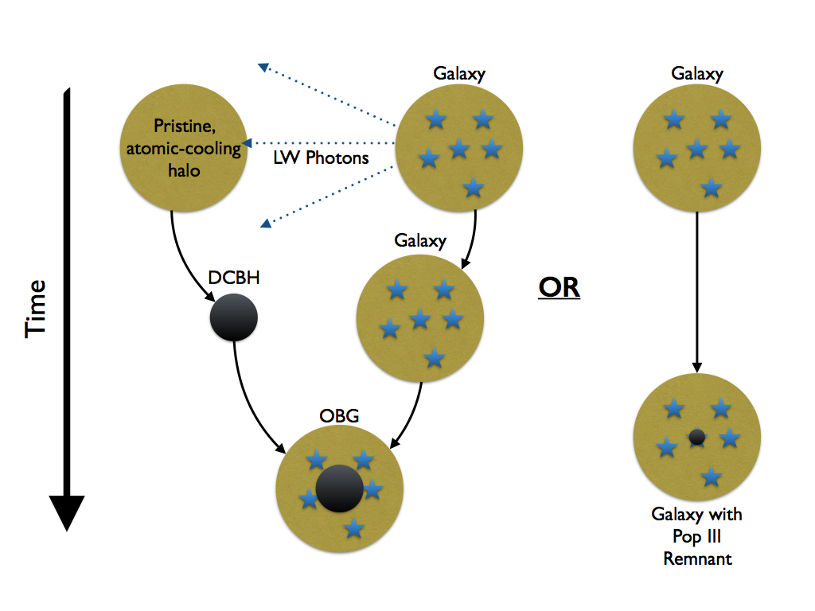
SCHEMATIC OF HIGH-Z JWST SOURCES
PN+ 17

Slide 25
DIRECT COLLAPSE BHs AND THEIR OBESE BH HOST GALAXIES
JWST WILL PROBE ENVIRONMENTS OF HALOS THAT HOST DCBHs
Agarwal+ 12; 14
Notes:
Here’s the scheme – we produce Massive BH seeds and follow their growth history over cosmic time...
They will sit at different locations on the M-sigma correlation at higher redshifts....

Slide 26
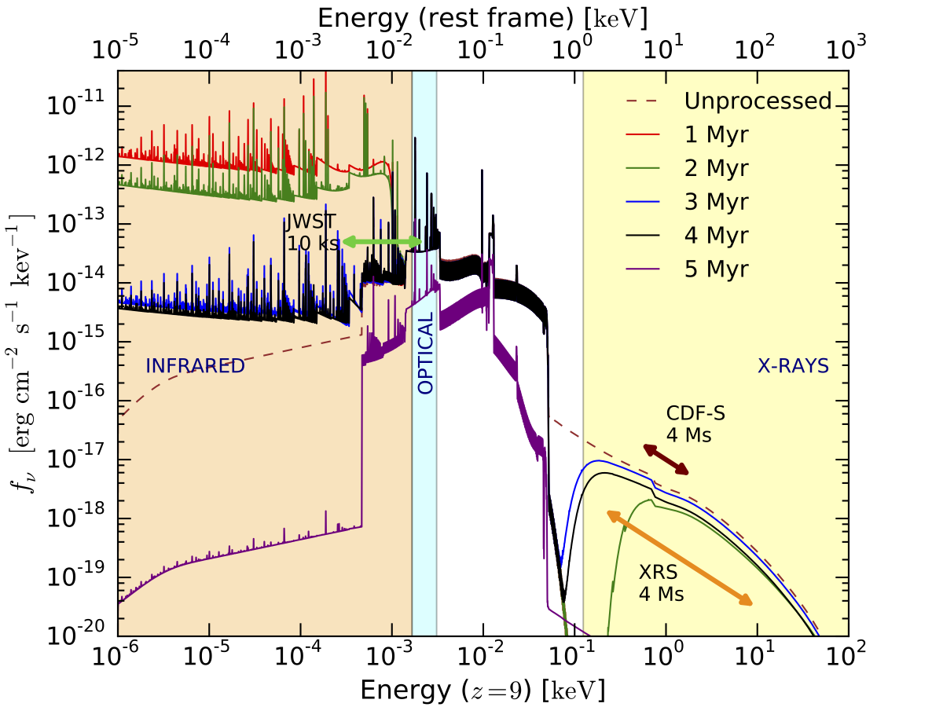
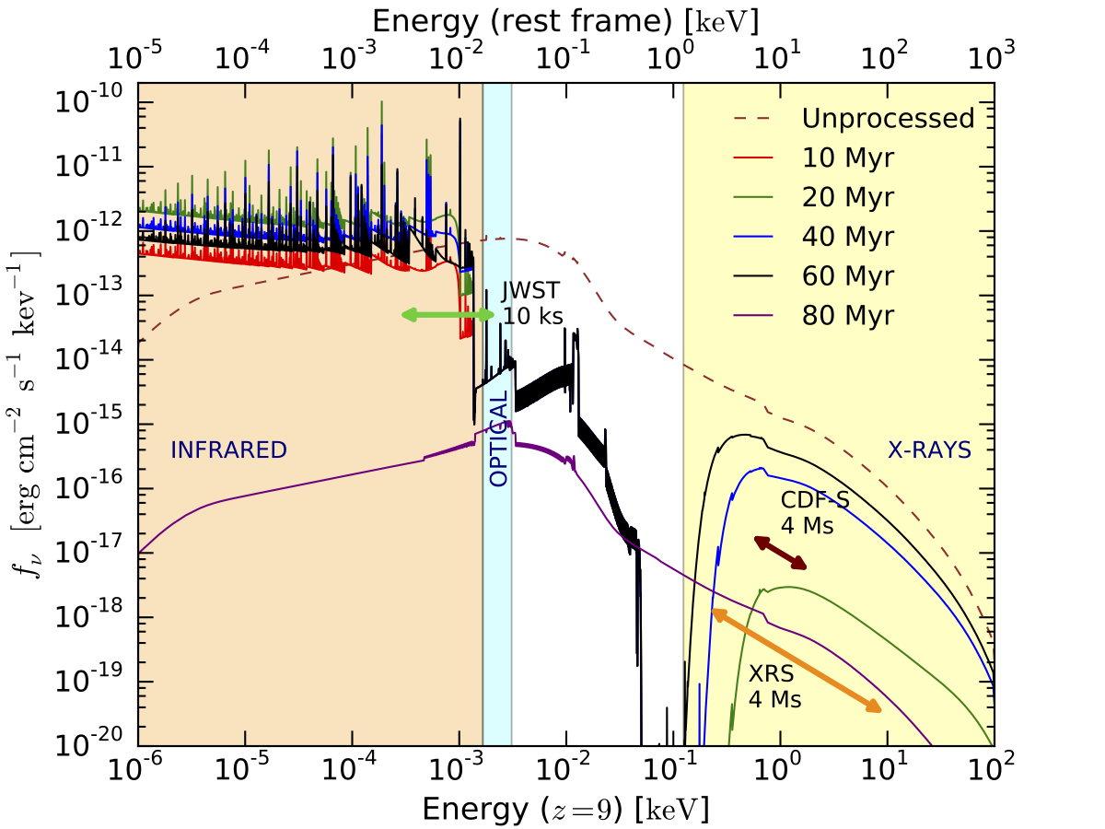
Multi-wavelength spectral energy distribution of DCBHs
SLIM DISK ACCRETION
STANDARD EDDINGTON ACCRETION
PN, Pacucci, Ricarte, Agarwal+ in prep.
Notes:
and post-processed them with a spectral synthesis code, in order to compute the time-evolution of the spectrum emerging from the host halo. The source spectrum is assumed to be AGN-like with the usual three components indicated in this plot, the multi-color black body, a power-law and a reflection component. The bolometric luminosity is then set by our hydrodynamic code. This source is embedded in a gas cloud with time-dependent density and temperature profiles, which we provided to the spectral synthesis code.
ABSORPTION OF X-RAYS AND RE_RADIATION IN THE INFRA-RED which is why JWST with its near-mid and far IR filters will offer the tantalizing possibility of seeing these sources. the multi-color black body, a power-law and a reflection component

Slide 27
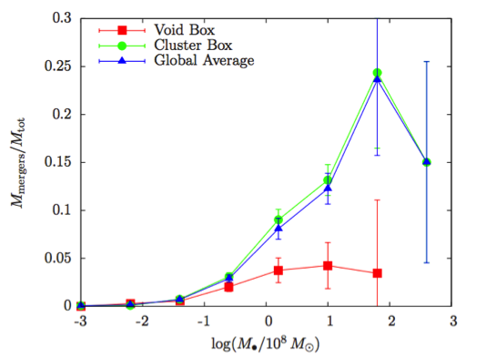
Merger Rates for Binary Black Holes
dependence on seed mass and environment
Kulier+ 15; Sesana+ 13; 14; 15
Notes:
One key question – the relative importance of mergers and accretion for mass assembly
over cosmic time, accretion is the dominant physical process for growth however there
are cosmic epochs when mergers dominate and for highest mass BH at every epoch they
are a significant channel for growth, even at low redshifts ....we have recalculated event rates for
GW detection as well as EM counter-parts.

Slide 28
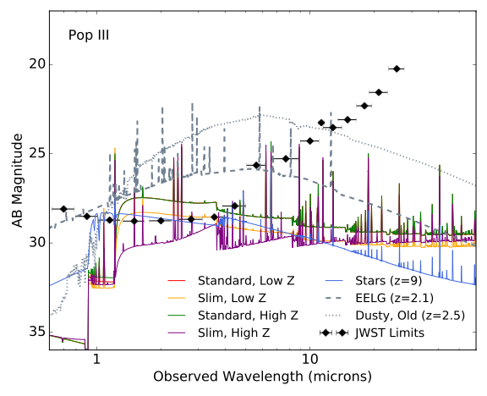
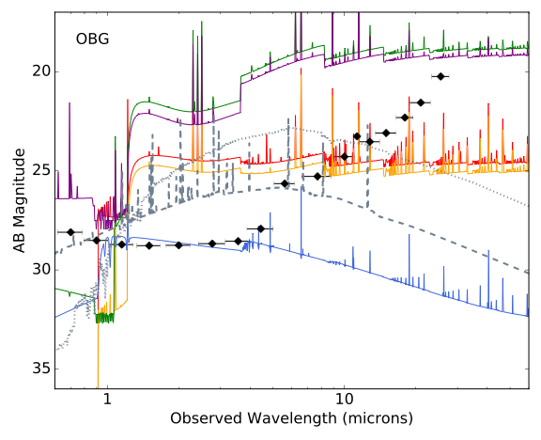
DISCRIMINATING LIGHT & MASSIVE SEEDS WITH JWST
MASSIVE SEEDS
LIGHT SEEDS
Pacucci+ 15; 16 (GEMS); Agarwal+ 16; PN+ 17
Notes:
JWST spectra for growing DCBHs and Pop III seeds - selection extreme XR-IR ratio >>1 well above what is expected from SFR alone…XRAY surveys Lynx-Athena
Discriminant slope and brightness in the MIRI bands 1 - 10 microns. S/N ~10 for a 10^4 sec observation, METAL CONTENT IS CRITICAL AS Z INCREASES ABSORPTION OF HIGH E PHOTONS and INCREASES RE-RADIATED (REPROCESSED UV PHOTONS FROM THE GROWING BH) IN THE IR DUE TO AUGER LIKE EMISSION (1s hole filled by 2s electron energy released as a photon but also kicks out e in an outer shell…)…STEEP INFRA-RED SPECTRA….OBG CAN BE DISTINGUISHED FROM DUSTY LOW redshift sources

Slide 29
OPEN QUESTIONS IN BLACK HOLE ASTROPHYSICS
Masses of initial BH seeds
Early accretion history of seed BHs
When are correlations between BHs and hosts set-up
Flows onto BHs, instabilities, role of magnetic fields
Contribution to Re-ionization
Observational signatures of Super-Eddington flows, jets
Detection of merging SMBHs – EM counterparts to gravitational wave events
JWST, ATHENA, LISA and future X-ray missions will shed light on many of these questions
Notes:
Follow-up JWST sources
to discriminate flux from stars vs. AGN
need 5 – 100 keV (rest-frame) to detect the high-z obscured population
-Sensitivity matched to detect super-Eddington flows at high z, detect IMBHs at z > 10High throughput, high angular resolution,
ideally factor of 100 gain in sensitivity from Chandra

