Slide 1
Spin-lattice relaxation of individual lanthanide ions via quantum tunneling
Orlando
December 20th
2010
Quantum Coherent Properties of Spins-III Workshop
Fernando LUIS

Slide 2
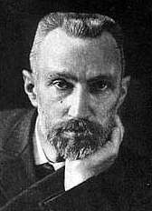
Spin-lattice relaxation
P. Curie P. Ehrenfest
(1892) (1919)
h
Spin ensemble
P. Curie, Comptes Rendus Acad. Sci. (France) 115 805-808 (1892)
P. Ehrenfest, Leiden Commun. Suppl. 4b (1919).
Spin-lattice interaction
T
Thermal bath
(phonons)

Slide 3
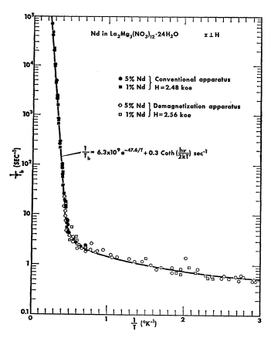
ΔE_{cb}
ΔE_{ba}
1/τ (s⁻¹)
Equilibrium
Orbach
Kronig, R. de L., Physica 6, 33 (1939).
Van Vleck, J. H., Phys. Rev. 57, 426 (1940).
R. Orbach, Proc. Roy. Soc. (London) A264, 456 (1961)
Direct
Phonon emission and absorption
1/T (K⁻¹)

Slide 4
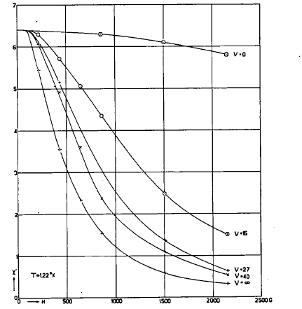
ΔE_{cb}
ΔE_{ba}
Equilibrium
Kronig, R. de L., Physica 6, 33 (1939).
Van Vleck, J. H., Phys. Rev. 57, 426 (1940).
R. Orbach, Proc. Roy. Soc. (London) A264, 456 (1961)
Van Vleck (1940)
Phonon emission and absorption

Slide 5
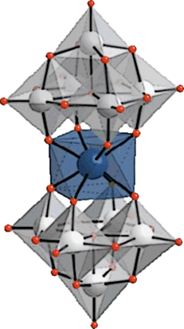
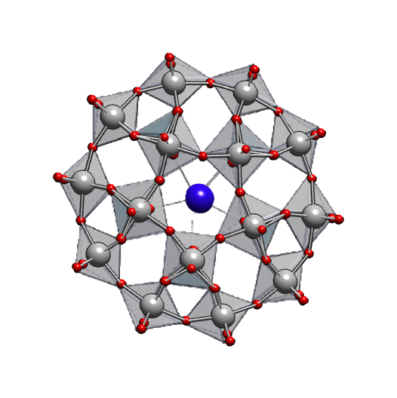
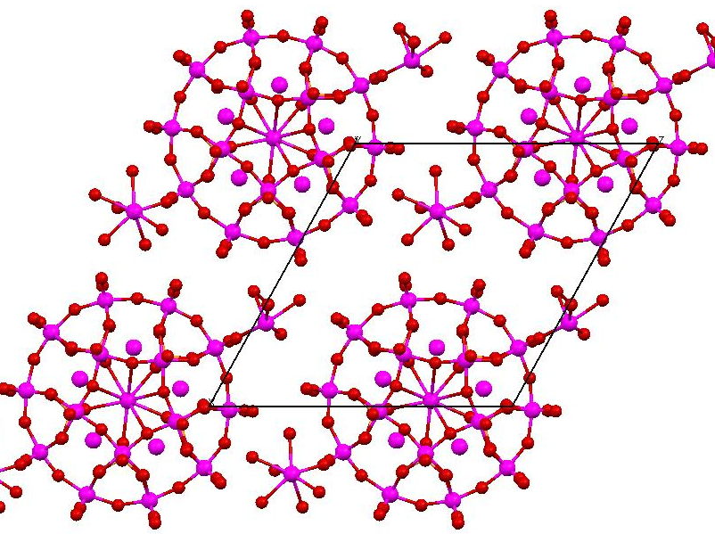
Mononuclear single-molecule magnets
Polyoxometalate moiety
Lanthanide (Er, Ho, Gd, Tm…)
Some outstanding characteristics…
Simple (just 1 magnetic atom)
Weak interactions
Magnetic solubility
Nuclear-spin free systems
Control over parameters
M. A. AlDamen et al, J. Am. Chem. Soc. 130, 8874 (2008)
LnW₁₀
LnW₃₀
17.9 Å

Slide 6
Tailoring the magnetic anisotropy by chemistry: the case of Gd
?
GdW₁₀
GdW₃₀
Gd: [Xe]4f⁷
L = 0, S = 7/2
Model crystal-field probe

Slide 7
GdW₁₀
GdW₃₀
S = 7/2
g = 2
S = 7/2
g = 2

Slide 8
GdW₁₀
GdW₃₀
S = 7/2
g = 2
S = 7/2
g = 2
B₂₀/k_{B} = -0.059 K
B₄₄/k_{B} ≈ 4 × 10⁻⁴ K
B₂₀/k_{B} = +0.019 K
B₂₂/k_{B} ≈ +0.019 K

Slide 9
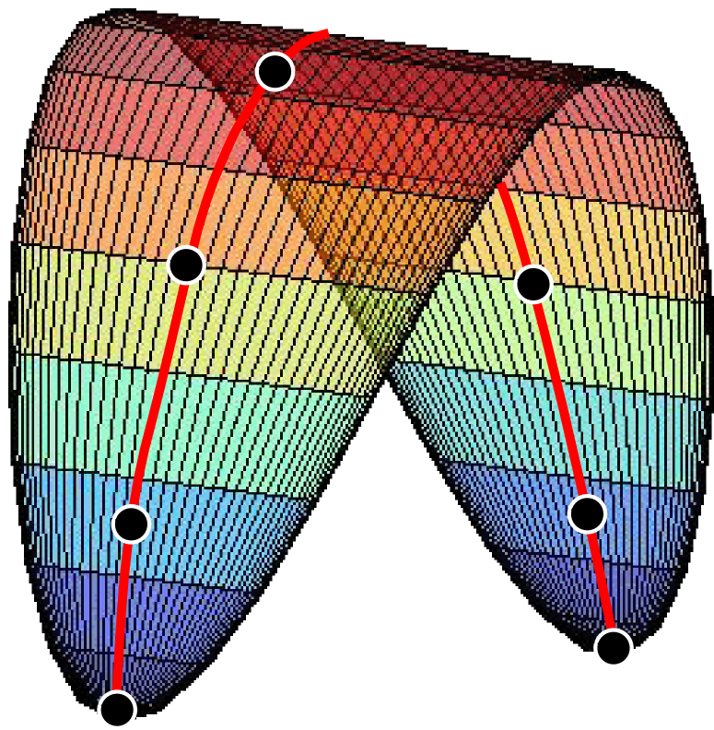
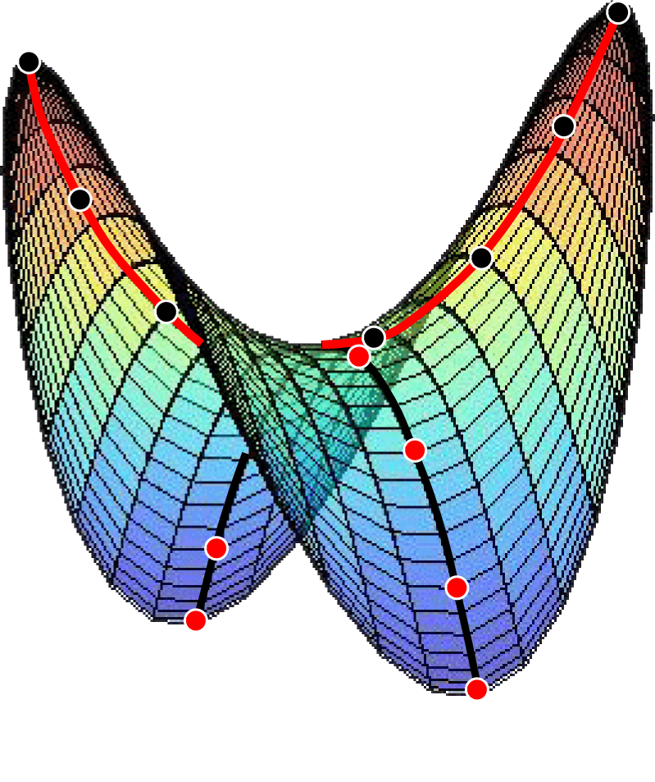
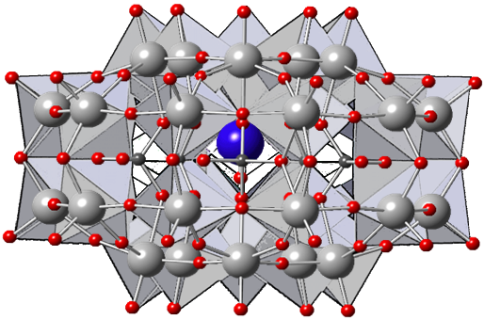
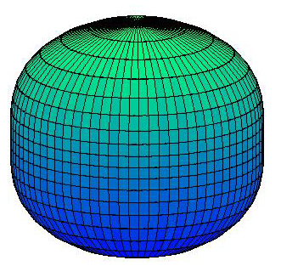
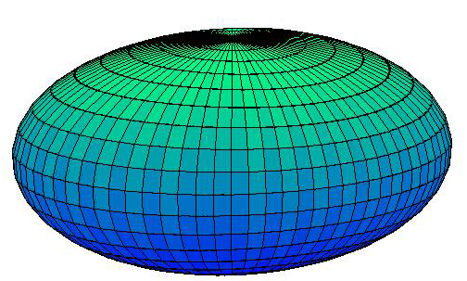
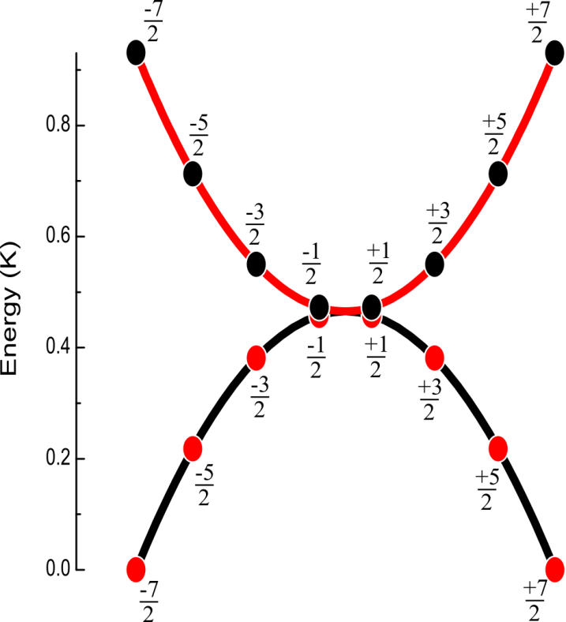
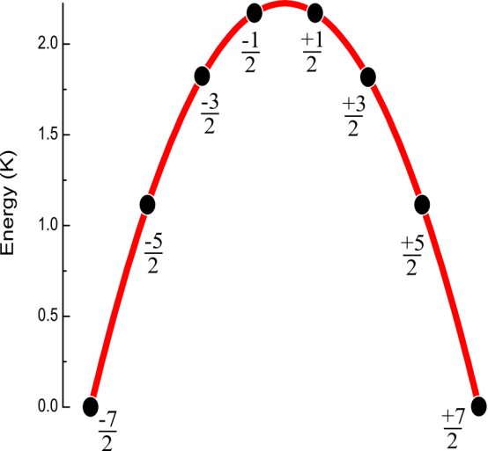
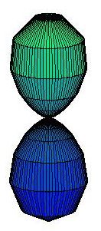
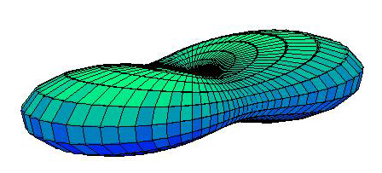
J_{z}
J_{y}
4 K
0.5 K
Δ/k_{B} = 10⁻⁶ K
Δ/k_{B} = 10⁻⁴ K
Easy axis
Easy plane

Slide 10
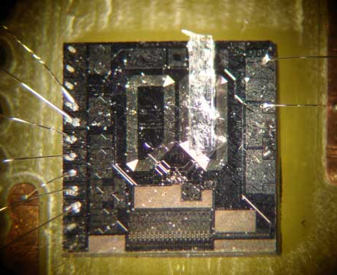
GdW₁₀
M. J. Martíınez-Pérez, J. Sesé, F. Luis, D. Drung, T. Schurig, Rev. Sci. Instrum. 81, 016108 (2010).
GdW₃₀

Slide 11
Long-range magnetic order: T_{N} ≈ 20 mK
ξ_{dip}/k_{B} ≈ 0.02 K
Above T_{N}, χ_{T} follows Curie-Weiss law
τ is a SLR time

Slide 12
10⁹
T > 0.1 K:
Thermally activated
Agrees with Orbach process
T < 0.1 K:
Independent of T
8-9 orders of magnitude faster than direct processes

Slide 13
Spin-lattice relaxation and quantum tunneling the case of Er
~ 45 K
ErW₁₀
M. Aldamen et al., Inorg. Chem. 48, 3467 (2009)
F. Luis et al., Phys Rev. B 82, 060403(R) (2010)
J = 15/2
g = 6/5
SMM behaviour below 5 K
AF order at T_{N} = 80 mK
Strong uniaxial anisotropy
B₂₀/k_{B} = -1.35 K; B₄₀/k_{B} = -1.07 × 10⁻² K; B₆₀/k_{B} = 1.67 × 10⁻⁴ K
B₄₄/k_{B} ≈ 1.8 × 10⁻² K

Slide 14
F. Luis et al., Phys Rev. B 82, 060403(R) (2010)
10⁹

Slide 15
What about tunneling then?
Δ/k_{B} ≈ 10⁻⁴ K
σ_{dip} ≈ 0.08 K
N. V. Prokof’ev and P. C. E. Stamp, Phys. Rev. Lett. 80,
5794 (1998).
Tunneling
Direct process

Slide 16
Effect of a magnetic field
ξ_{Zeeman}
ξ_{dip} = -ξ_{Zeeman}

Slide 17
Effect of a magnetic field
ξ_{Zeeman}
ξ_{dip} = -ξ_{Zeeman}
Direct process

Slide 18
Spin concentration Er_{x}Y_{1-x}W₁₀
Er
Y

Slide 19
Er³⁺: Kramers ion (J = 15/2)
Γ_{tun} ∝ x
Δ = 0 at zero field
Γ_{tun} ∝ x²
H_{dipx} are required to break
Kramers degeneracy
Δ ∝ x
Increasing
σ_{dipx}
σ_{dip}∝ x

Slide 20
Hyperfine interactions ¹⁶⁷ErW₁₀
¹⁶⁴Er,¹⁶⁶Er
¹⁶⁸Er,¹⁷⁰Er
¹⁶⁷Er
I = 7/2
A/k_{B} = -6×10⁻³ K
I = 0
Δ ≈ 0

Slide 21
Hyperfine interactions ¹⁶⁷ErW₁₀
ξ_{dip} = -ξ_{hyperfine}

Slide 22
Strong hyperfine interactions HoW₁₀
(1)
(2)
(1)
(2)
(1)
(2)

Slide 23
Relaxation vs long-range order: ErW₁₀
T_{N} = 81 mK
T > T_{N}
T < T_{N}
ξ_{dip} >> Δ
The onset of long-range order blocks QT and relaxation

Slide 24
Aging: monitoring the growth of spin-spin correlations
t₁
t₂
t₃→∞
time

Slide 25
QT spin reversal vs spin lattice relaxation
Spin ensemble
τ⁻¹
QT flips the spins but conserves energy of the spin ensemble
How is energy exchanged with the thermal bath then?
T
Thermal bath
(phonons)

Slide 26
Collective emission of phonons: phonon superradiance
Γ_{tun}
Zeeman
bath
Dipolar
bath
τ⁻¹_{dir}
τ⁻¹_{SR}
H. N. V. Temperley, Proc. Camb. Phil. Soc. 35, 256 (1939).
E. M. Chudnovsky and D. A. Garanin, Phys. Rev. Lett.
93, 257205 (2004).
Phonon
bath

Slide 27
Conclusions
Mononuclear SMM: tailoring the energy level structure with chemistry ⇒ magnetic coolers, qubits, …
Nearly quantitative agreement between measured tunneling rates and theory
Quantum spin tunneling provides a very efficient mechanism of spin-lattice relaxation
Puzzle: energy flow between spins and the lattice
?

Slide 28
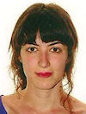
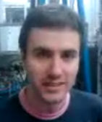
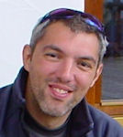
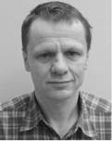
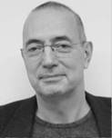
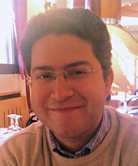
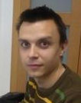
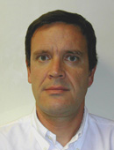
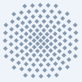
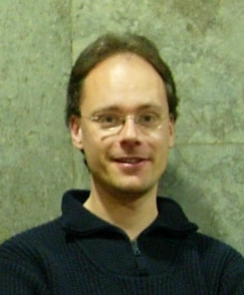
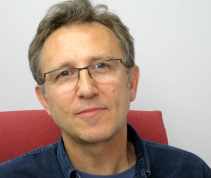
Mª José Martínez
Enrique Burzurí
Marco Evangelisti
Dietmar Drung
Thomas Schurig
Oscar Montero
David Zueco
Agustín Camon
Javier Sesé
Salvador Cardona-Serra
Carlos Martí-Gastaldo
Juan Modesto Clemente
Eugenio Coronado
Joris van Slageren
Christoph Schlegel

