Slide 1
f-element-Based Single-Molecule Magnetism: Escaping the Double Well
Jeffrey Rinehart, Katie Meihaus, Prof. Jeffrey Long
UC Berkeley

Slide 2
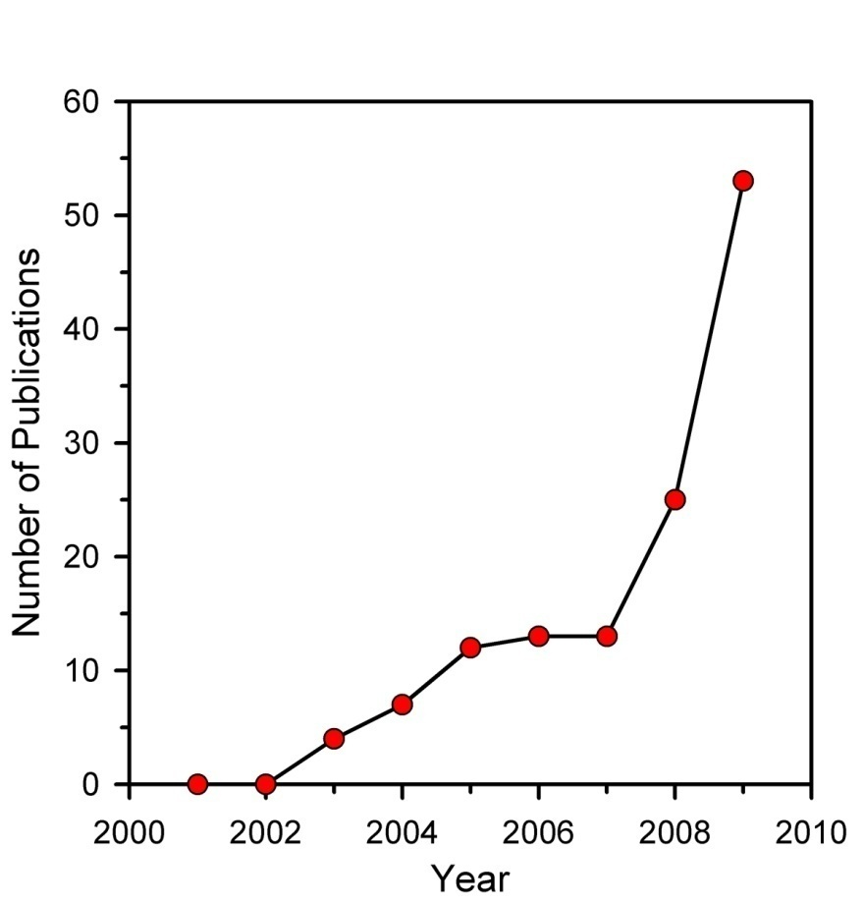
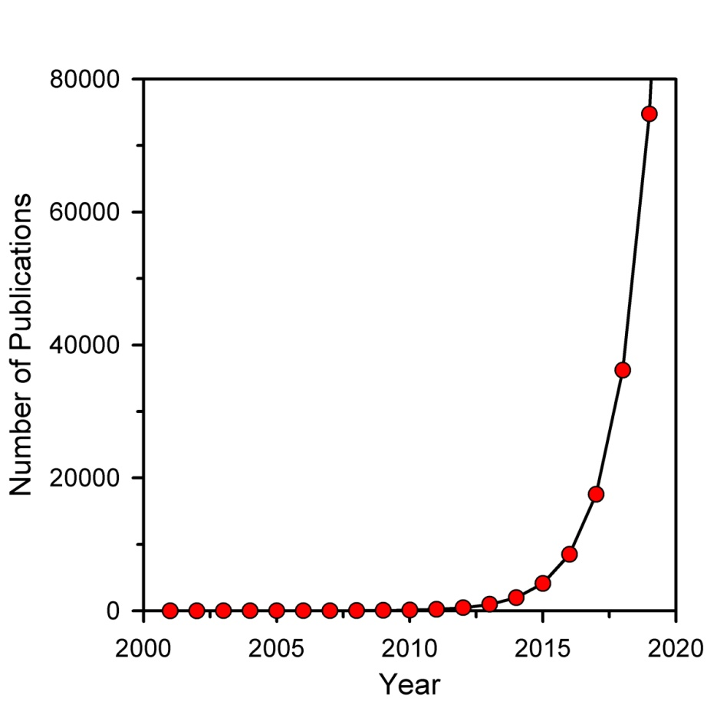
f-elements in Single-Molecule Magnetism
La | Ce | Pr | Nd | Pm | Sm | Eu | Gd | Tb | Dy | Ho | Er | Tm | Yb | Lu
Ac | Th | Pa | U | Np | Pu | Am | Cm | Bk | Cf | Es | Fm | Md | No | Lr
● Vast majority of SMM papers published in the last ten years were based on iron and
manganese oxo clusters
● Growth in An/Ln papers published is significant

Slide 3
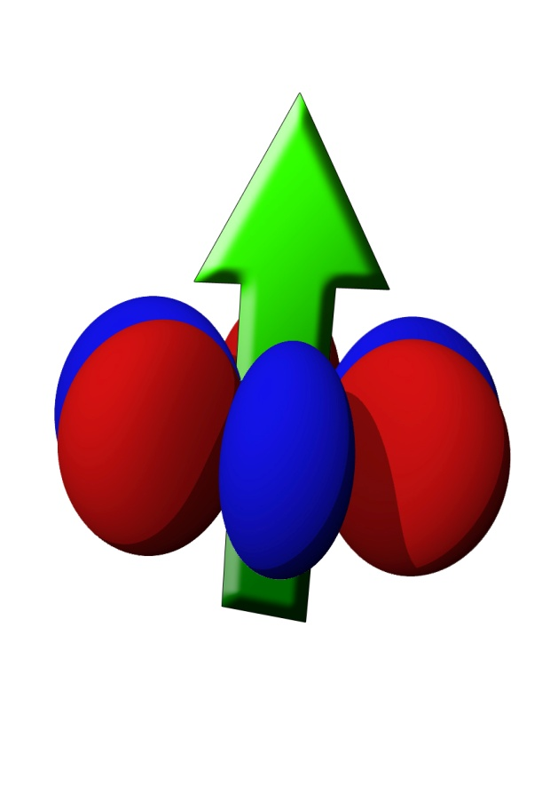
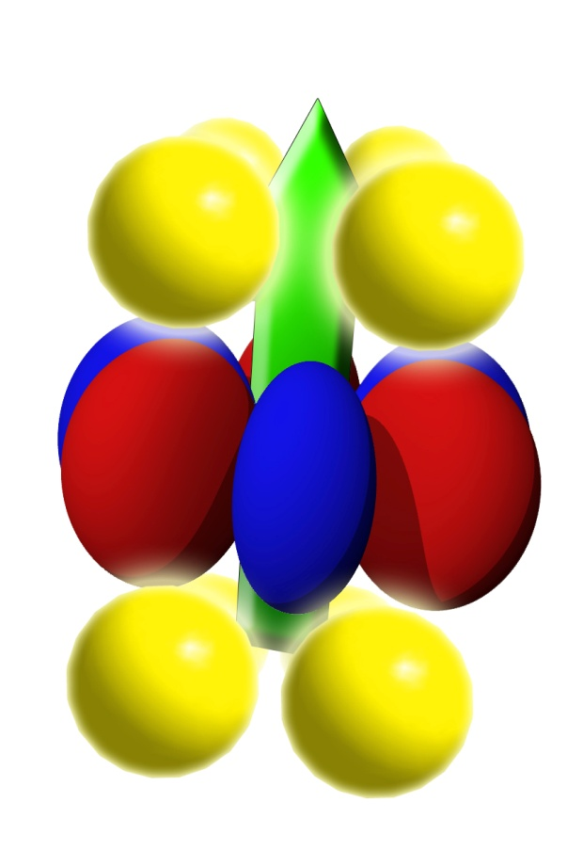
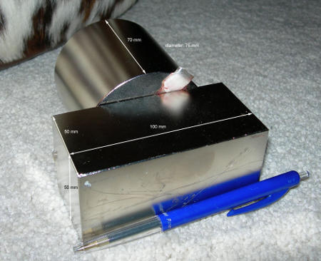
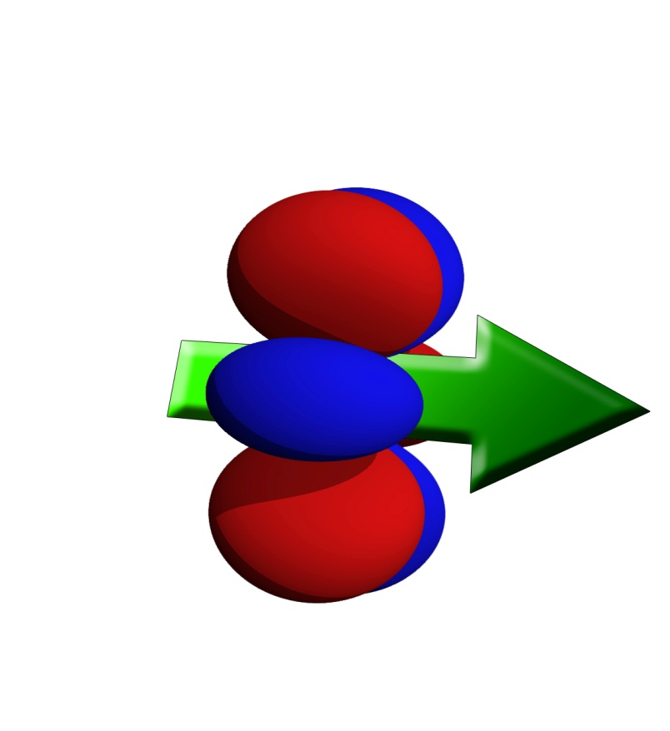
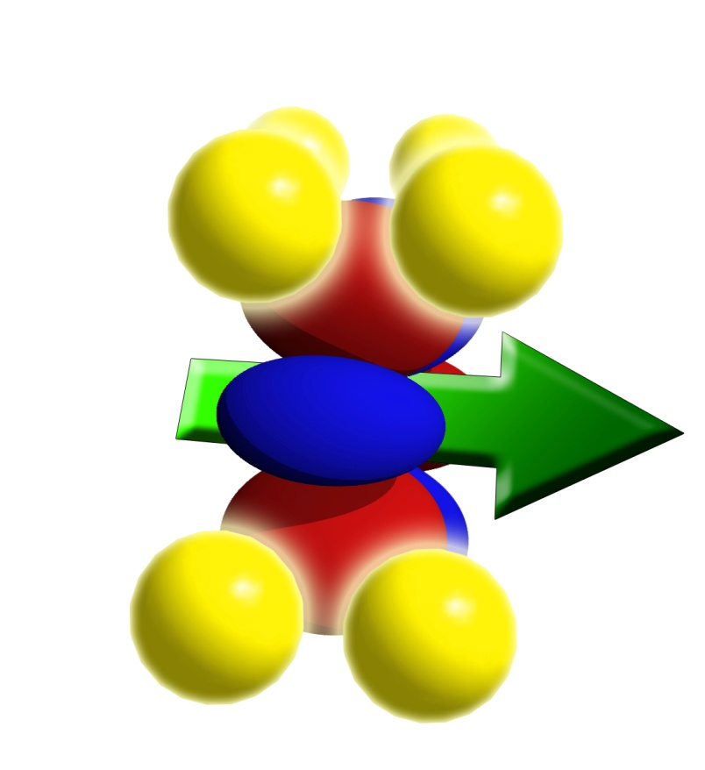
Exploiting Magnetocrystalline (Single-ion) Anisotropy
low energy
high energy
Strong spin-orbit coupling
Large unquenched orbital moment
Anisotropic f-electron density
Notes:
So I’ve talked a lot about ligand-metal interaction to create single molecule magnets, but how are we actually going to do that in uranium. Well lets take a look at a rough representation of a urnaium(III) ion. It has 3 f electrons and by hund’s rules they enter f-orbitals such that they create a fairly oblate electron density. Strong spin-orbit coupling causes the spin to orient itself depending on the orientation of the electron cloud. However there is no energetic reason why this situation would be preferable to this one (point). If we add in some ligand field though it becomes evident that, from an electrostatic point of view, this orientation is lower in energy than this one where the negative charge of the f orbitals is in direct contact with the electron charge cloud of the ligands.

Slide 4
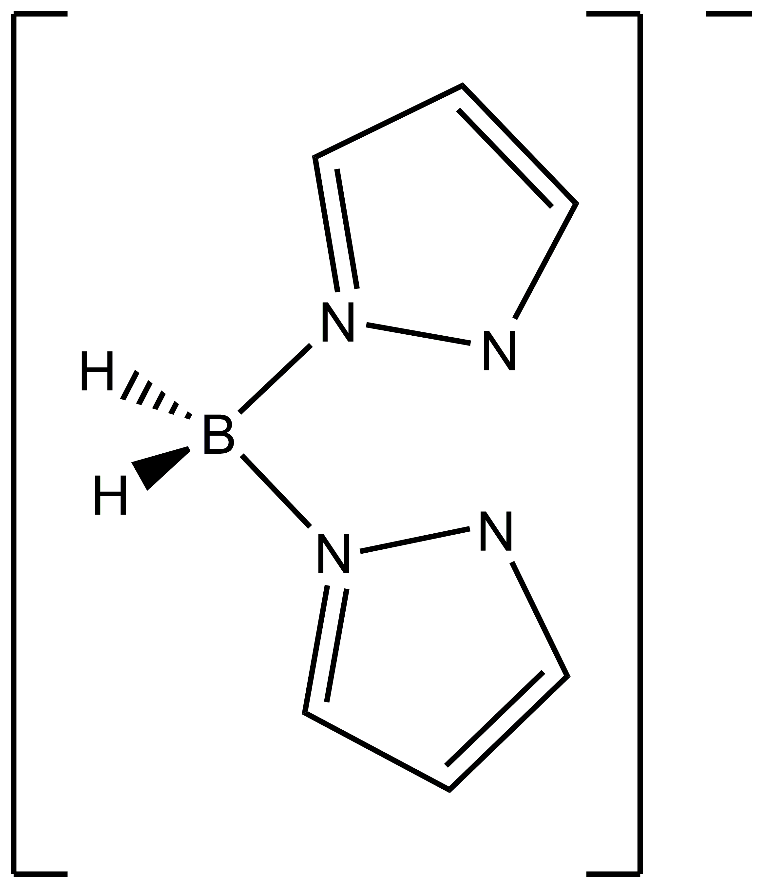
A Tricapped Trigonal Prismatic U(III) Complex
UI₃
+
THF
3
(H₂BPz₂)¹⁻
U(H₂BPz₂)₃
• B-H stretching frequencies are consistent with a U-H
interaction at the lateral faces of the trigonal prism
Structure: Sun, Y.; Takats, J.; Eberspacher, T.; Day, V. Inorg. Chim. Acta 1995, 229, 315.
with Katie Meihaus
Magnetism: Rinehart, J.; Meihaus, K.; Long, J. J. Am. Chem. Soc. 2010, 132, 7572.
Notes:
Some very new results I’d like to mention were done in collaboration with a new graduate student, Katie Meihaus, who will be taking over this project soon. Katie structurally characterized the analog of the previous compound but with hydrogen atoms replacing the phenyl rings on the boron. In this compound there is a U-H interaction at the faces of the trigonal prism leading to a tricapped trigonal prismatic geometry. We were interested in how this subtle change in coordination environment would effect the magnetic relaxation

Slide 5
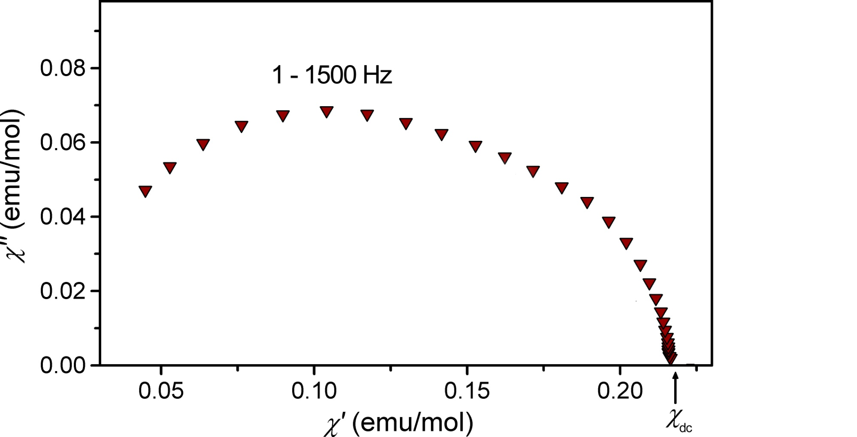
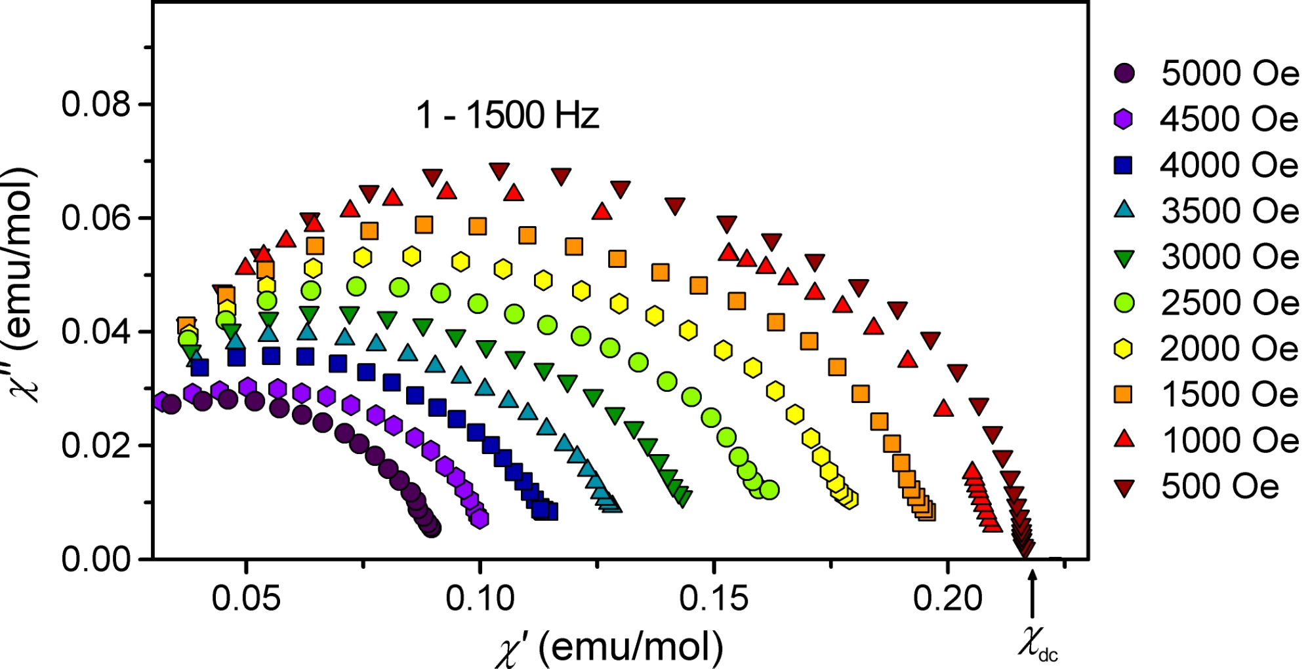
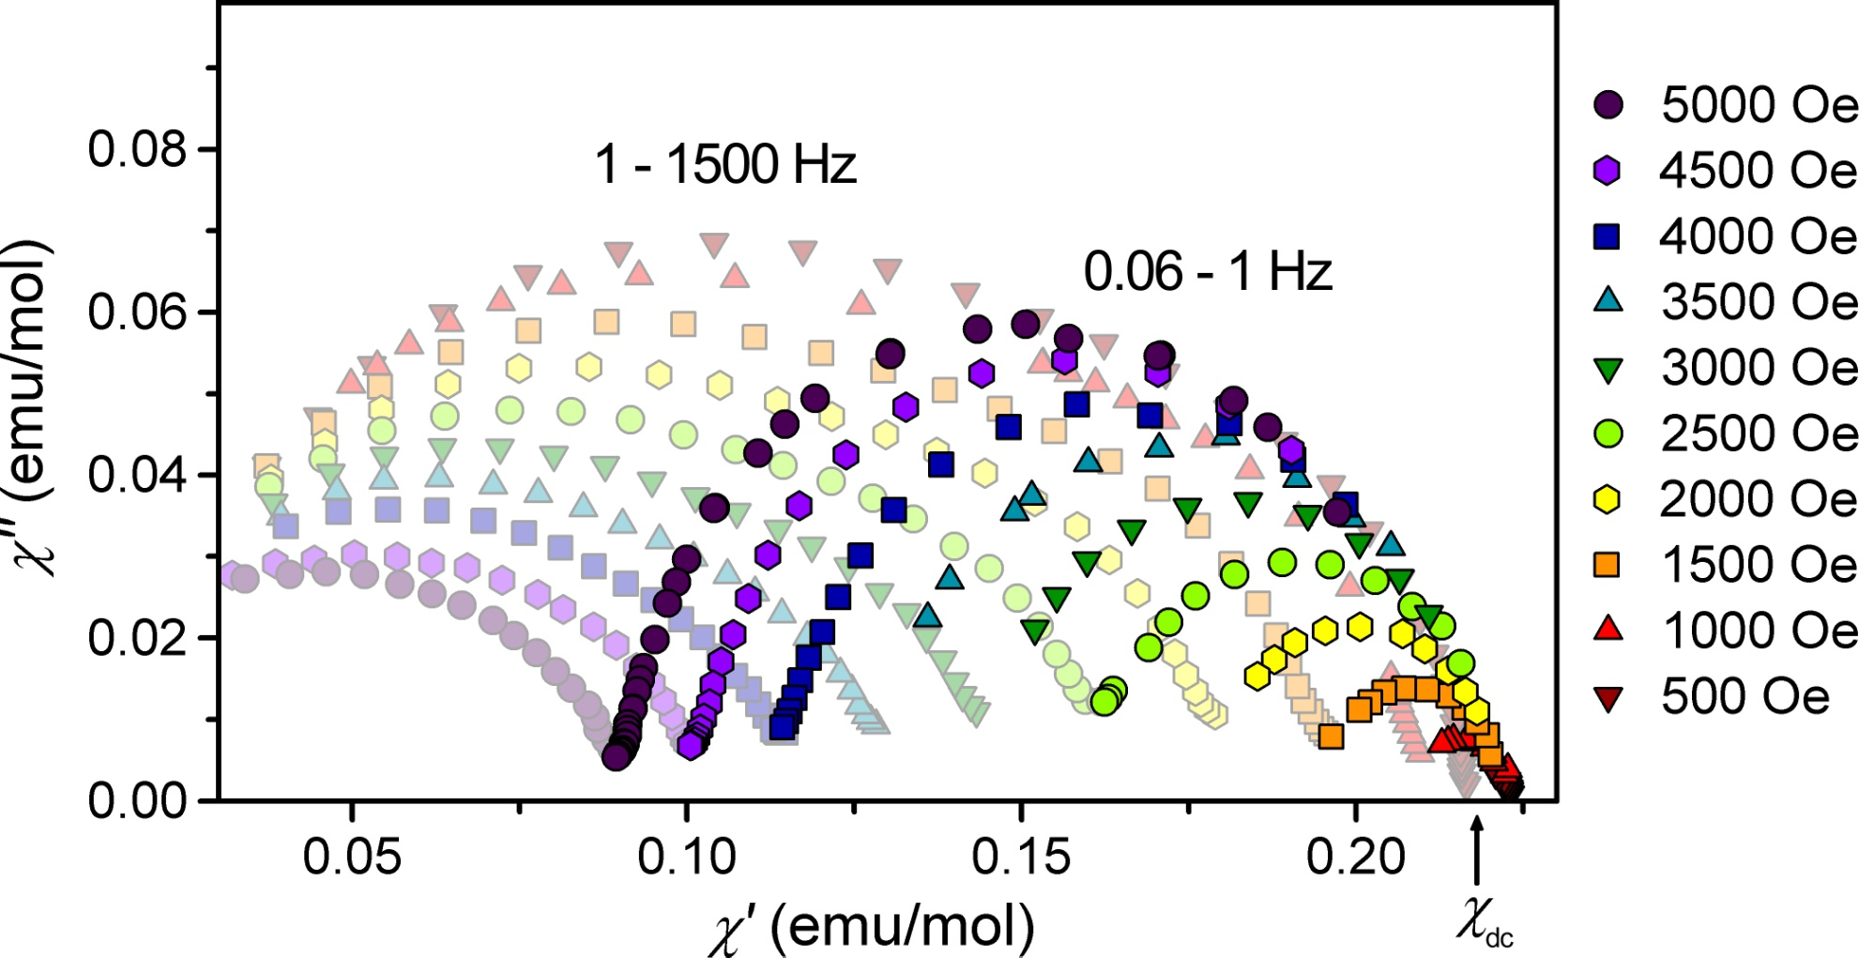
Multiple Pathways to Magnetic Relaxation
Fast Relaxation Domain
Slow Relaxation Domain
• Multiple relaxation processes are difficult to explain with only a single
paramagnetic ion per cluster
Notes:
Here we plot the in phase and out of phase components of suceptibility are ploted at various frequencies. In a single well-defined relaxation process the plot should form a semicircle, however it is evident that several processes are occurring due to the double-hump appearance of the data. We were hoping to use an applied dc field to isolate the two processes and characterize them independently. Shown here is the data at various applied field strengths. What we see is that instead of separating, one of the processes appears to go away as the dc field is applied. As seen in the previous molecule, this may imply a quantum process that is broken by apply a field. So this all made sense except for one curious thing. We noticed that as we applied a field, the data at low frequency no longer approached the susceptiblity for a purely static field. This lead us to consider that there may be another relaxation process occurring outside of our normal frequency range. We collected lower frequency data, actually finding the limit of our instrument at 0.06 Hz and what we saw was a clear, well defined relaxation process. This is the first such compound where a well defined secondary process such as this has been observed, and its very low frequency nature added to our interest. To characterize it further, we again decided to study the field dependence of the relaxation time.

Slide 6
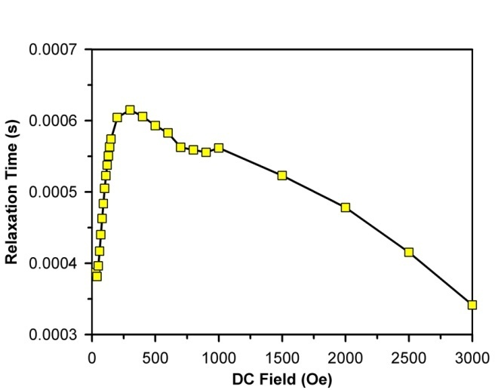
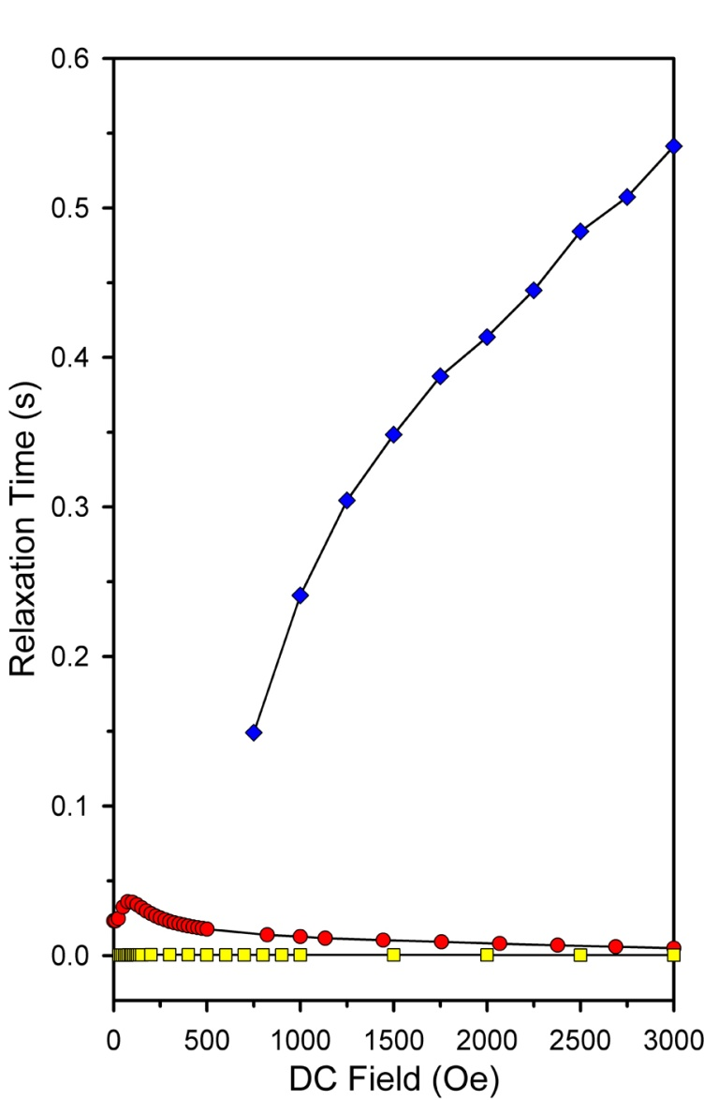
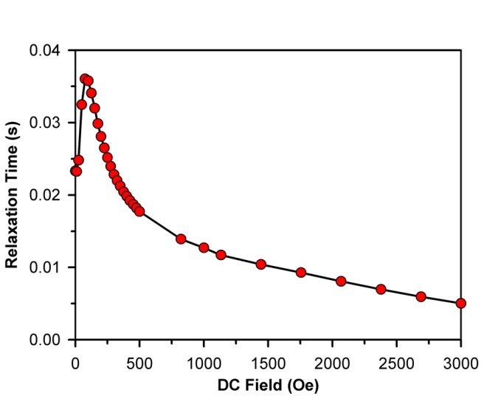
Field Dependence of Magnetic Relaxation Times
U(H₂BPz₂)₃
1.8 K
(Fast Domain)
(Slow Domain)
U(Ph₂BPz₂)₃
(Fast Domain)
Notes:
Shown here is the field dependence of the phenyl compound again for reference. In this plot we have gone all the way out to 3000 Oe however the same general trend is seen in the relaxation time. Now I’m showing the relaxation time for the hydro compound. On the scale of the other compound it looks field independent, however if we blow it up it has the same general shape (although more rounded) as the phenyl compound. Now if we plot the relaxation times versus field for the process from frequency region B we see just how dramatically different the behavior is. It is an order of magnitude higher and continues to increase with applied field. These results are still preliminary, but we think that a direct phonon-based relaxation between opposite orientations of the ground state may be leading to this very slow relaxation behavior.

Slide 7
Magnetic Dilution of U(H₂BPz₂)₃
YCl₃:UI₃
+
THF
3
(H₂BPz₂)¹⁻
4% U(H₂BPz₂)₃ in Y(H₂BPz₂)₃
• Similar ionic radii allow co-crystallization of U(H₂BPz₂)₃ in Y(H₂BPz₂)₃ without
alteration of the space group or crystal field environment
• In undilute structure, four uranium ions are ~8.6 Å from each uranium ion
Katie Meihaus

Slide 8
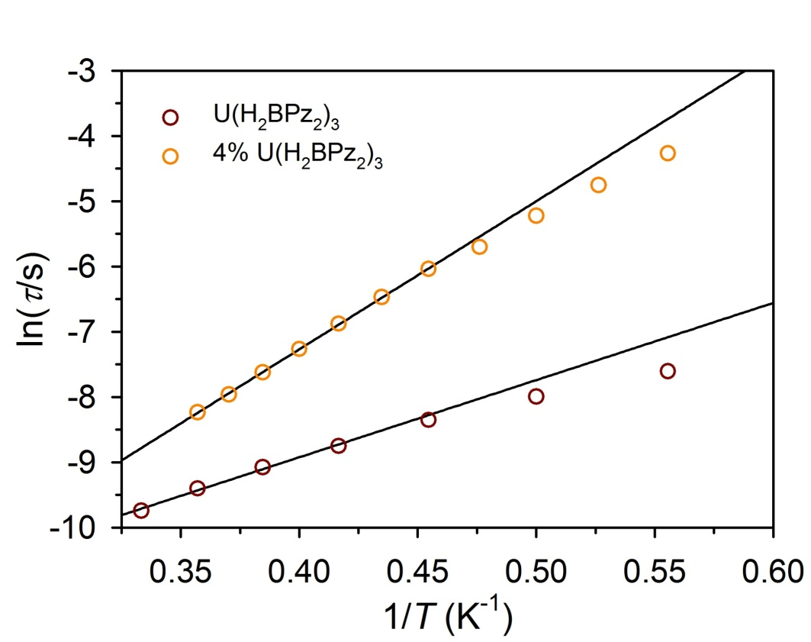
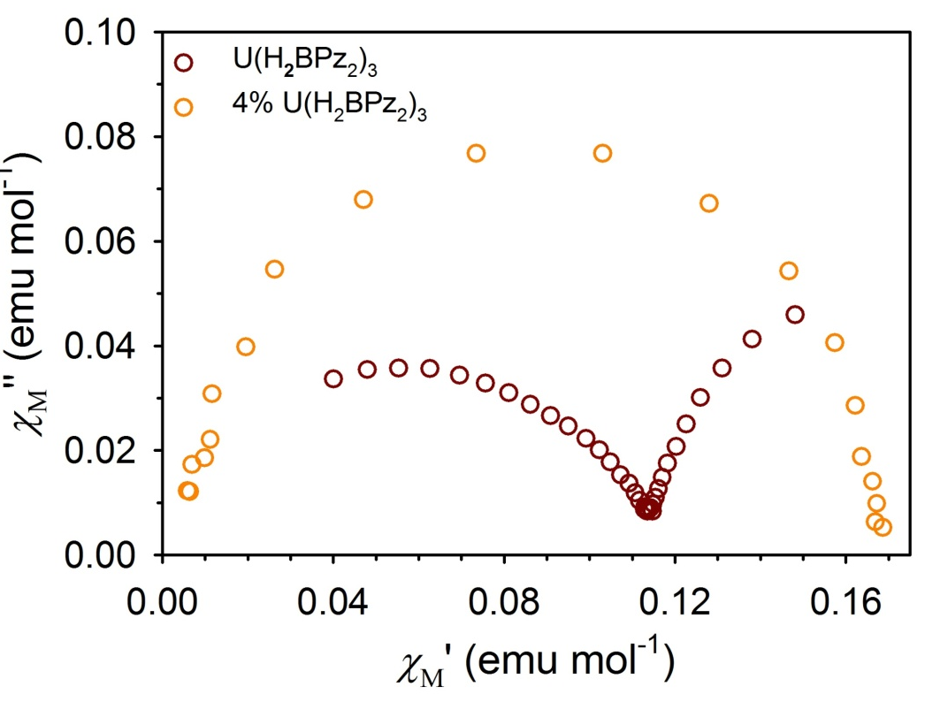
Results of Magnetic Dilution of U(H₂BPz₂)₃
U_{eff} /k_{B}= 23 K
U_{eff} /k_{B}= 11 K
• Fast Domain relaxation is slowed considerably and anisotropy barrier doubles.
• Slow Domain relaxation is eliminated
How much is the magnetic relaxation modulated by the concentration of magnetic ions?
Katie Meihaus

Slide 9
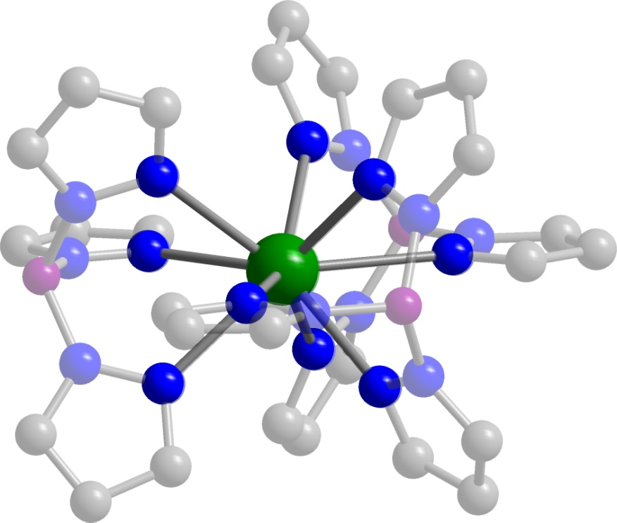
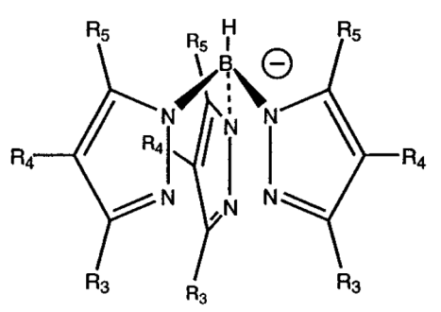
A Test Case for the Affect of Magnetic Dilution: Neodymium(III) tris(trispyrazolylborate)
C
NdCl₃
+
N
H₂O
Nd
B
NdTp₃
Tp⁻ (trispyrazolylborate anion)
• Tricapped trigonal prismatic coordination leads to D_{3h} site symmetry.
• High symmetry should hinder direct tunneling relaxation pathway (Kramers ion)
Structure: Apostolidis, C et. al. Polyhedron. 1997, 16, 1057.

Slide 10
The Electronic Structure of NdTp₃
²H
⁴F_{7/2}
⁴F
⁴H_{9/2}
⁴F_{5/2}
⁴F_{3/2}
f³
⁴I_{15/2}
⁴I_{13/2}
⁴I
⁴I_{11/2}
107 cm⁻¹
⁴I_{9/2}
^{(2S+1)}L
^{(2S+1)}L_{J}
m_{J}
Electrostatic Repulsion
Spin-orbit
Coupling
Ligand Field Splitting
Reddmann, H. et. al. Z. Anorg. Allg. Chem. 2006, 632, 1405.

Slide 11
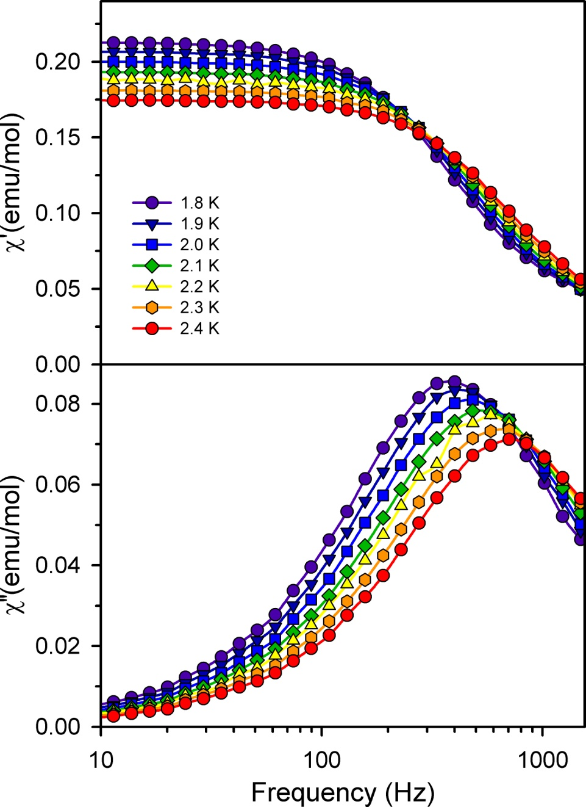
Slow Magnetic Relaxation in NdTp₃
C
N
Nd
B
• Requires application of > 100 Oe dc
field to observe out-of-phase signal
• Relaxation data can be fit to give U_{eff} =
~3 cm⁻¹ (4 K) and τ₀ = 4x10⁻⁵ s
3 % of expected barrier!

Slide 12
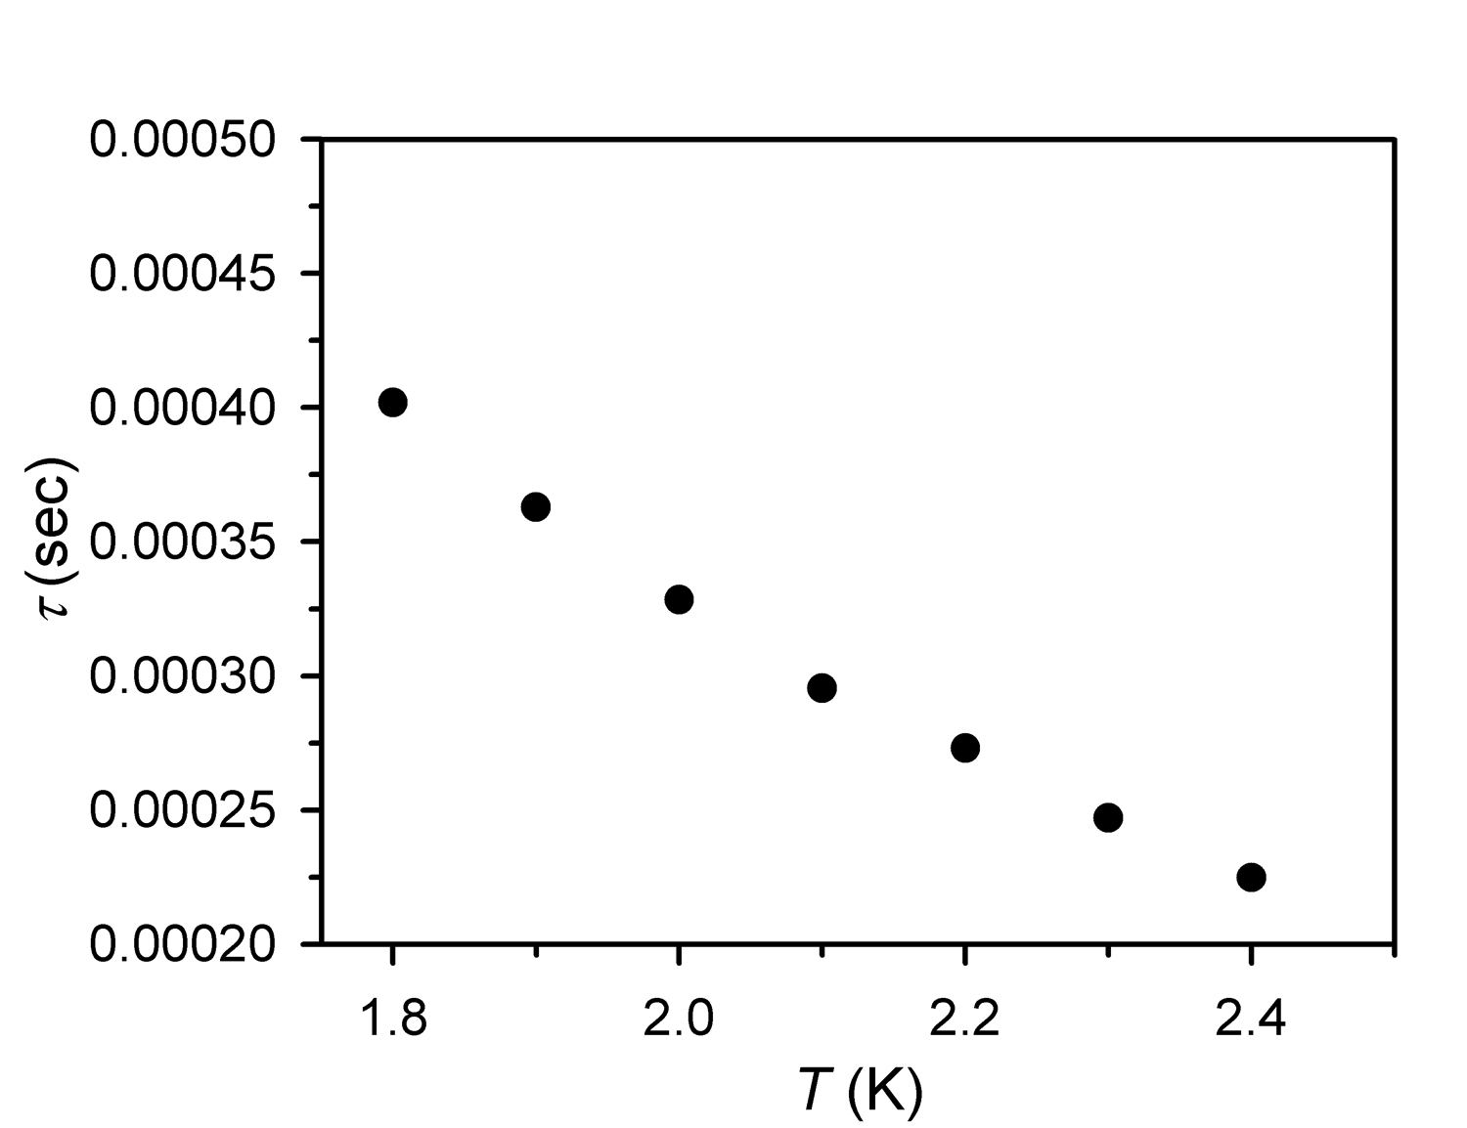
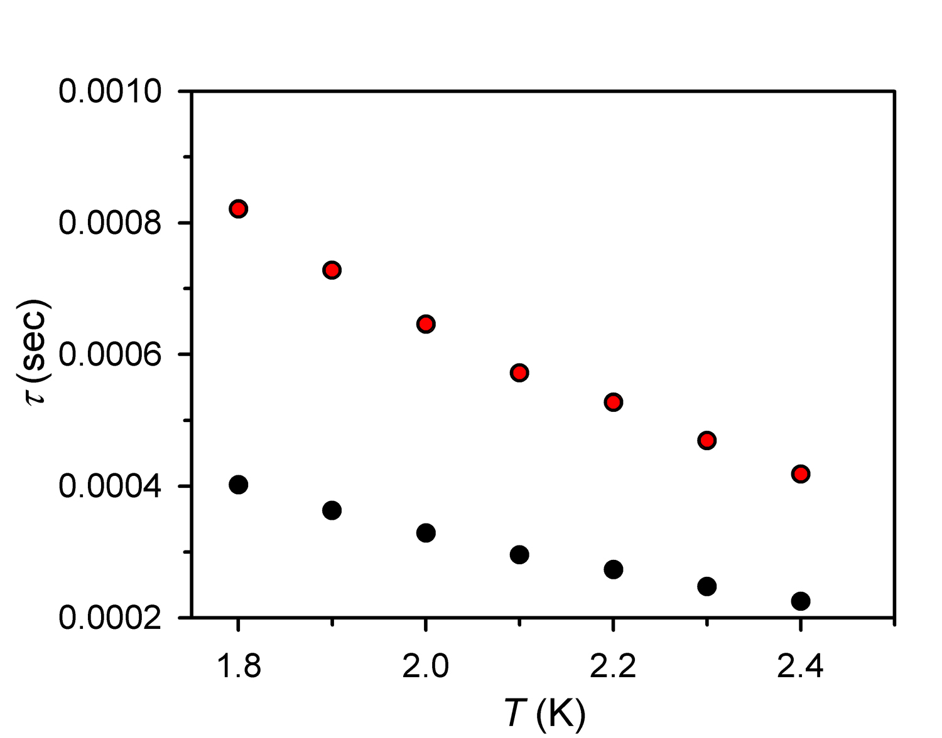
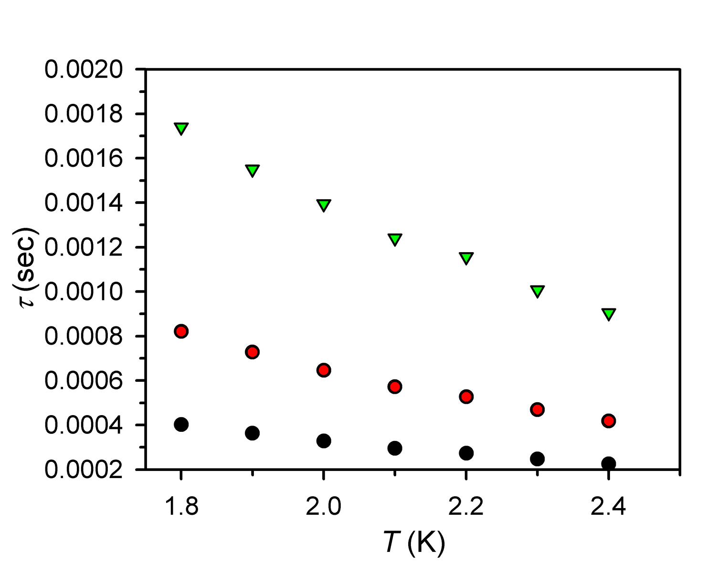
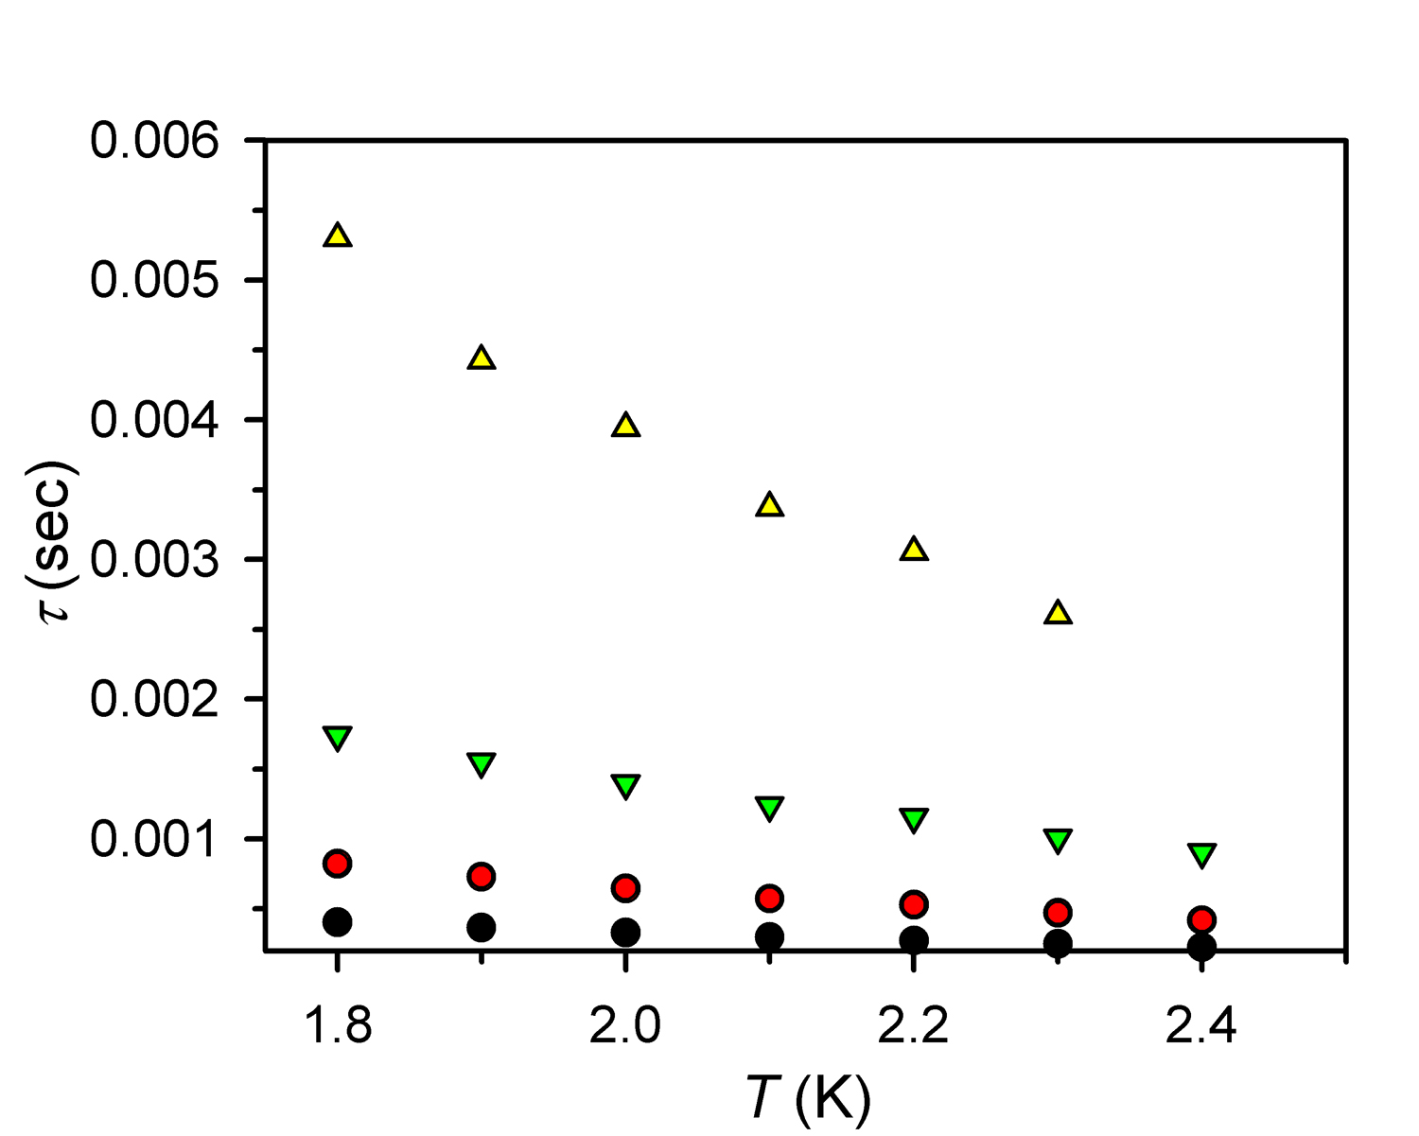
Effect of LaTp₃ Dilution on NdTp₃ Relaxation
• 1:30 dilution results in 650% increase in relaxation time at 1.8 K

Slide 13
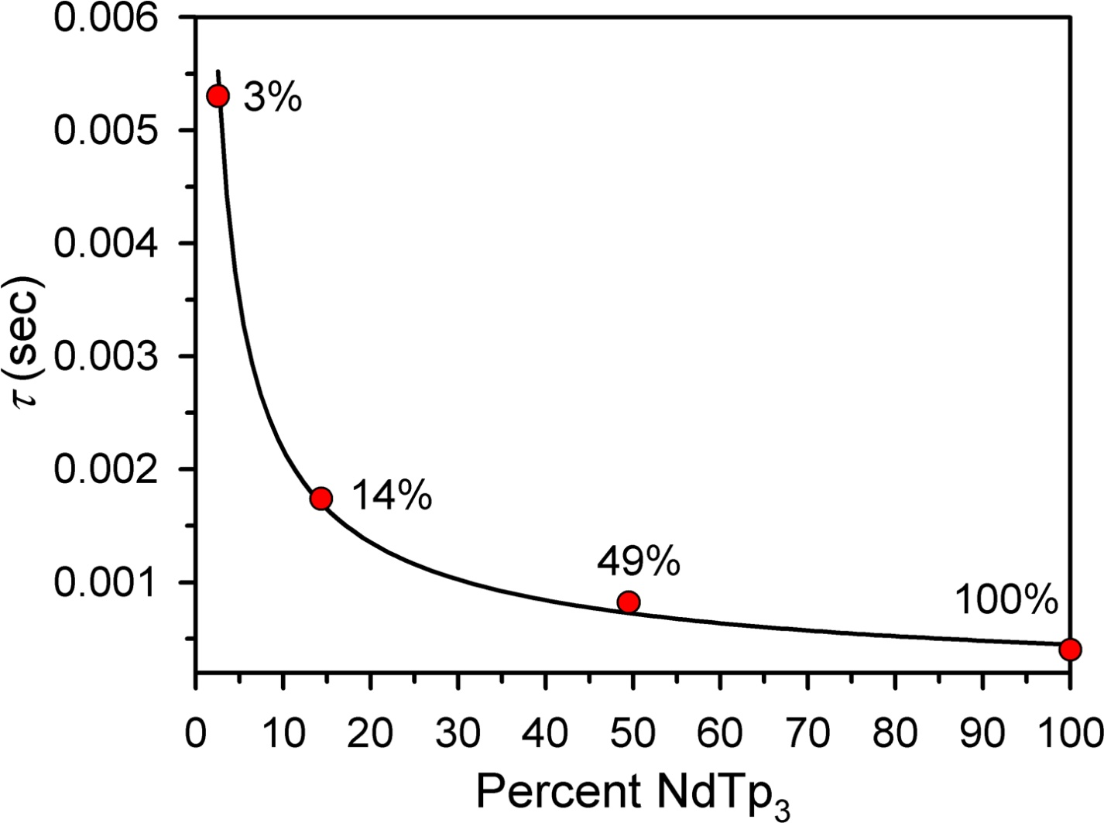
Relaxation time vs. % NdTp₃
● Data are fit empirically to the equation τ = 0.0105*(Percent NdTp₃)^{-0.684}
● Relaxation time is slowing but are we approaching predicted Arrhenius
behavior?

Slide 14
Effect of Dilution on Arrhenius Behavior in NdTp₃
U_{eff} /k_{B} = 6 K; τ₀ = 2x10⁻⁴ s⁻¹
U_{eff} /k_{B} = 5 K; τ₀ = 1x10⁻⁴ s⁻¹
U_{eff} /k_{B} = 5 K; τ₀ = 6x10⁻⁵ s⁻¹
U_{eff} /k_{B} = 4 K; τ₀ = 4x10⁻⁵ s⁻¹
● Dilution drastically alters relaxation time but has little effect on anisotropy barrier

Slide 15
Effect of Dilution: Drastic But Not that Drastic
● Long range effects cannot fully account for the discrepancy between observed
behavior and that predicted by the electronic structure of NdTp₃

Slide 16
Predicted vs. Actual Magnetic Behavior (guess which is better)
Compound | Predicted Barrier (K) | Measured Barrier (K) | Percent of Expected Barrier
UTp₃ | 388 | 6 | 1.5%
NdTp₃ | 154 | 4 | 2.6%
[TbPc2]⁻ | 619 | 331 | 53.5%
U(COT)₂ | 662 | 0 | 0.0%
[Er(W₅O₁₈)₂]⁹⁻ | 144 | 55 | 38.2%
f-element mononuclear single-molecule magnets have shown impressive new behavior, yet the factors governing their relaxation must be better understood to fully exploit their potential

Slide 17
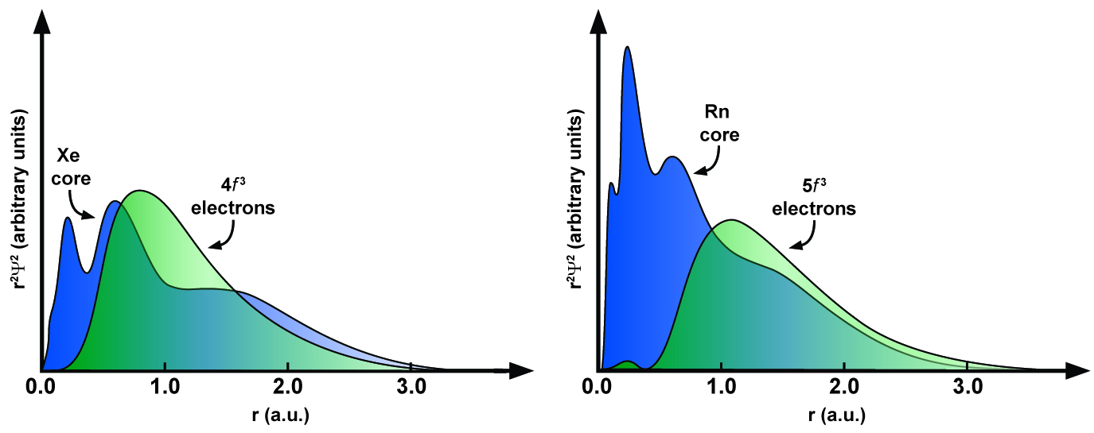
Radial Extension of the f-orbitals
La | Ce | Pr | Nd | Pm | Sm | Eu | Gd | Tb | Dy | Ho | Er | Tm | Yb | Lu
Ac | Th | Pa | U | Np | Pu | Am | Cm | Bk | Cf | Es | Fm | Md | No | Lr
Nd³⁺
U³⁺
Adapted from Crosswhite, Crosswhite, Carnall, Paszak J. Chem. Phys. 1980, 72, 5103
Notes:
My work involves f-elements and all of the single-ion work had been done in this area of the periodic table (point). I had bee studying exchange coupling in uranium and was interested in seeing if the lanthanide single molecule magnetism could be extended to the actinides. Two reasons for this – one is the approxiamtely 2x greater spin-orbit coupling of the actinides which should have a big effect on anisotropy. The second is that compared to lanthanides, the actinides have a greater radial orbital extension, which should allow for greater interaction between the metal ion and the crystal field environment.

Slide 18
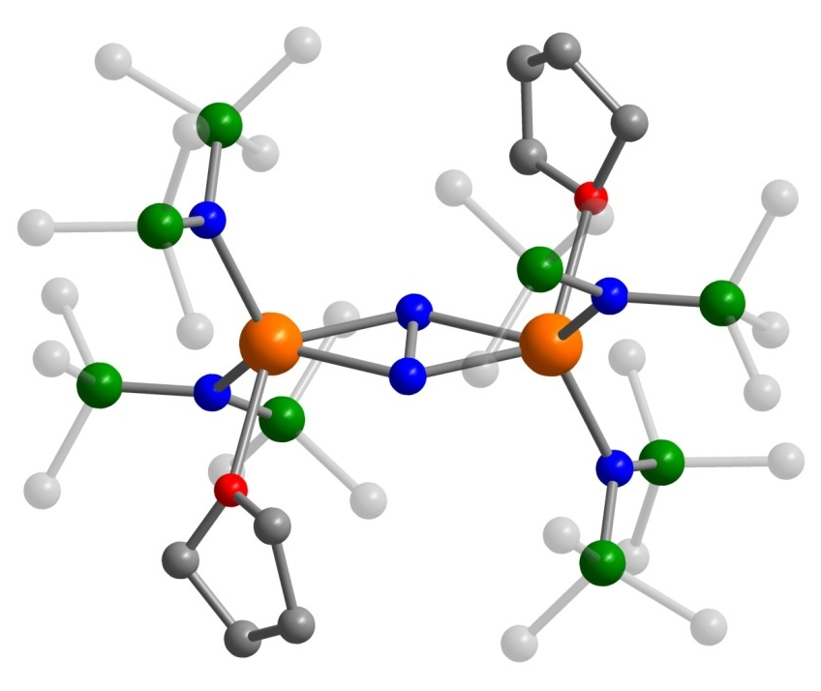
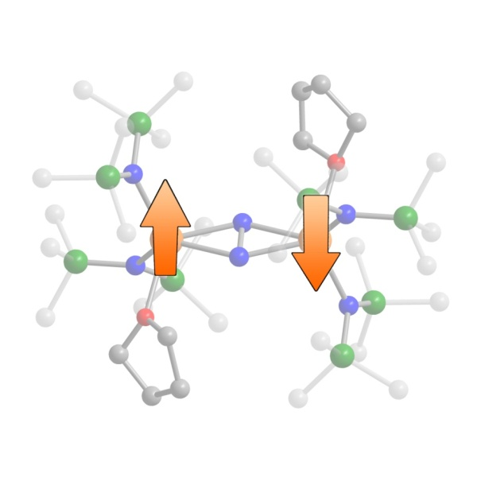
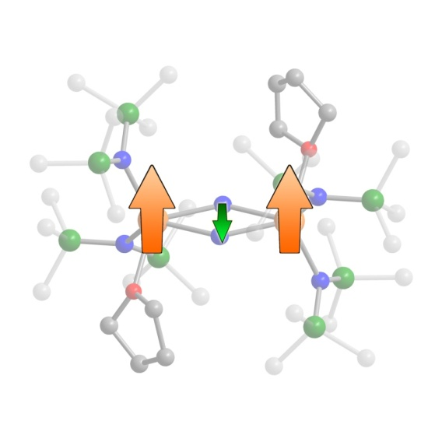
N₂^{3–} Radical-Bridged Lanthanide Complexes
Si
N
Ln
O
Ln₂N₂
C
[Ln₂N₂]⁻
[Ln₂N₂]^{n} (Ln = Gd, Dy; n = 0, −1)
● [Gd₂N₂]⁻: Possibility of strong exchange coupling
● [Dy₂N₂]⁻ : High anisotropy could make it a SMM
With Dr. Ming Fang, Prof. William Evans at UC Irvine

Slide 19
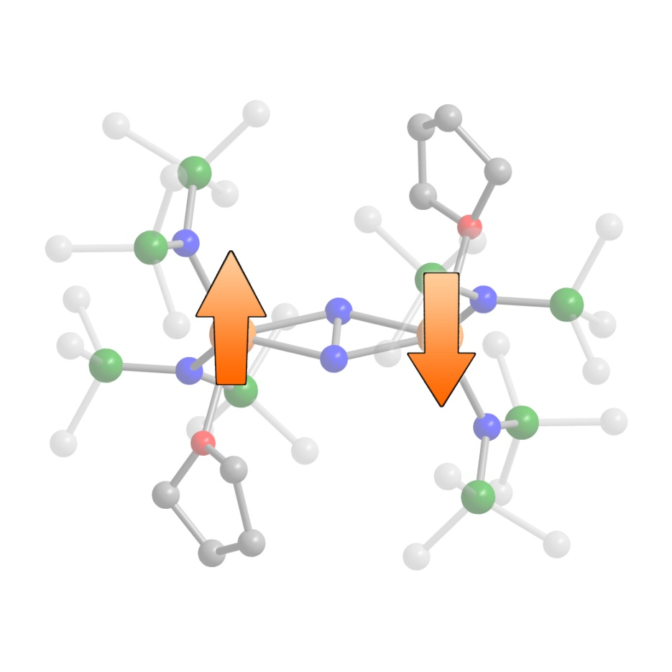
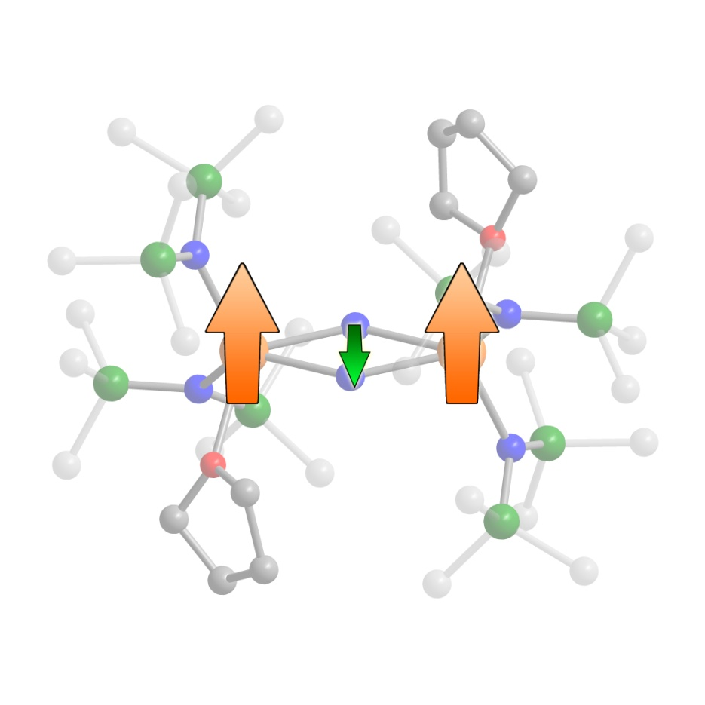
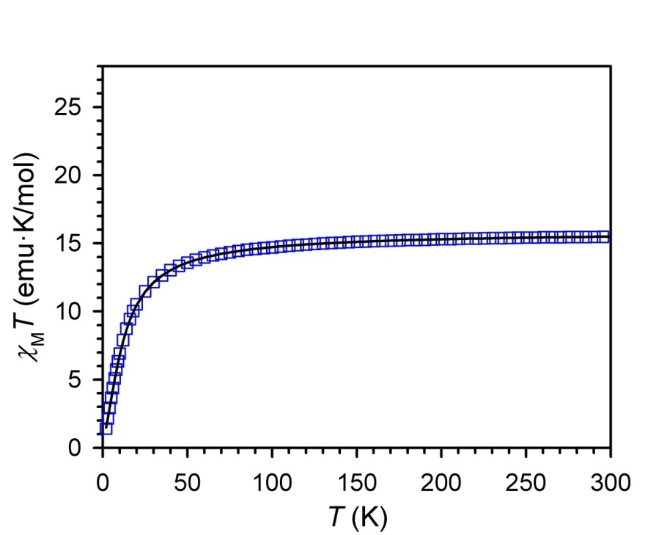
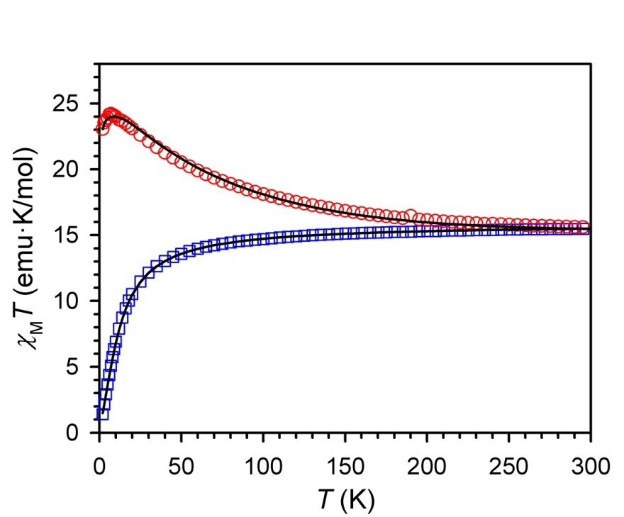
Strong Antiferromagnetic Coupling in [Gd₂N₂]⁻
Ĥ = -2J [Ŝ_{rad} • (Ŝ_{Gd1} + Ŝ_{Gd2})]
J = −27 cm⁻¹
S = −1/2
S = 7/2
S = 7/2
S = −7/2
S = 7/2
J = −0.49 cm⁻¹
Ĥ = -2J [Ŝ_{Gd1} • Ŝ_{Gd2}]
[Gd₂N₂]⁻
Gd₂N₂
● Gadolinium complexes tend to have coupling constants of −2 < J < 2 cm⁻¹

Slide 20
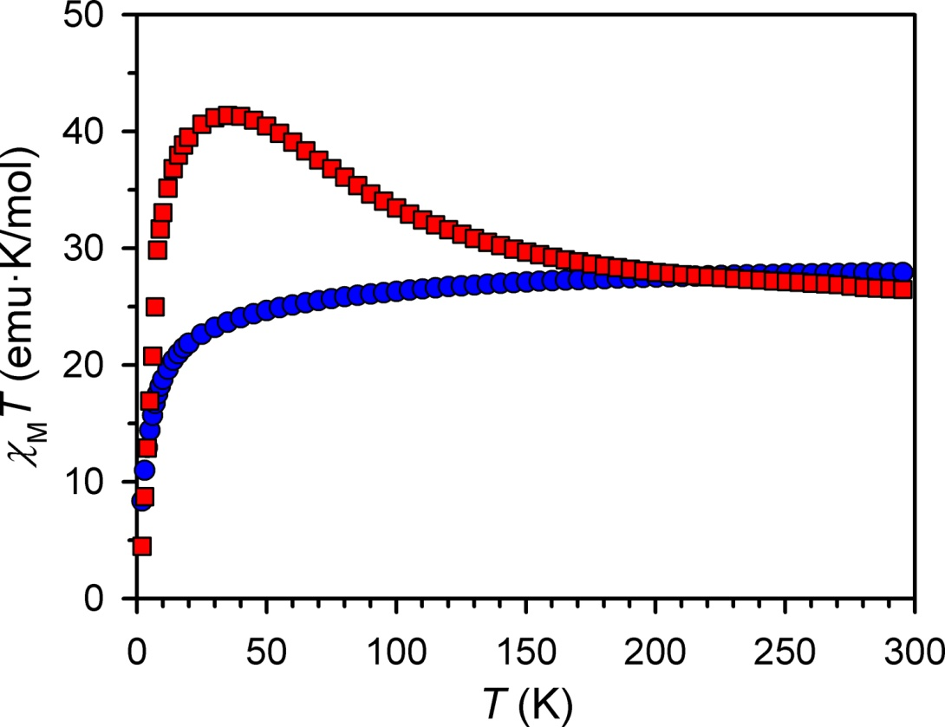
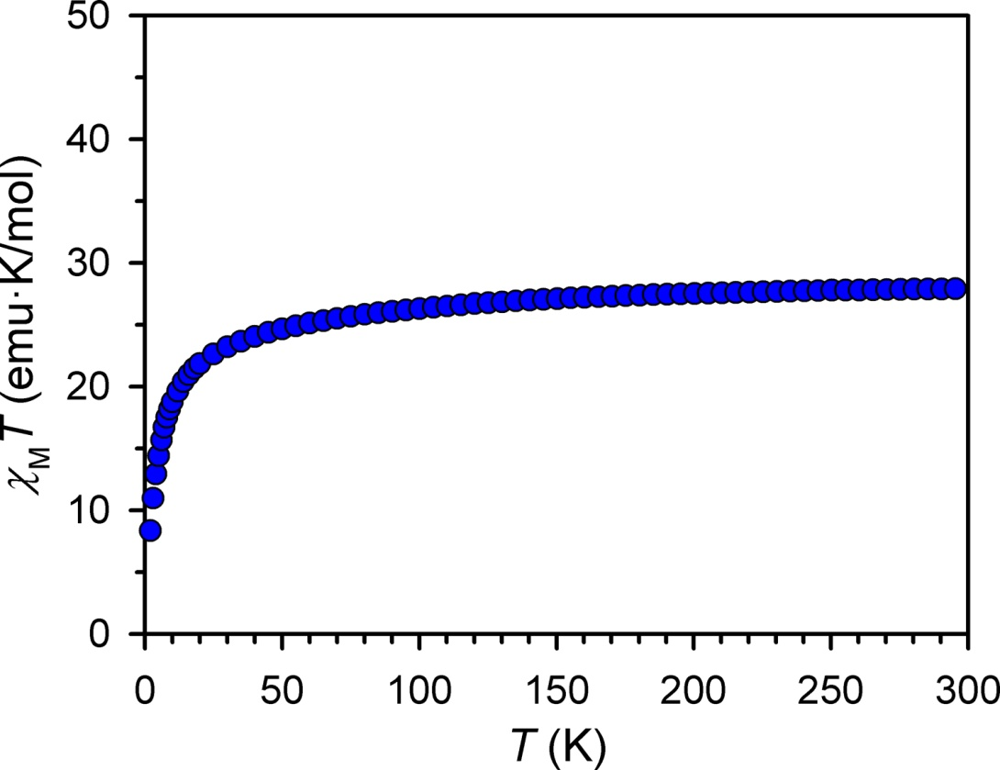
Magnetic Susceptibility of Dy₂N₂ and [Dy₂N₂]⁻
[Dy₂N₂]⁻
Dy₂N₂
● Steep rise in χT is highly unusual and indicative of strong magnetic
coupling, however quantitative analysis is hindered by Dy(III) electronic
structure

Slide 21
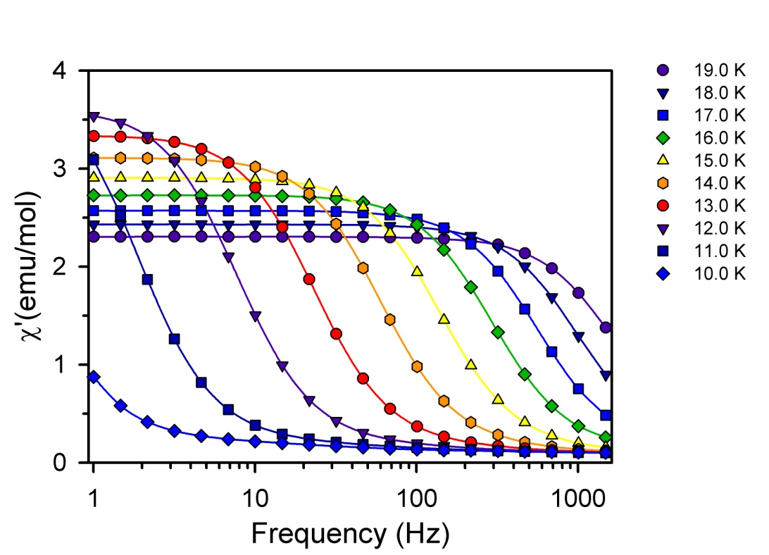
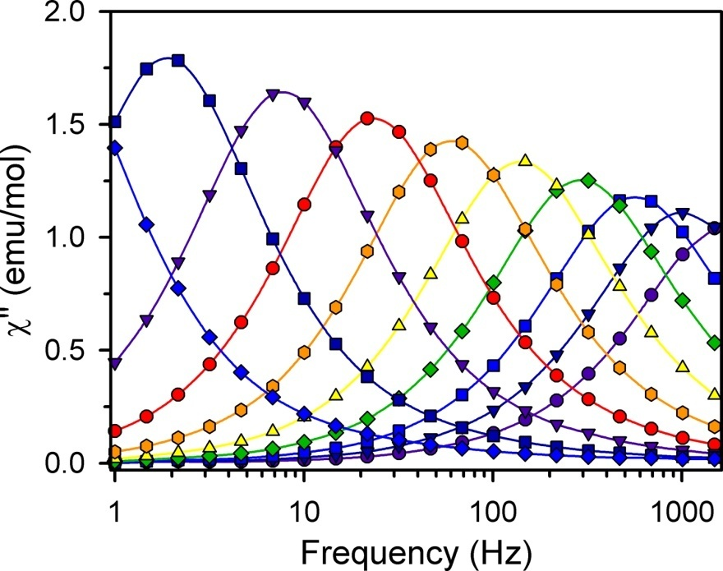
Single-Molecule Magnetism in [Dy₂N₂]⁻
● Ac susceptibility data fit using generalized Debye model between 1–1500 Hz and 10–19 K.

Slide 22
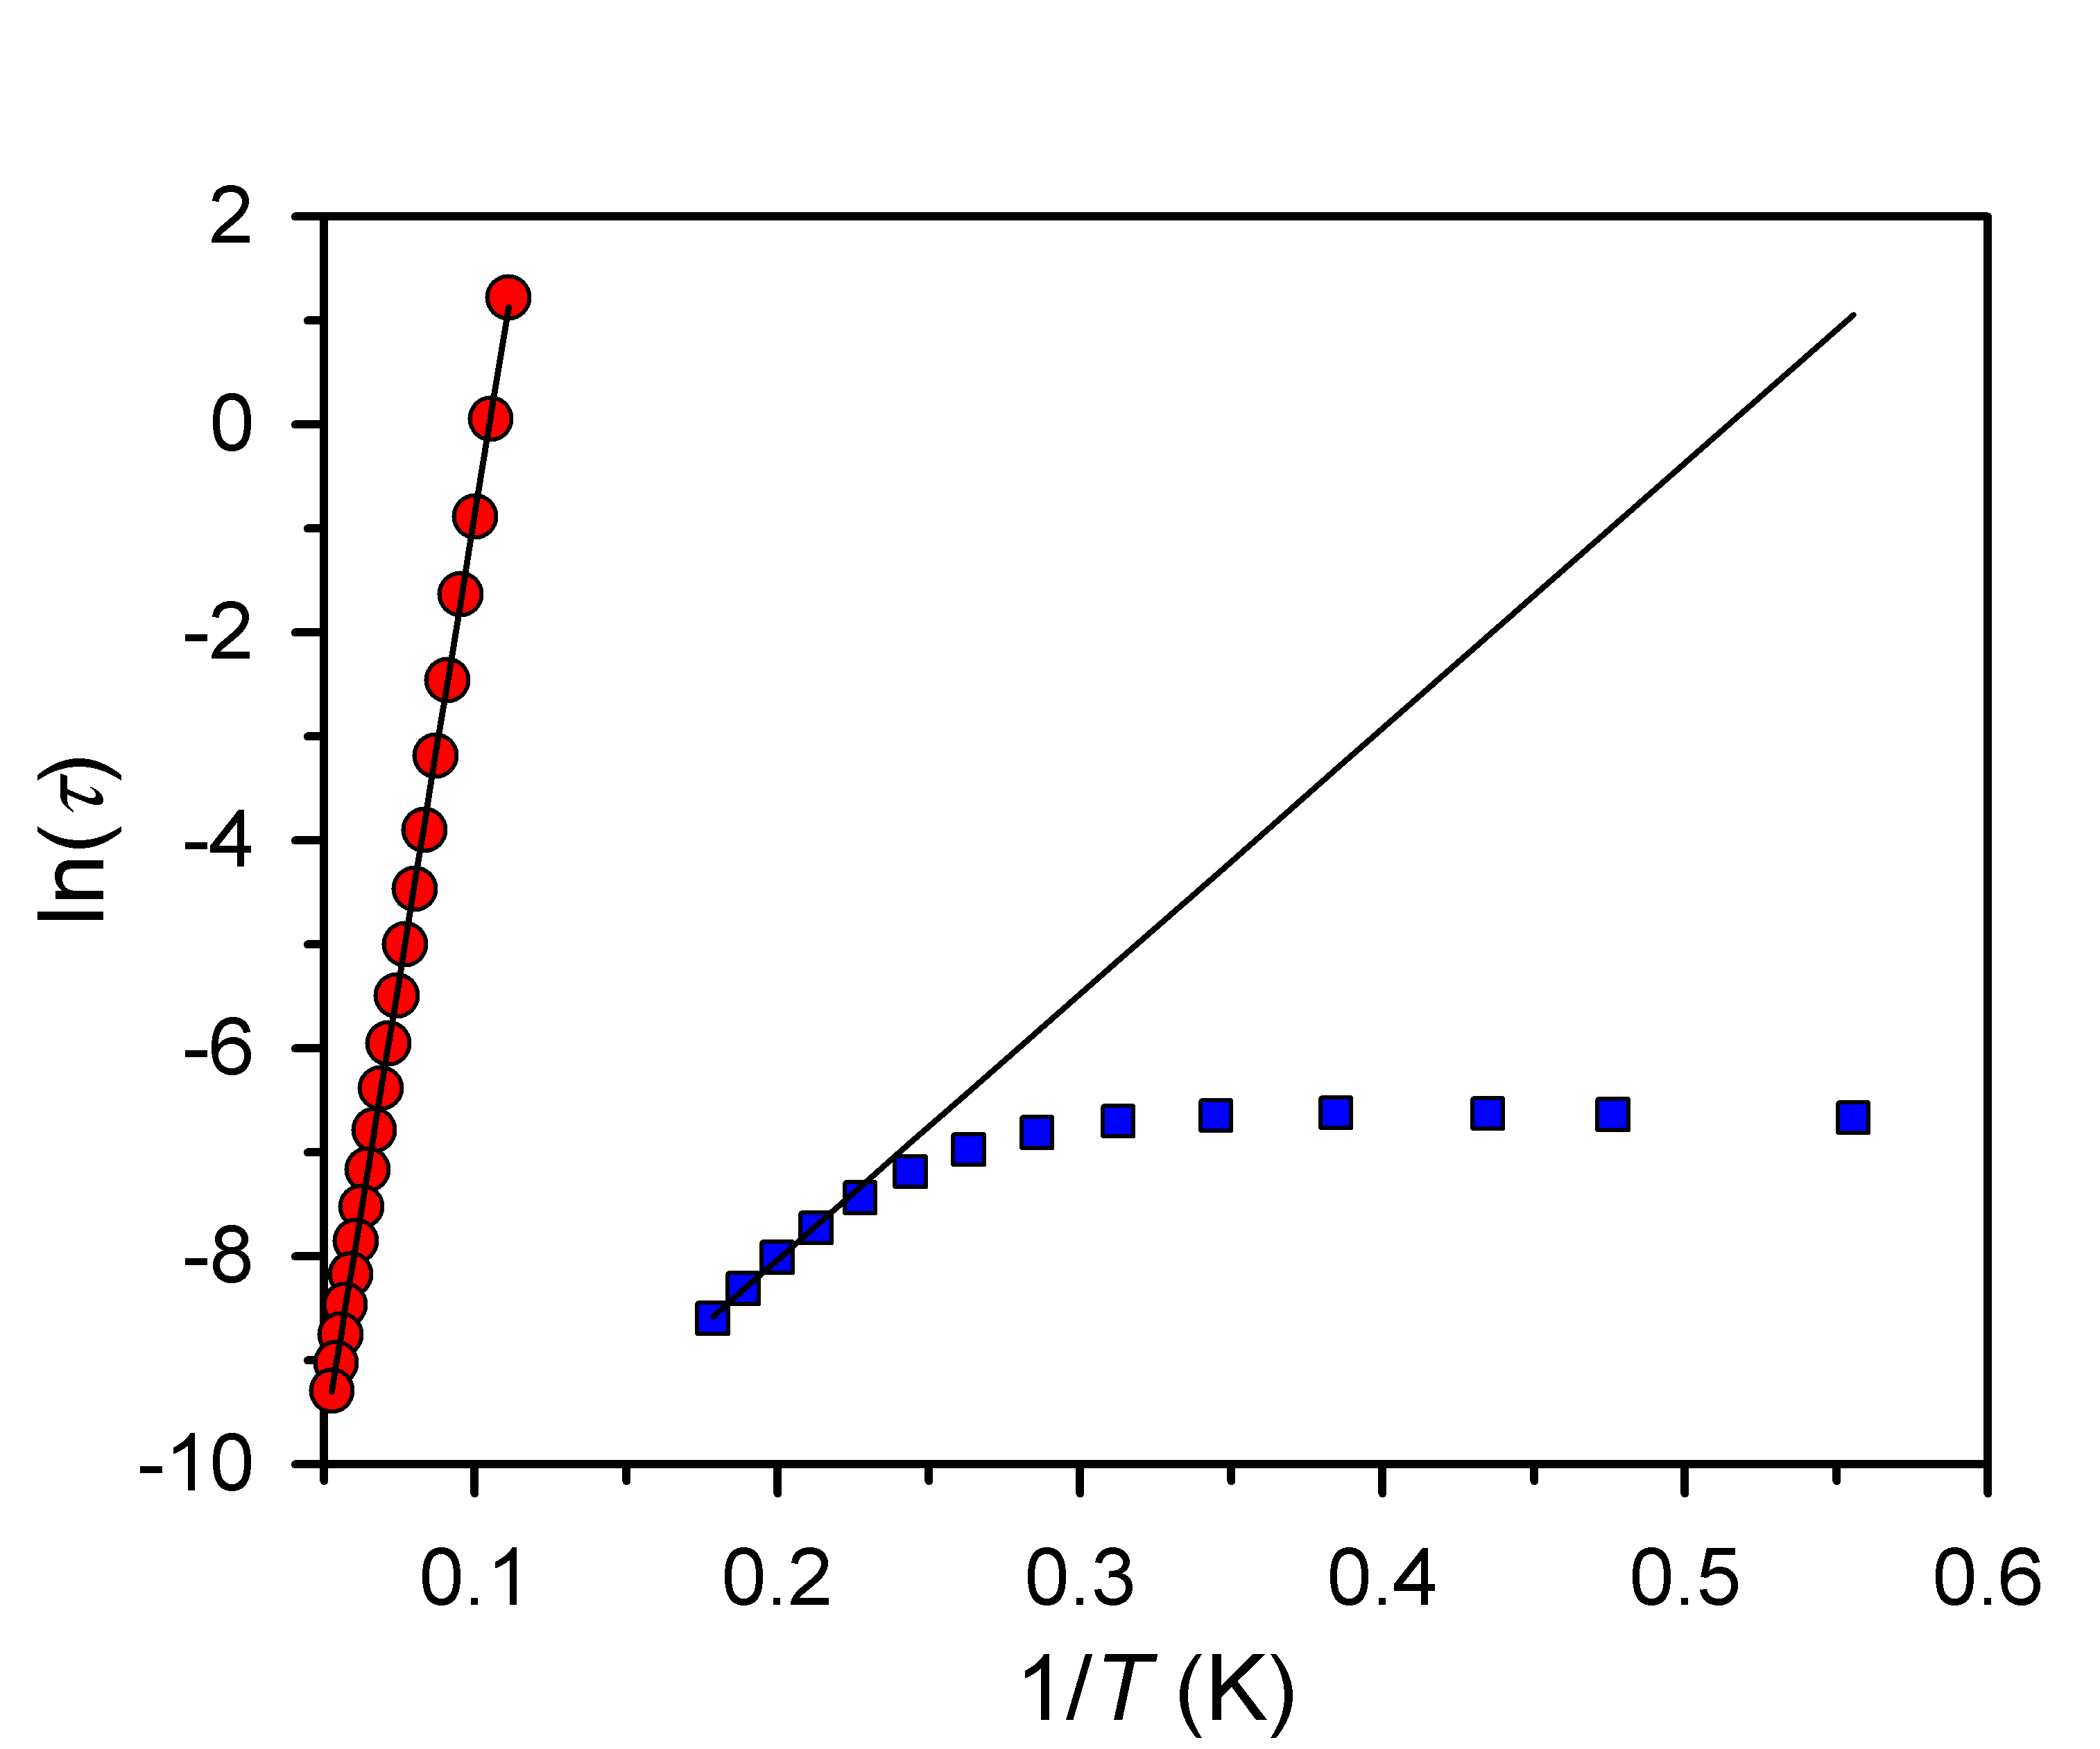
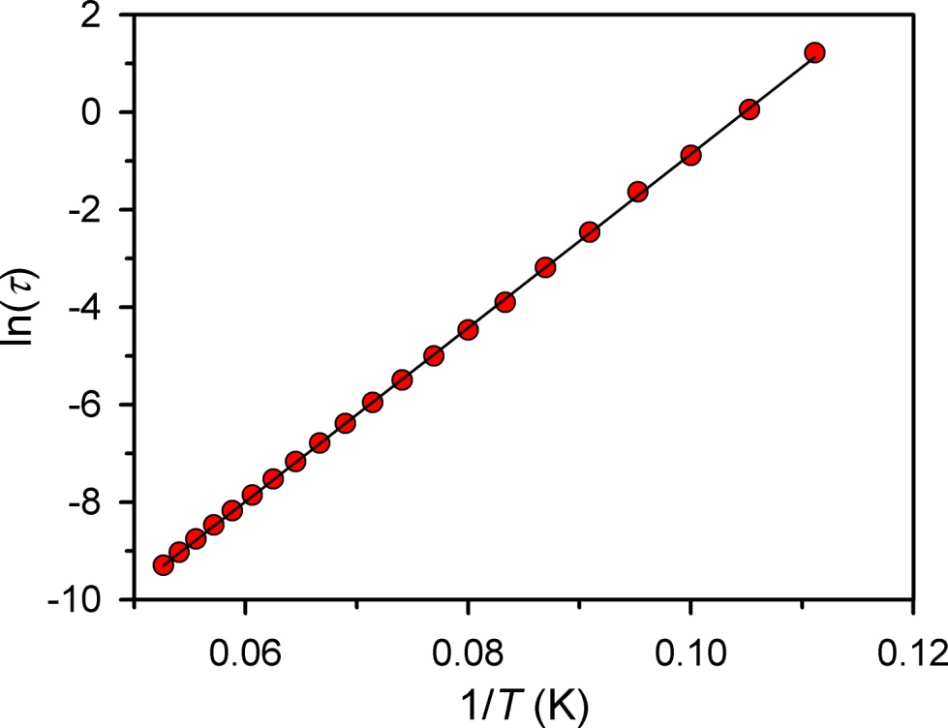
Arrhenius Behavior of [Dy₂N₂]⁻
[Dy₂N₂]⁻
U_{eff} = 123 cm⁻¹ (178 K)
τ₀ = 8 x 10⁻⁹ s
Dy₂N₂
U_{eff} = 18 cm⁻¹ (26 K)
τ₀ = 2 x 10⁻⁶ s
● Linear ln(τ) vs. 1/T indicates an Arrhenius temperature dependence
of the relaxation process

Slide 23
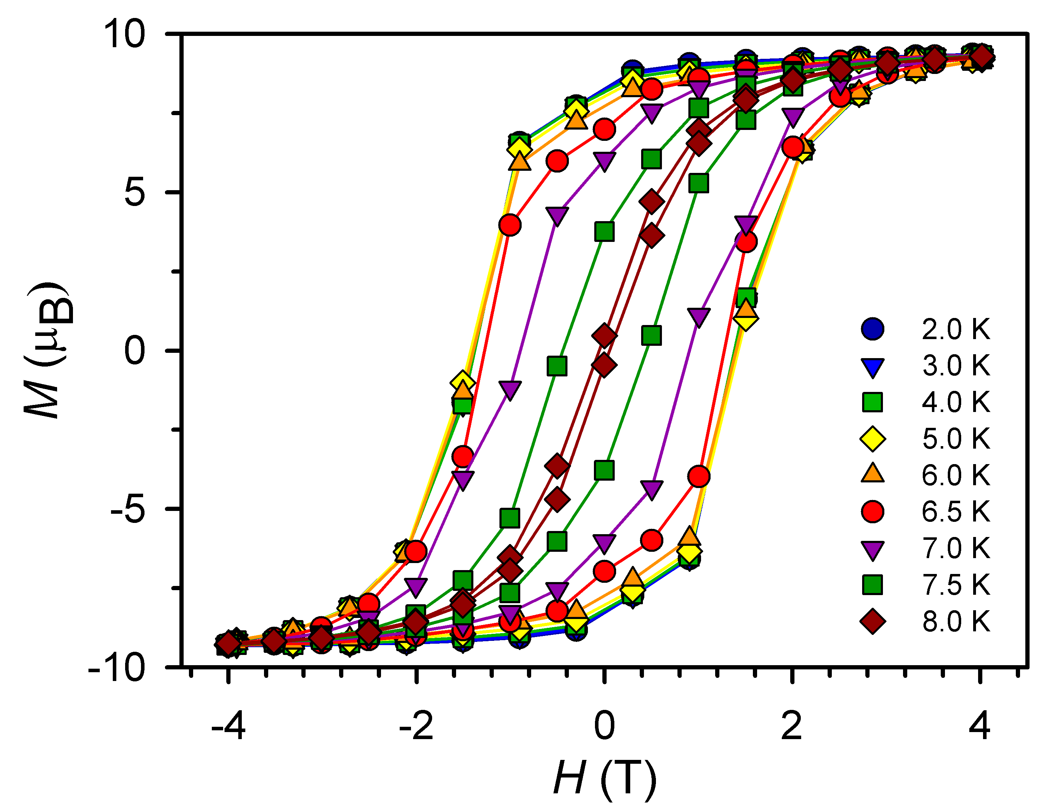
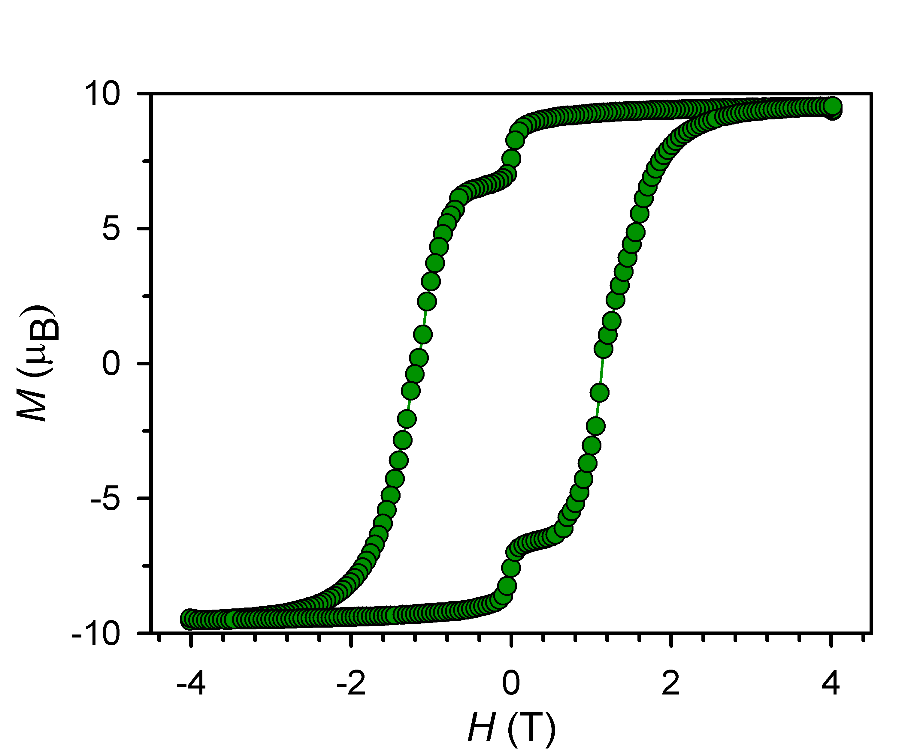
Magnetic Hysteresis in [Dy₂N₂]⁻
● Although Arrhenius behavior persists to low temperatures, eventually
anomalously fast zero field relaxation is observed

Slide 24
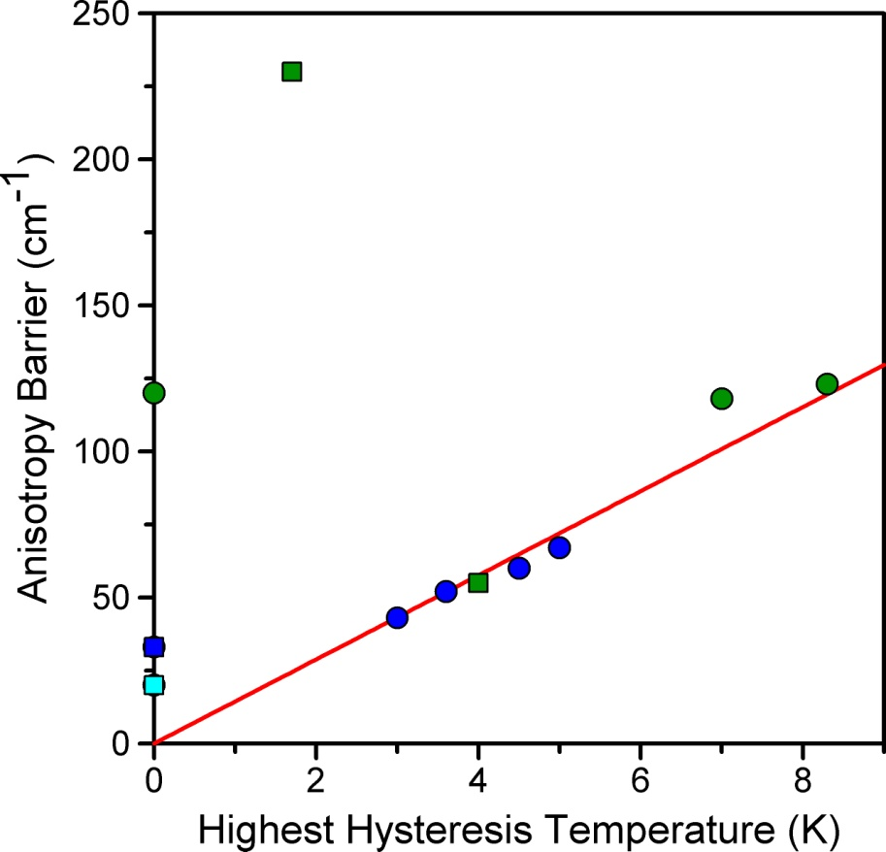
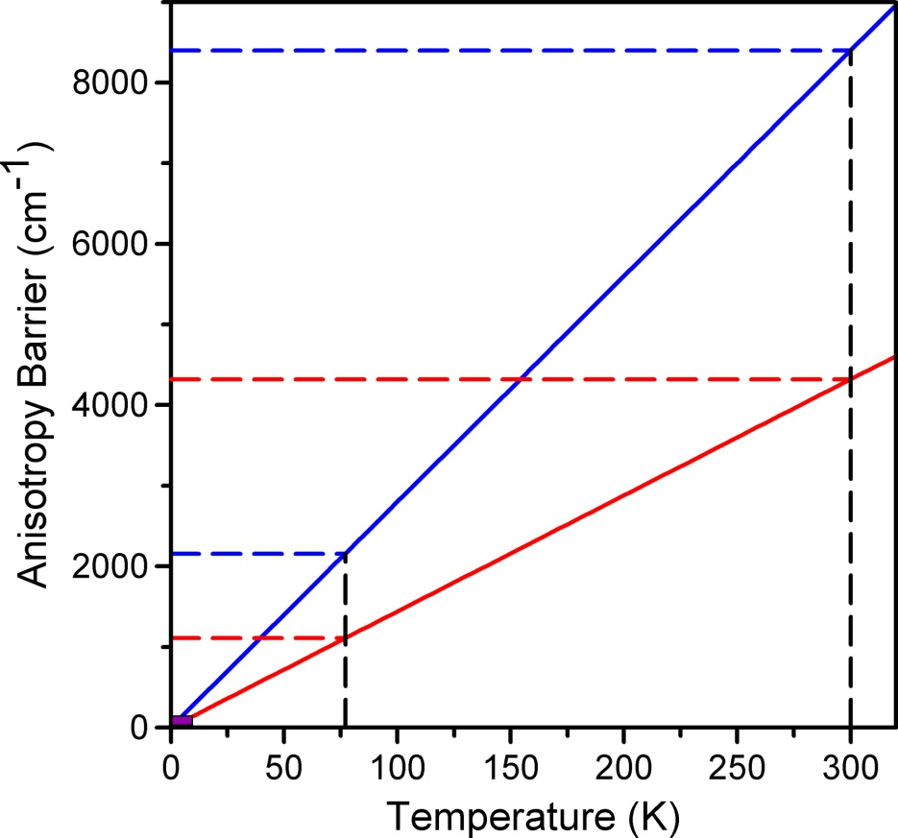
Context of [Dy₂N₂]⁻ Among Single-Molecule Magnets
[TbPc₂]⁻
Arrhenius prediction for 1 s relaxation
[Dy₂N₂]⁻
Mn₁₂-OAc
● Newest dysprosium-based single-molecule magnets have barriers and
hysteresis temperatures more than double that of Mn₁₂-OAc
● Is increasing the anisotropy barrier the most interesting synthetic goal?

Slide 25
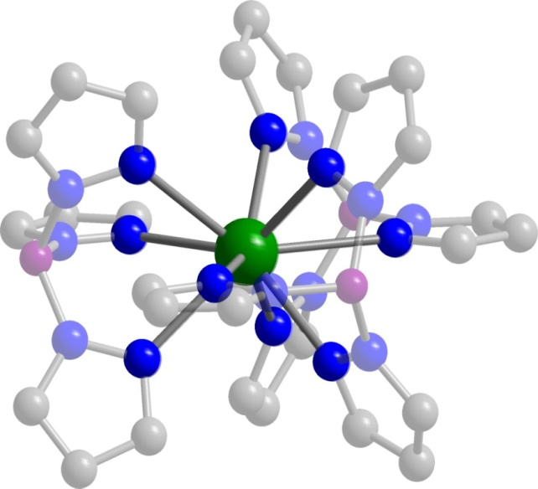
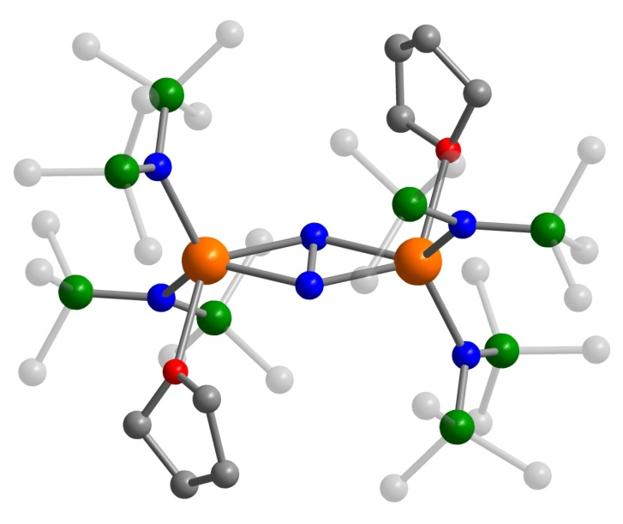
Remaining Questions
● What is the source and can we model the behavior
of the Slow Domain relaxation process?
U(H₂BPz₂)₃
● What is the extent of dilution effects on relaxation?
NdTp₃
● Is there a way to model the magnetic coupling of
[Ln₂N₂]⁻? Will other lanthanides yield higher
relaxation barriers?
[Ln₂N₂]⁻
Notes:
So to conclude my part of the talk I’d like to say that the magnetic characterization of these two uranium compounds brought the actinides into the field of single-molecule magnetism. And there are a number of interesting and unique behaviors that require further experimentation to work out.

Slide 26
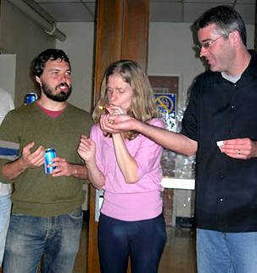
Acknowledgments
Jeffrey R. Long
Katie Meihaus
William Evans
Ming Fang
Stephen Hill
Enrique del Barco

Slide 27
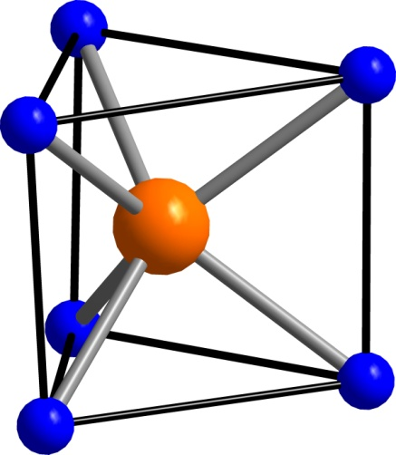
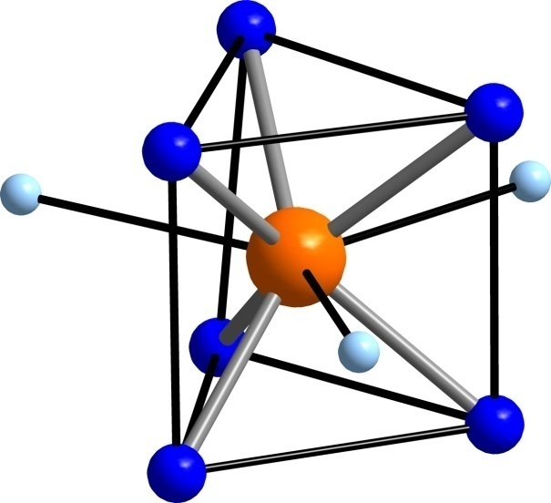
Coordination Sphere of U(H₂BPz₂)₃ and U(Ph₂BPz₂)₃
73.6 °
80.2 °
3.0 Å
3.2 Å
U(Ph₂BPz₂)₃
U(H₂BPz₂)₃
Ligand Field Perturbations:
1) Coordination increased from trigonal prismatic to tri-capped trigonal
prismatic
N-U-N angle increases
Distance between triangular faces of prism increases
Notes:
Another important difference between the molecules is shown here. The inner coordination spheres of the diphenyl compound and the newly crystallographically characterized dihydro compound are similar except in the N-U-N angle which is expanded in the hydro compound. This leads to an expansion of the coordination sphere which, according to our model, should decrease the anisotropy and lower the barrier to spin inversion.

Slide 28
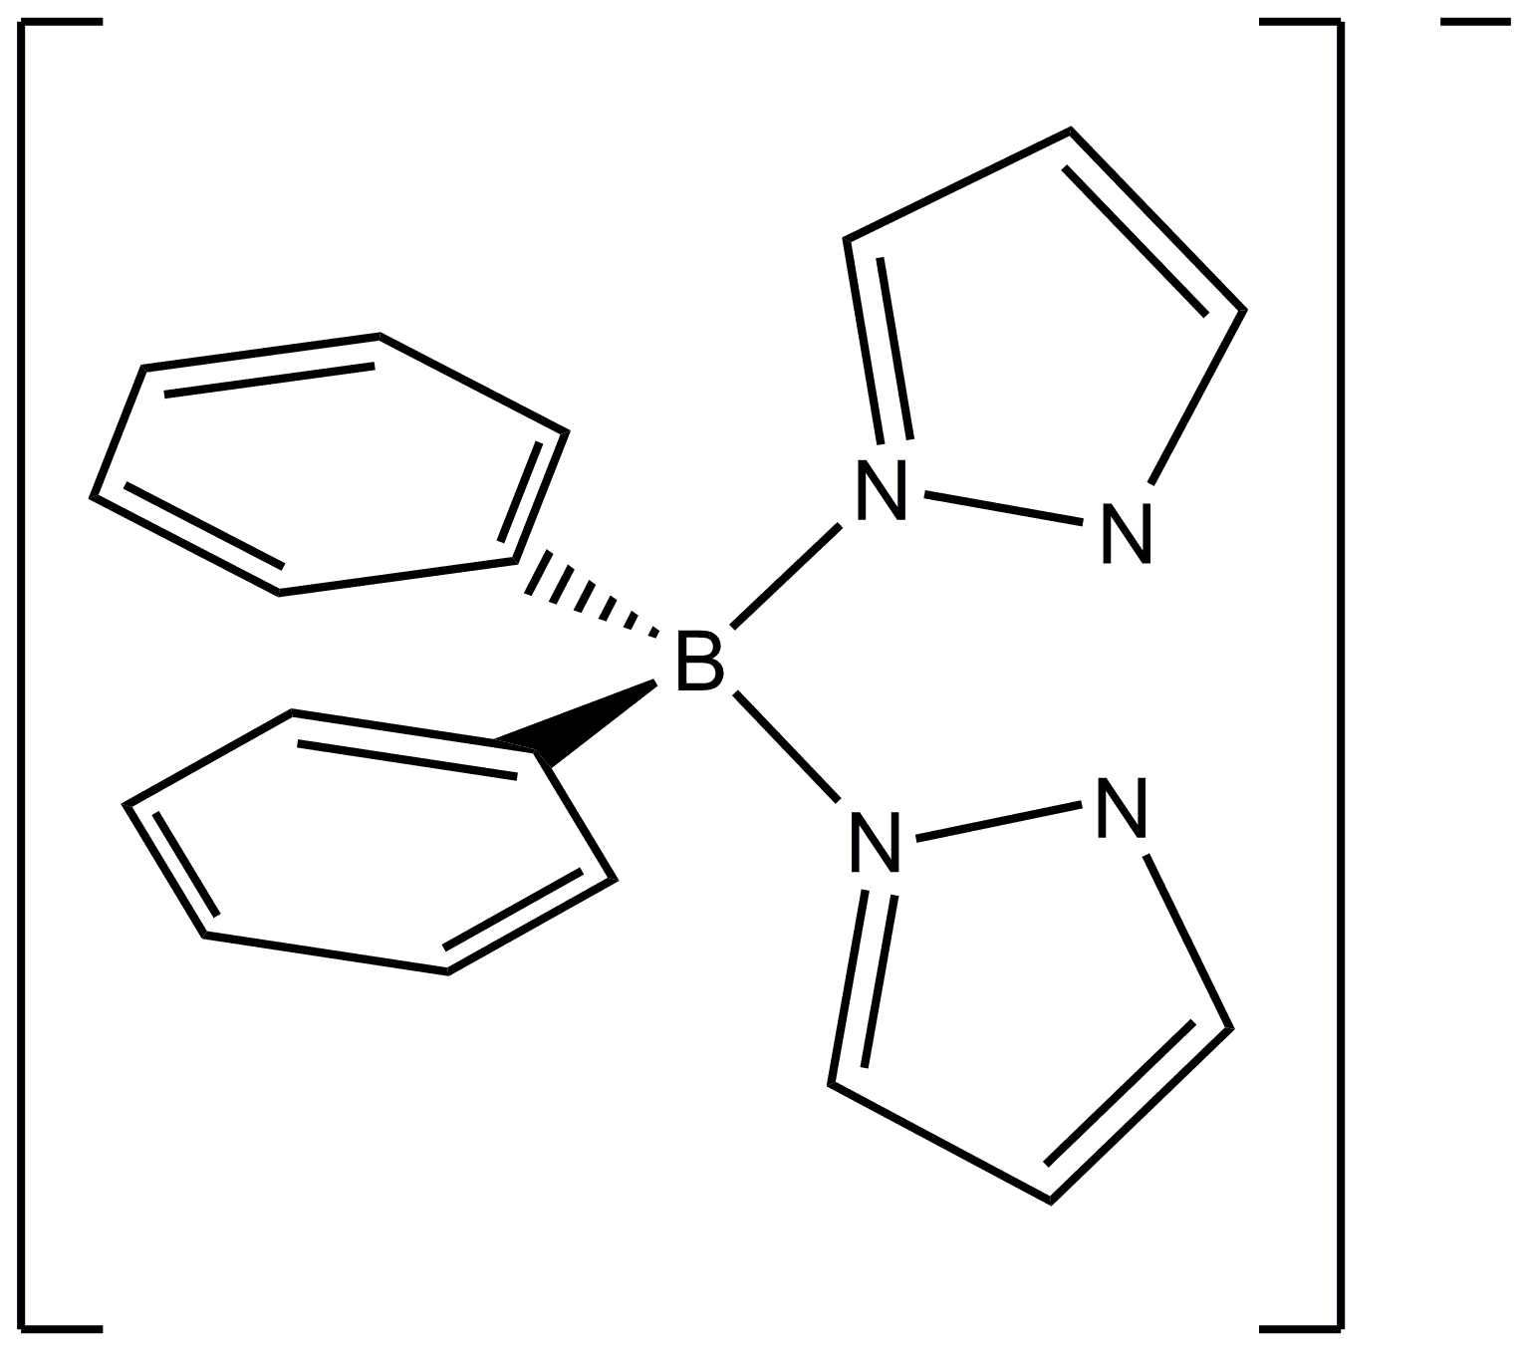
A Trigonal Prismatic U(III) Complex
Showing Single-Molecule Magnetism
UI₃
+
THF
3
(Ph₂BPz₂)¹⁻
U(Ph₂BPz₂)₃
• mononuclear U(III) molecular species with pseudo-3–fold symmetry axis
• axially coordinated ligand density forms trigonal prismatic crystal field
Maria, Campello, Domingos, Santos, Andersen. J. Chem. Soc., Dalton Trans. 1999, 2015
Notes:
There are many possible systems to consider since this is essentially a wide open area of molecular magnetism. One such molecule is this U(III) complex which was first isolated a decade ago. The reaction of UI3 and sodium diphenylbispyrazolyl borate in THF yields crystalline tris-diphenylbisporazolyl borate uranium (III).
The crystal structure shows that the phenyl groups restrict the coordination to the relatively rare for uranium coordination mode of trigonal prismatic. The three nitrogen atoms above and three below form that sandwich-type structure we were hoping to provide us with SMM behavior for f3 systems.

Slide 29
Single-Molecule Magnetism in U[Ph₂BPz₂)₃
• frequency dependency of out-of-phase susceptibility (χ′′ ) is the signature of low-
dimensional slow magnetic relaxation
• effective barrier height invariant to applied dc field, measurement technique, and
sample preparation
Rinehart, Long J. Am. Chem. Soc. 2009, 131, 12558
Notes:
What we found is that the compound did in fact display slow magnetic relaxation indicative of single-molecule magnet behavior. Or typical method of characterizing SMM behavior is through ac magnetic susceptibility. In this technique an oscillating field is applied to the sample and its response is measured. Frequency-dependent lag between the instrument signal and sample response indicates that there is a barrier to rotation of the spin. This leads to an out-of-phase signal. Here we plot the out-of-phase signal versus temperature. Peaks represent a characteristic frequency and from them we can derive a relaxation time for the molecules. It is interesting to note that quite different behavior is observed with and without an additional applied dc field. A much greater magnitude signal is observed when even a small dc field is applied.

Slide 30
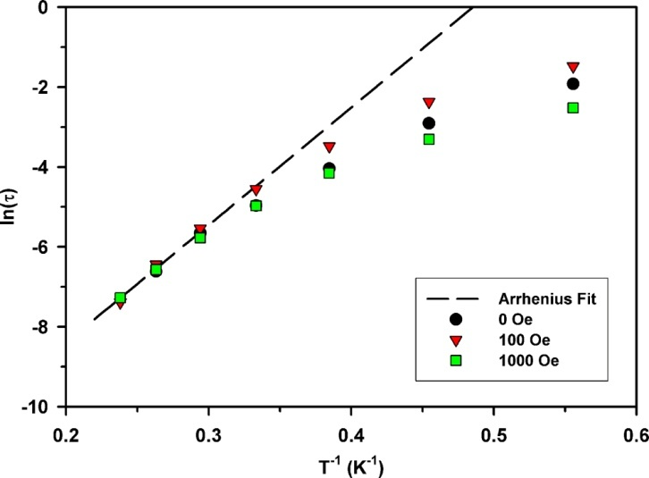
DC Field Dependence of the Relaxation Time
U_{eff} = 20 cm⁻¹ τ₀ = 1x10⁻⁹ s
● relaxation times (τ) obtained by fitting both χ′ and χ′′ between 1-1000 Hz to
a generalized Debye equation
● high temperature linear region defines the thermally-activated regime
Notes:
Here I’m showing the Arrhenius plot we made to try to characterize the process whereby the system was magnetically relaxing. We were able to fit the highest temperature region to give an effective thermal barrier of One particularly interesting aspect of this system was the deviations from Arrhenius behavior at very low temperature. This effect indicated the transition from a thermally activated regime into a quantum regime wherein the relaxation rate is completely independent of temperature. While the thermally activated region remained similar under various applied fields, the relaxation rates in the quantum regime vary significantly with applied field. and the variation is not uniform with applied field. For the plot above it is obvious that at very low temperature the 100 Oe applied dc field leads to the longest relaxation time followed by the zero applied field data and the 1000 Oe field has the shortest relaxation time.

Slide 31
Quantum Effects on Relaxation Times in U(Ph₂BPz₂)₃
1.8 K
• small applied dc fields may break QTM pathways and force the slower process of
thermal relaxation
Notes:
If we look at a single temperature (1.8K) and plot the relaxation time versus applied field we can see that within the low temperature quantum regime there is a drastic increase in the relaxation time under small applied dc fields followed by a gradual downturn. This behavior could be explained by a ground state tunneling pathway which is broken by the application of a field. This behavior is by no means fully characterized, and understanding exactly what is going on will involve a number of different experiments on this and related molecules. Especially interesting is the decrease in relaxation time with applied field at higher fields – this may be due to the fact that the randomly oriented powder samples allow for transverse field components to effect the relaxation rate.

