Slide 1
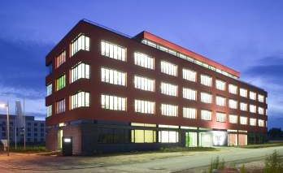
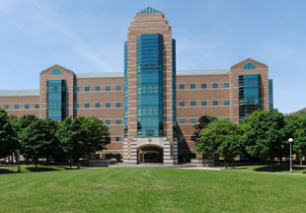
Vision-based magnetoreception system in birds
Ilia A. Solov'yov
Frankfurt Institute for Advanced Studies
Frankfurt am Main, Germany
&
Beckman Institute for Advanced Science and Technology

Slide 2
Overview
Introduction
Discovery of the magnetic sense in birds
Experimental facts about avian magnetoreception
Cryptochrome: a candidate for a magnetoreceptor
Magnetic field response in cryptochrome
Conclusion

Slide 3
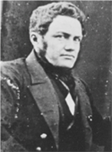
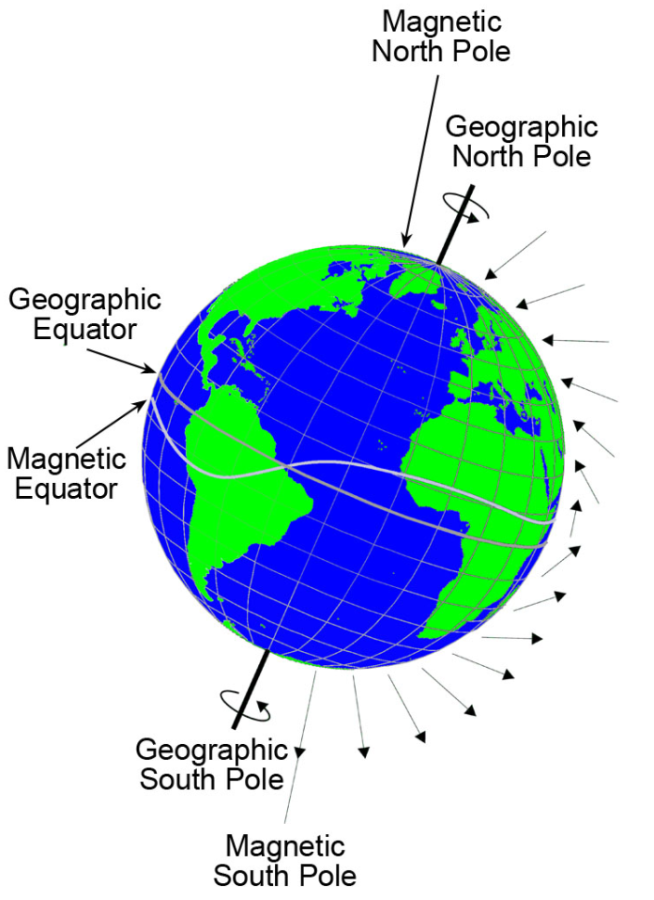
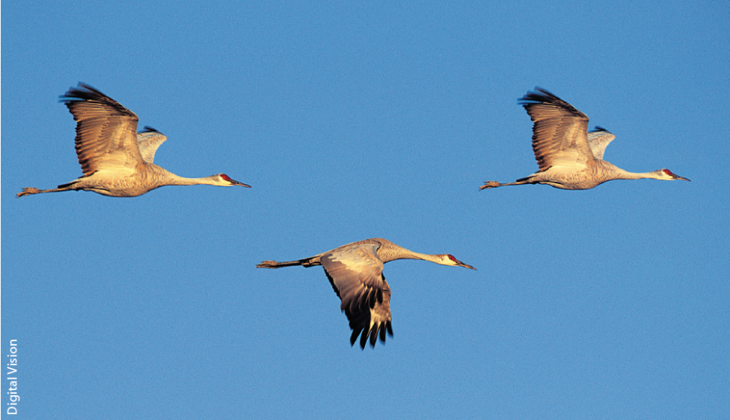
The geomagnetic field
The hypothesis that migrating birds utilize the geomagnetic field for orientation had been proposed as early as 1855.
A. von Middendorff , Mem. Acad. Sci. St. Petersburg VI 95, 71, (1859)
The strength of the magnetic field at the Earth's surface ranges from less than 30 microtesla (0.3 Gauss) in an area including most of South America and South Africa to over 60 microtesla (0.6 Gauss) around the magnetic poles in northern Canada and south of Australia, and in part of Siberia.
A. von Middendorff
1815-1894
1 T =10,000 G
I.A. Solov‘yov, K. Schulten, and W. Greiner, Physik Journal 9, 23 (2010)

Slide 4
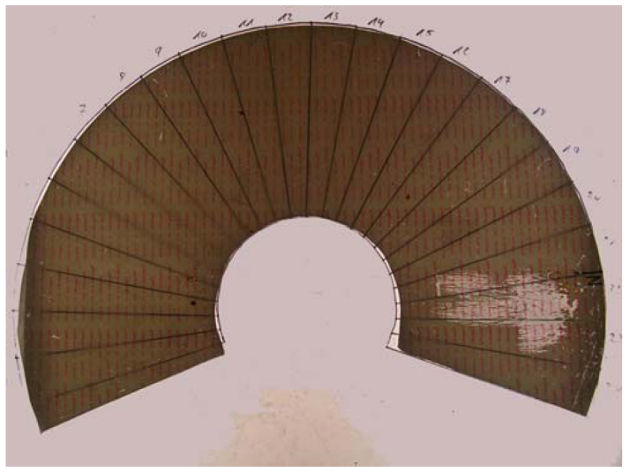
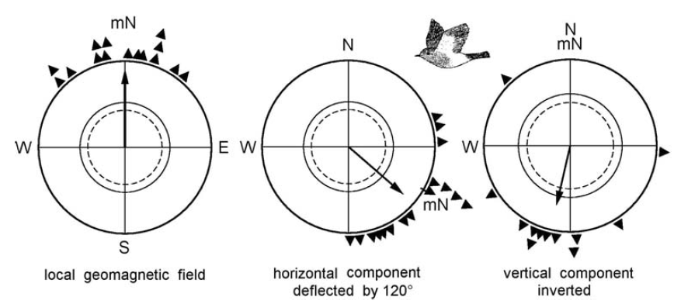
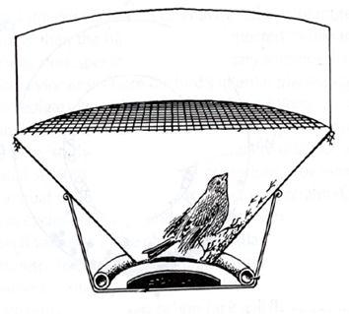
The discovery of magnetic sense
Tip-Ex paper
scratches
European Robin
(Erithacus rubecula)
Merkel and Wiltschko showed that the bird‘s migratory direction can be influenced by applied external magnetic field.
W. Wiltschko and F. Merkel, Verh. Dt. zool. Ges. 59, 362, (1966)
Wiltschko and Wiltschko, Science 176, 62 (1972)
Wiltschko and Wiltschko, J. Comp. Physiol. A. 191, 675 (2005)

Slide 5
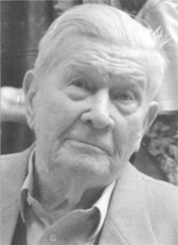
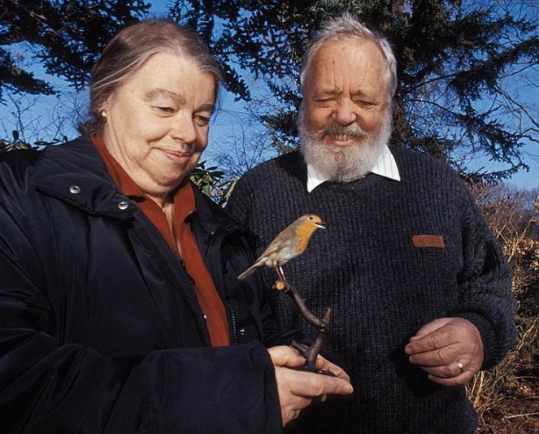
Principle Researchers
Friedrich Wilhelm Merkel, Frankfurt
Roswitha and Wolfgang Wiltschko, Frankfurt

Slide 6
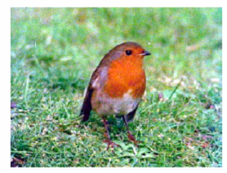
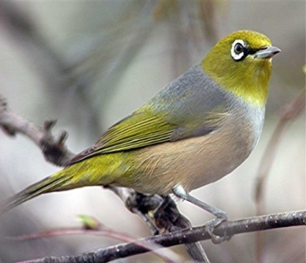
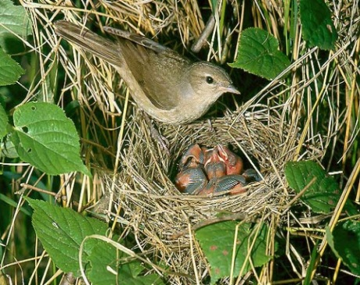
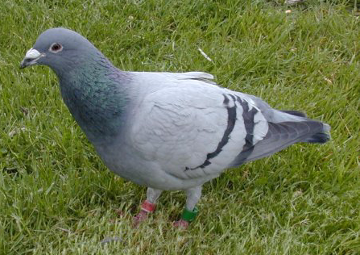
Magnetoreception in Birds
The use of a magnetic compass by migratory birds was first demonstrated for European robins in 1966 in Frankfurt am Main (Germany).
Wiltschko W. and Merkel F., Verh. Dt. zool. Ges., 59, 362 (1966)
European Robin
(Erithacus rubecula)
Australian silvereyes
(Zosterops lateralis)
Garden warblers
(Sylvia borin)
Homing pigeons
(Columba livia)
Later, this sensory capability was demonstrated in 17 further species.
Wiltschko W. and Wiltschko R., J. Exp. Biol. 199, 29 (1996)

Slide 7
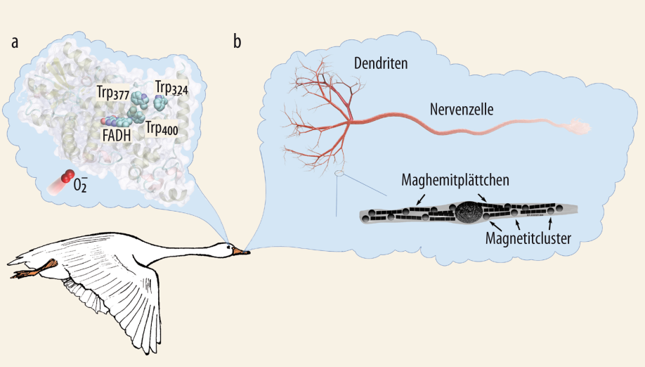
The mechanism is unknown!
Despite an intensive search the mechanism behind the magnetic sense is still unknown!
Most likely two co-existing receptors detecting magnetic field exist in birds. The existence of the two receptors is motivated by behavioral, physiological and histological studies which were performed during the last decades.
The birds have a magnetic field receptor in the eye: a magnetic field sensitive protein.
The magnetic field receptor is in the beak: a structure consisting of magnetic minerals
I.A. Solov‘yov, K. Schulten, and W. Greiner, Physik Journal 9, 23 (2010)

Slide 8
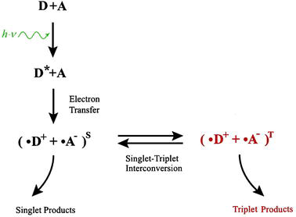
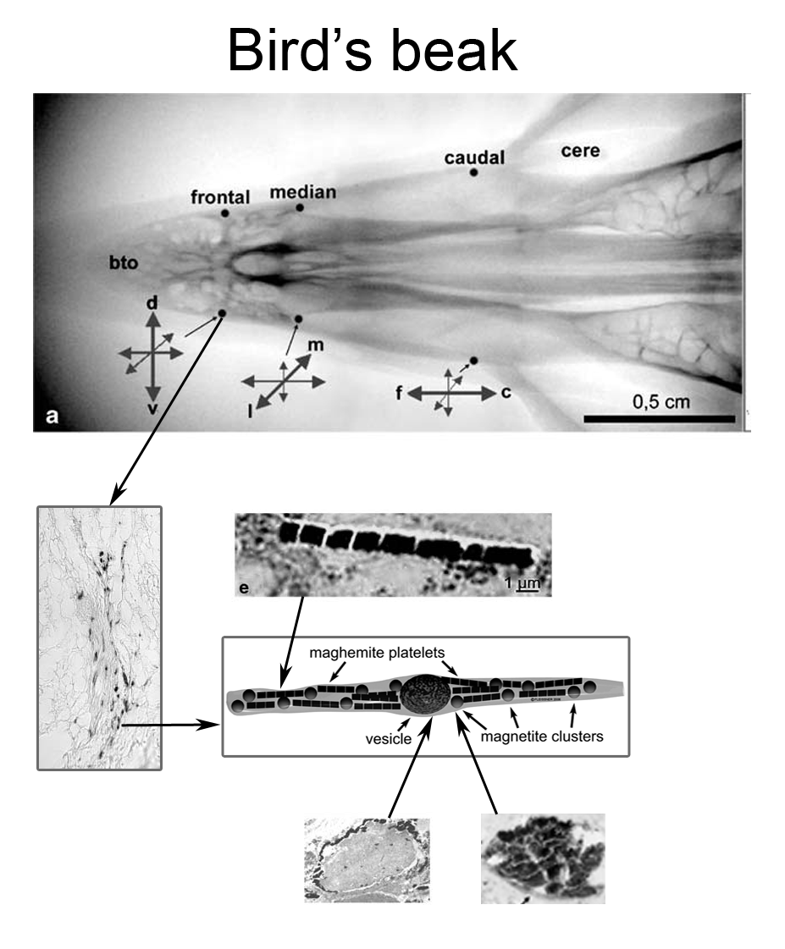
Magnetoreception mechanisms
Radical Pair Mechanism
Iron-mineral based model
Radicals are atoms, molecules or ions with unpaired electrons. These unpaired electrons are usually highly reactive, so radicals are likely to take part in chemical reactions.
Example: ethane (C₂H₆) formation
Reactants in singlet state
Reactants in triplet state
T. Ritz, S. Adem, and K. Schulten, Biophys. J. 78, 707 (2000)
I. Solov‘yov, D. Chandler, K. Schulten, Biophys. J. 92, 2711 (2007)
G. Fleissner, et al, J. Comp. Neur. 458, 350 (2003)
G. Fleissner, et al, Naturwissenschaften 94, 631 (2007)
I. Solov‘yov, W. Greiner, Biophysical J. 93, 1493 (2007)
Quantum Coherent Properties of Spins III

Slide 9
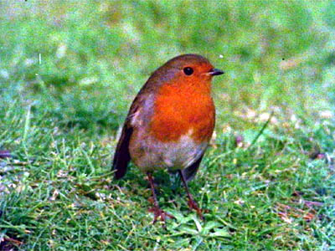
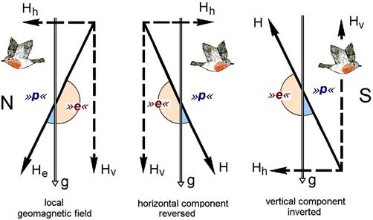
Avian compass is an inclination compass
Perception depends only on the inclination
of the field lines, not the polarity
European robin
Birds must know the direction of “up” to differentiate North from South
R. Wiltschko and W. Wiltschko, Science 176, 62 (1972)
W. Wiltschko, et al, Birkhauuser Verlag Basel, 167 (1993)

Slide 10

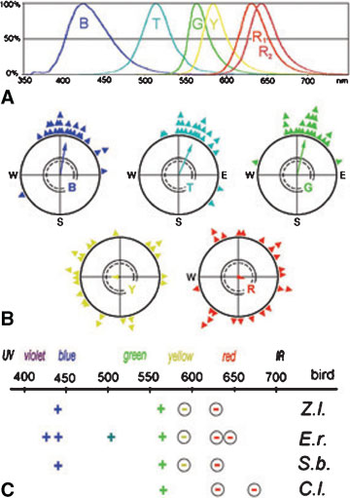


Light-dependent magnetic compass in birds
Wiltschko and Wiltschko, BioEssays 28, 157 (2006)
Australian silvereyes
Australische Silberauge
(Zosterops lateralis)
Z.l.
European Robin
Rotkelchen
(Erithacus rubecula)
E.r.
Garden warblers
Gartengrasmücke
(Sylvia borin)
S.b.
Homing pigeons
Brieftaube
(Columba livia)
C.l.

Slide 11
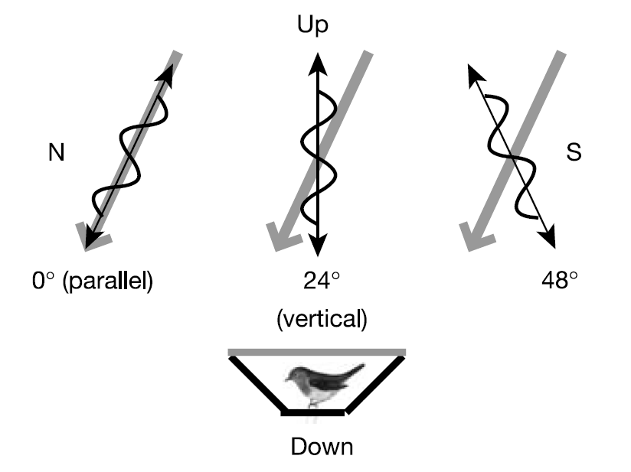
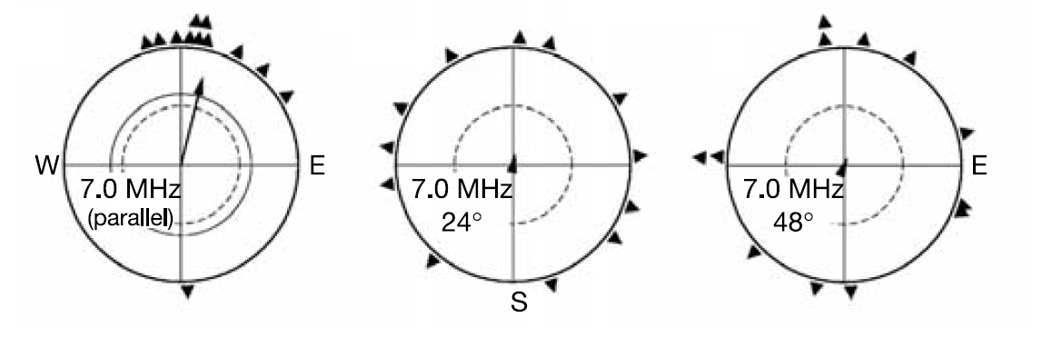
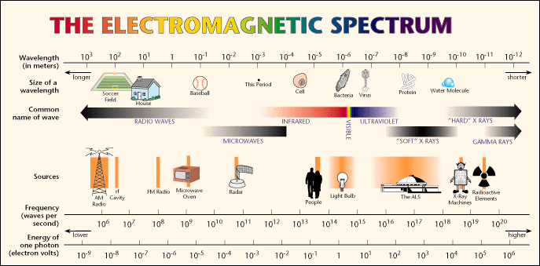
Effect of radio frequency fields
T. Ritz, P. Thalau, J.B. Phillips, R. Wiltschko and W. Wiltschko, Nature 429, 177 (2004)

Slide 12
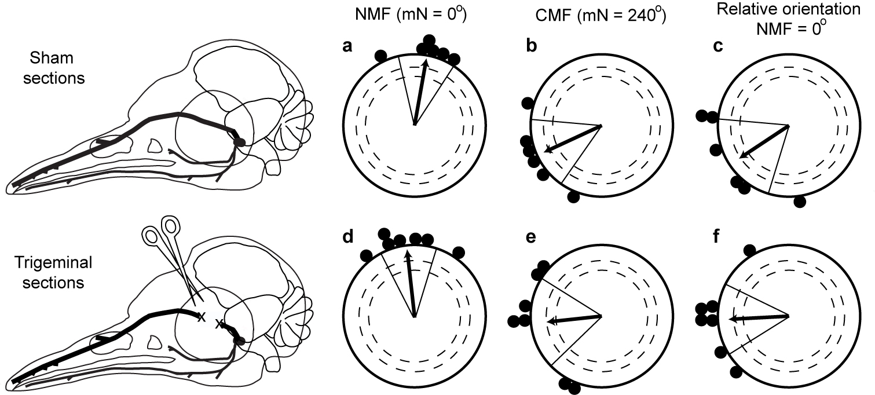
Magnetic compass in the eye
Bilateral sectioning of the opthalmic branch of the trigeminal nerve does not affect magnetic compass orientation in European robins.
M. Zapka, D. Heyers, C.M. Hein, S. Engels, N.L. Schneider, J. Hans, S. Weiler, D. Dreyer, D. Kishkinev, J.M. Wild, H. Mouritsen, Nature 461, 1274, (2009)

Slide 13
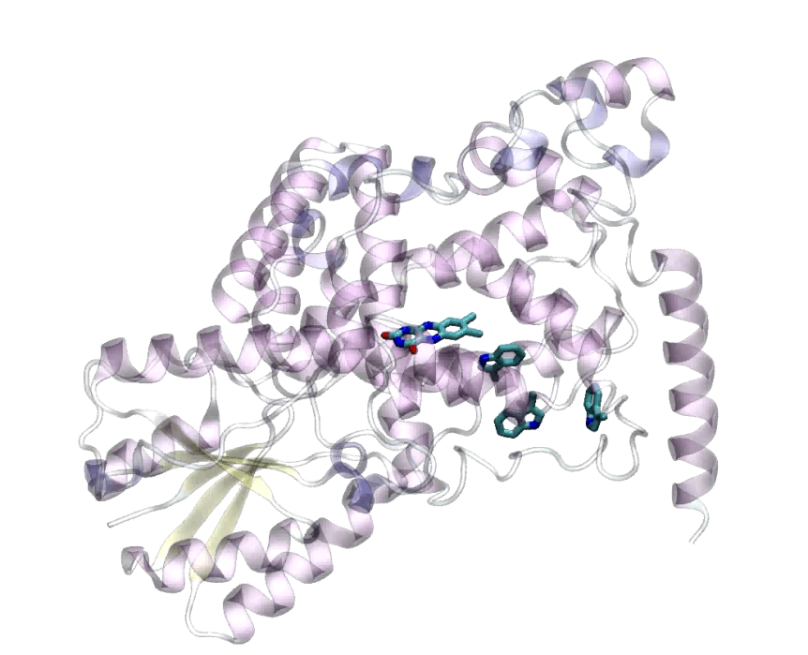
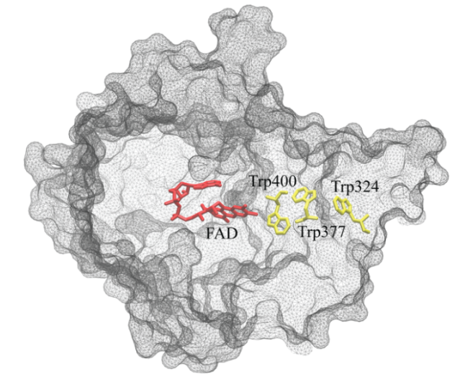
Protein cryptochrome: candidate for a magnetoreceptor
Protein cryptochrome was found localized in the retina of birds eyes.
T. Ritz, S. Adem, and K. Schulten, Biophys. J., 78, 707 (2000)
Cryptochromes are a class of photoreceptor signaling proteins which are found in a wide variety of organisms and which primarily perform regulatory functions, such as the entrainment of circadian rhythm in mammals and the inhibition of hypocotyl (stem) growth in plants.
Cryptochrome is a signaling protein containing the blue light absorbing chromophore flavin adenine dinucleotide (FAD).
I.A. Solov‘yov, D.E. Chandler, and K. Schulten, Biophys. J. 92, 2711 (2007)

Slide 14
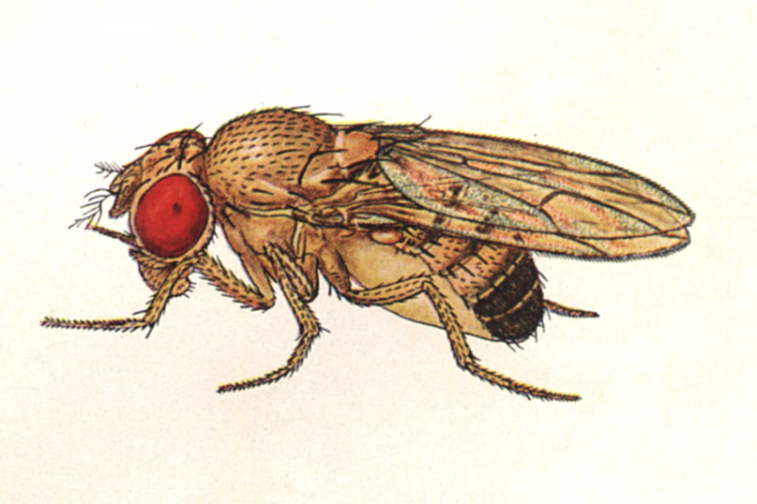
Why cryptochrome?
Is activated by blue light
Exist in many (if not all) living organisms
Magnetic field effects in cryptochrome were observed indirectly in plants and drosophila, where the mutated, cryptochrome-free, organisms did not react to applied magnetic field contrary to the normal (non mutated) species
Exists in retina of birds, and thus may form ordered arrays, necessary for the magnetic compass
Can form radical pairs (not all proteins can)

Slide 15

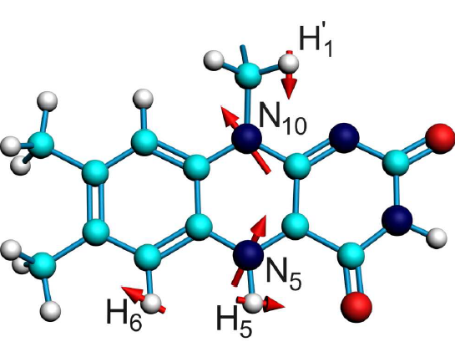
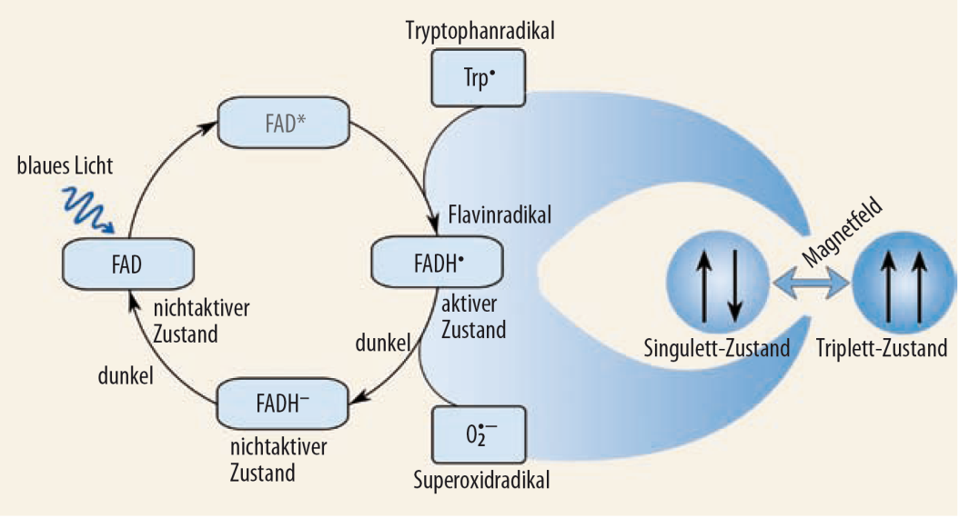
Cryptochrome active center
FADH
I.A. Solov‘yov, D.E. Chandler, and K. Schulten, Biophys. J. 92, 2711 (2007)

Slide 16
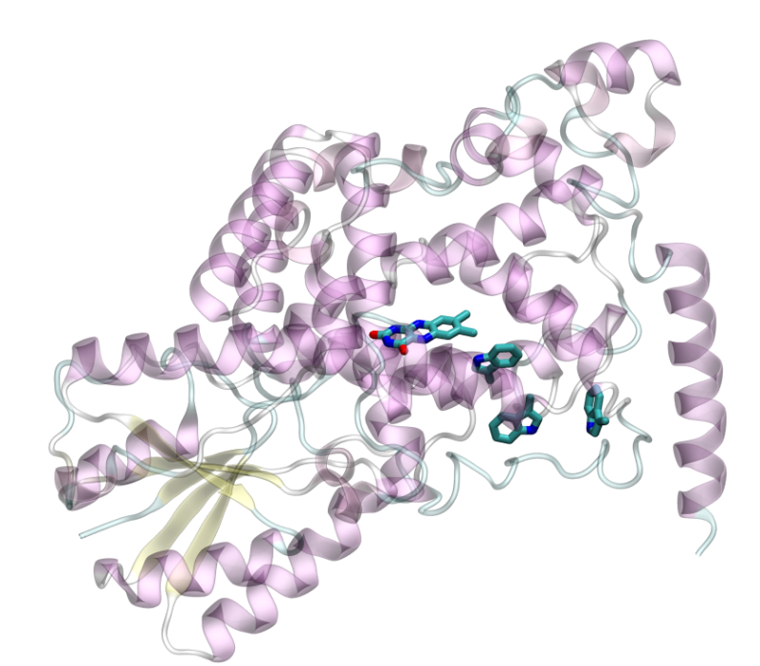



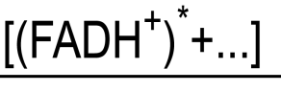






Cryptochrome signaling state
Cryptochrome is in its activated (signaling) state when the FAD cofactor is in the semireduced FADH state.
FAD is reduced through a series of light-induced electron transfers from a chain of three tryptophan residues: Trp₄₀₀, Trp₃₇₇, and Trp₃₂₄.
Signaling state

Slide 17

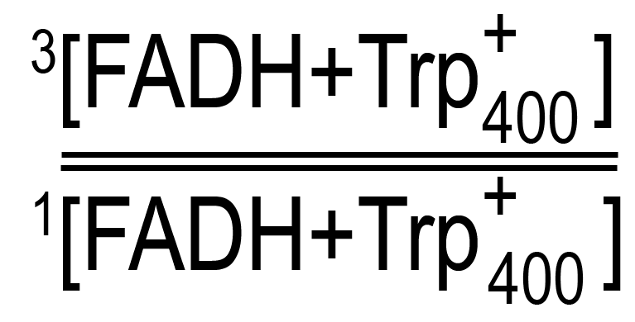
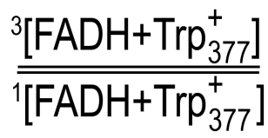
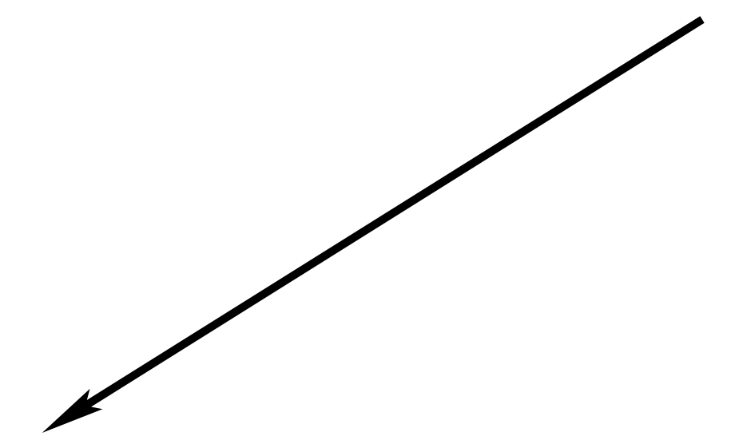
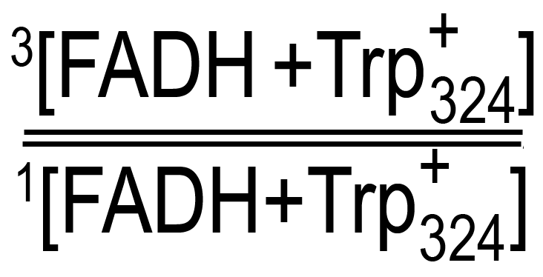
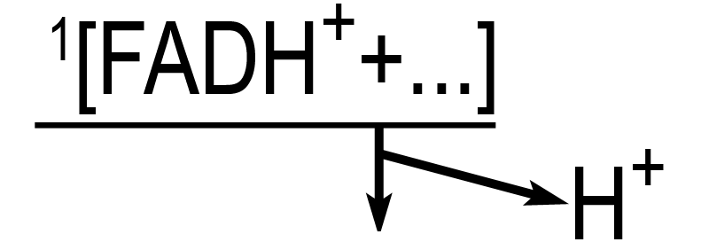
Magnetic field effect in cryptochrome
The electron spins of the radical pair precess about a local magnetic field produced by the addition of the external magnetic field and contributions from the nuclear spins on the two radicals. The spin precession continuously alters the relative spin orientation, causing the singlet (anti-parallel)↔triplet (parallel) interconversion which underlies the magnetic field effect.
Cryptochrome is in its activated (signaling) state when the FAD cofactor is in the semireduced FADH state.
FAD is reduced through a series of light-induced electron transfers from a chain of three tryptophan residues: Trp₄₀₀, Trp₃₇₇, and Trp₃₂₄.
The concentration of cryptochromes in the signaling state can be influenced by external magnetic field

Slide 18
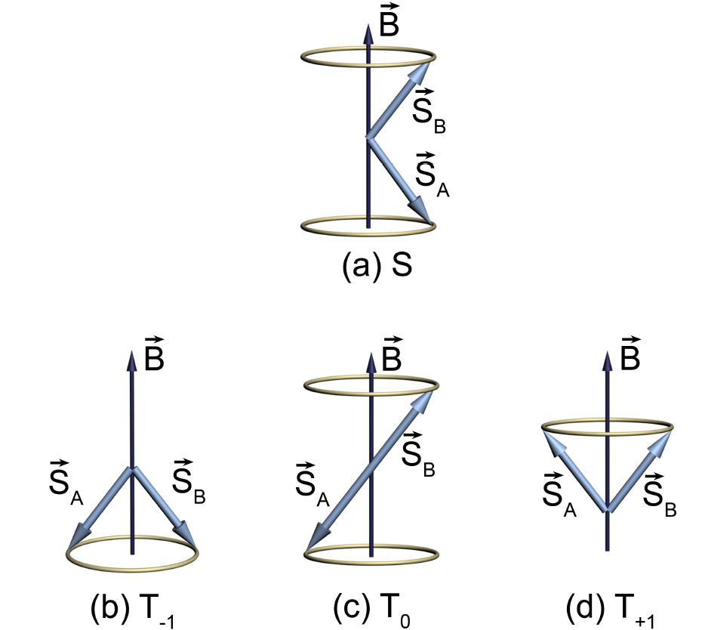
Spin-flip transitions
Singlet state
Spins of the radical pair
Magnetic field vector (local field, created by the nuclei of the atoms plus the external field)
Three triplet states
If the spins precess with different angular velocity the “S-state” may be transformed in the “T₀-state” after some characteristic time
Figure from: I.A. Solov‘yov, PhD thesis (2008)

Slide 19
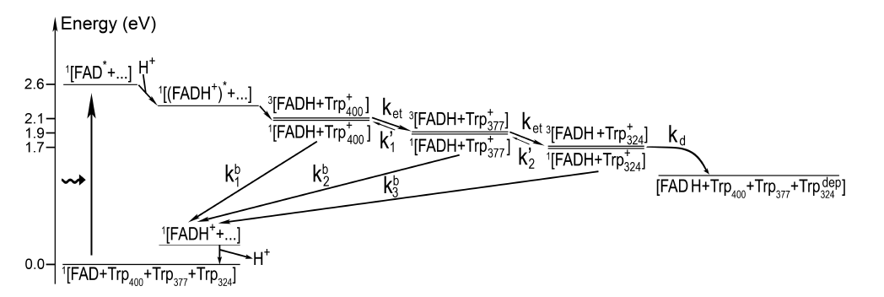
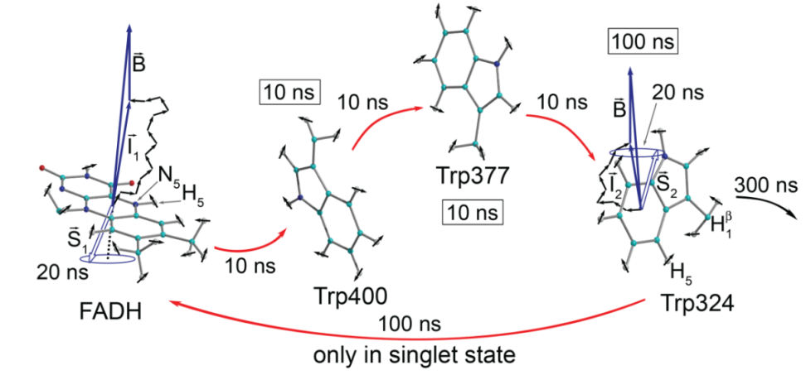
Characterizing cryptochrome active state
The dynamics of the three radical pairs ^{1,3}[FADH+Trp₄₀₀⁺], ^{1,3}[FADH+Trp₃₇₇⁺], and ^{1,3}[FADH+Trp₃₂₄⁺], can be described by the density matrices, ρ₁, ρ₂, and ρ₃.
ρ₁
ρ₂
ρ₃
I. A. Solov‘yov, D. Chandler, K. Schulten, Biophys. J., 92, 2711 (2007);
I. A. Solov‘yov, D. Chandler, K. Schulten, Plant Signaling & Behavior, 3, 676 (2008).

Slide 20
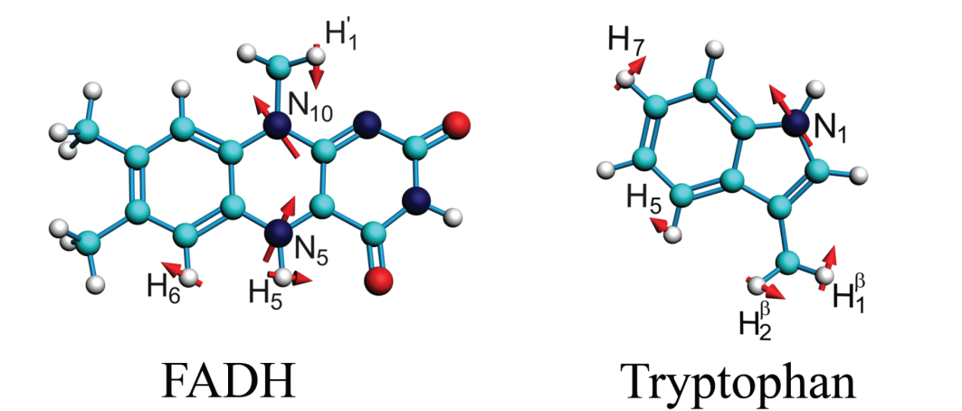
Radical pair mechanism in cryptochrome
Spins of the nuclei create an intrinsic
magnetic field
1) Define radical pair Hamiltonian
2) Solve stochastic Liouville equations
projection operators
Singlet-triplet interconversion
Different kinetic processes
initial conditions
I. Solov‘yov, D. Chandler, and K. Schulten, Biophys. J., 92, 2711 (2007)

Slide 21
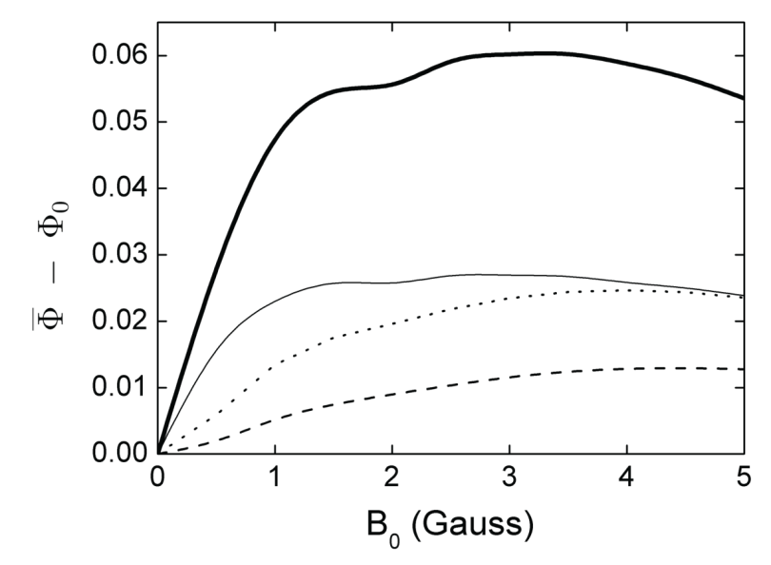
Activation yield of cryptochrome
Calculate Cryptochrome Activation Yield
Variation of Activation Yield with Magnetic Field Strength
Activation yield = density that reaches the final (FADH+Trp324), stabilized, signalling state
cryptochrome activation is affected by external magnetic field strength
exact dependence is highly sensitive to the hyperfine coupling constants of the selected nuclei, and to electron back-transfer rates
Maximum variation at B₀ = 5 G: 10%
I. Solov‘yov, D. Chandler, and K. Schulten, Biophys. J., 92, 2711 (2007)

Slide 22
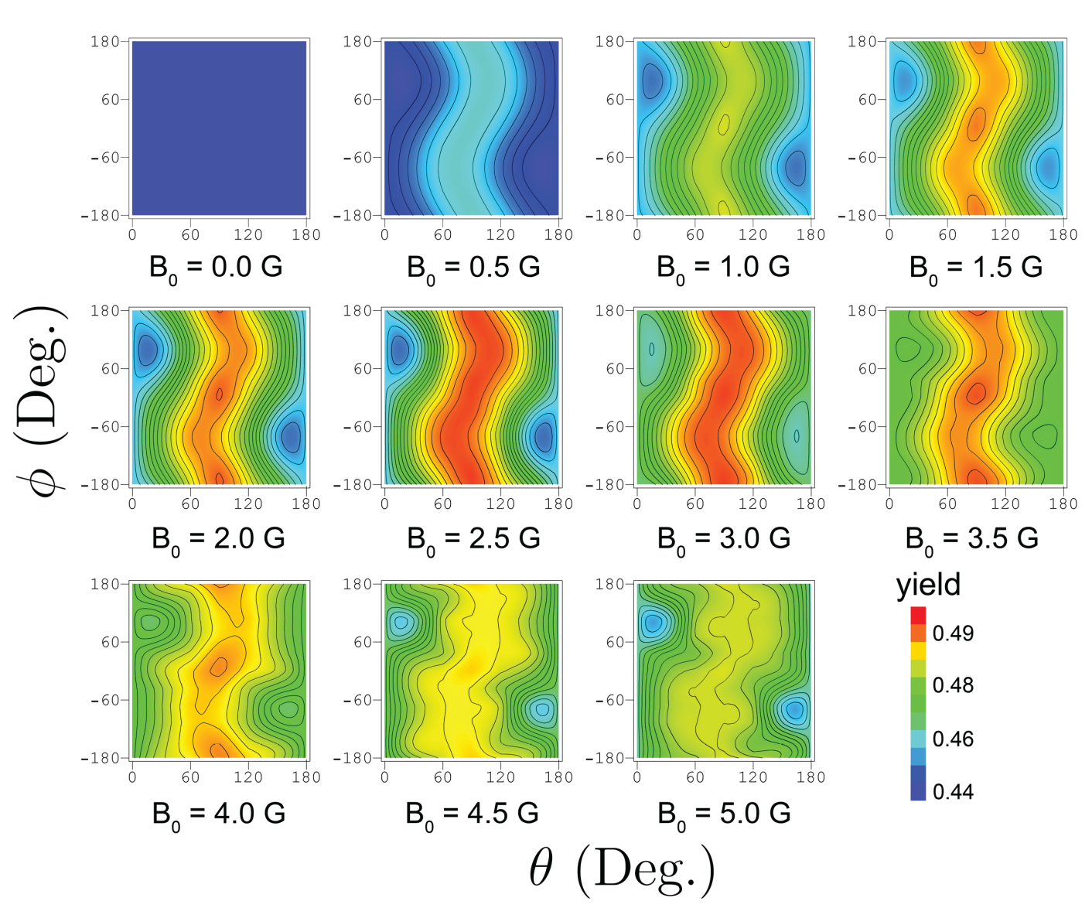
Angular dependence of cry-activation
Cryptochrome activation rate can be calculated as follows:
Symmetry of the angular dependence is consistent with an inclination compass condition
Maxima and minima caused by anisotropic hyperfine coupling tensors of the nuclei
I. Solov‘yov, D. Chandler, and K. Schulten, Biophys. J., 92, 2711 (2007)

Slide 23
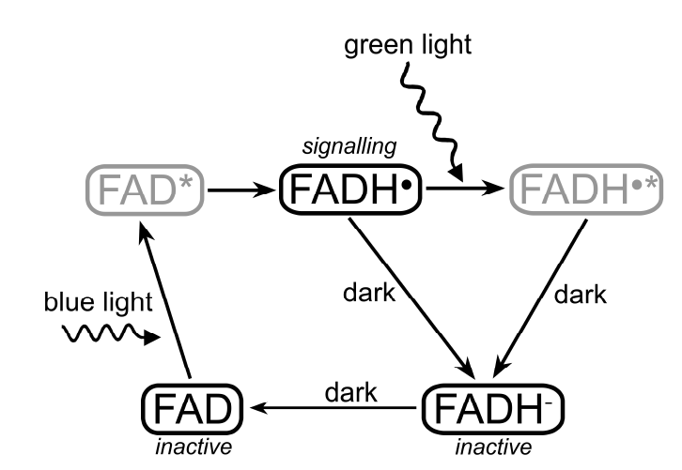
Photoactivation and dark deactivation in cryptochrome
I.A. Solov‘yov, D.E. Chandler, and K. Schulten, Biophys. J. 92, 2711 (2007)
magnetic field dependence 1
I.A. Solov‘yov and K. Schulten, Biophysical J. 96, 4804 (2009)
magnetic field dependence 2
Cryptochrome is observed in three states: FAD, FADH and FADH⁻

Slide 24
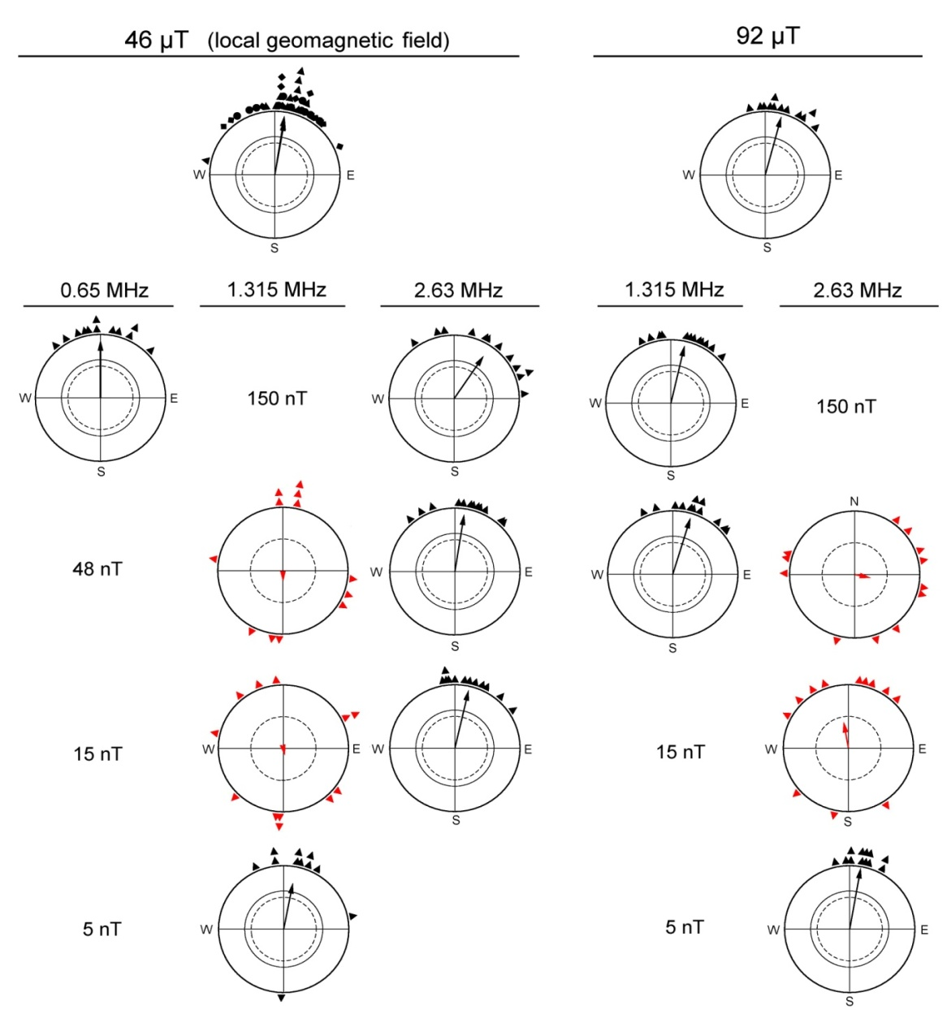

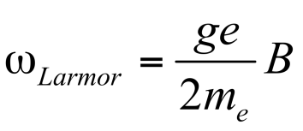
Key hint for dark deactivation mechanism derived from bird behavior in radio frequency fields
E
spin up/down
B
For an electron:
Disorientation at 1.315 MHz
→ precisely the Larmor frequency of an electron in the 0.47 G magnetic field.
Can be explained in a radical pair reaction, where one radical is devoid of hyperfine interaction.
T. Ritz, R. Wiltschko, P.J. Hore, C.T. Rodgers, K. Stapput, P. Thalau, C. Timmel. W. Wiltschko, Biophys J 96, 3451 (2009)

Slide 25
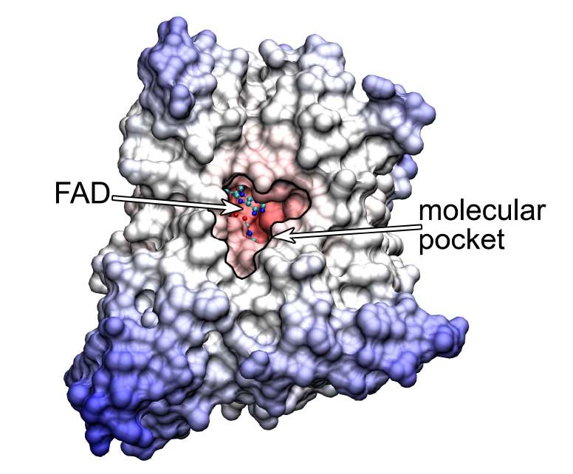
Molecular pocket of cryptochrome
Structure of Arabidopsis thaliana cryptochrome-1. Shown is the solute accessible surface of cryptochrome.
The molecular pocket directed towards the FAD cofactor is clearly visible.
I.A. Solov‘yov and K. Schulten, Biophysical Journal 96, 4804 (2009)

Slide 26
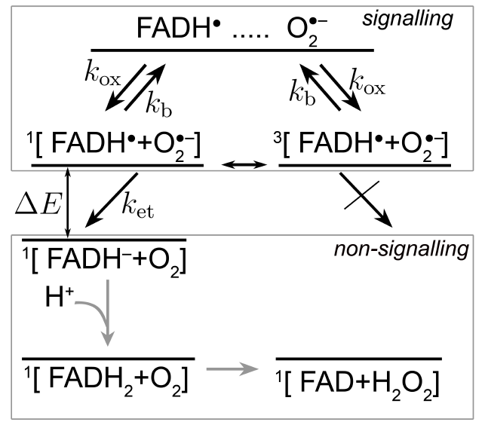
The dark reaction in cryptochrome
Calculated value
ΔE≈0.37 eV ≈ 8.53 kcal/mol
I.A. Solov‘yov and K. Schulten, Biophysical Journal 96, 4804 (2009)

Slide 27
Spin dynamics in the dark reaction
The spin dynamics of the radical pair can be described by the density matrix, ρ
ρ
I.A. Solov‘yov and K. Schulten, Biophysical Journal 96, 4804 (2009)

Slide 28


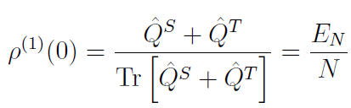
Stochastic Liouville equation
The time evolution of the density matrix is governed by the stochastic Liouville equation
Spin interconversion
O₂⁻ escape from molecular pocket
Electron transfer
Initial condition
at first encounter of the radicals
I.A. Solov‘yov and K. Schulten, Biophysical Journal 96, 4804 (2009)

Slide 29

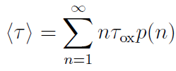

Duration of the dark reaction
The duration time of the dark reaction in cryptochrome
formation probability of FADH⁻ after the n-th encounter of FADH and an O₂⁻ radicals
describes the time needed for n attempts of forming an [FADH+O₂⁻]
radical pair
α - probability that after the first encounter of FADH+O₂⁻ the FADH molecule is reduced and cryptochrome stops signalling. It is depends on the external magnetic field and is determined by the density matrix ρ.
Observable:
duration of the
RedOx reaction
I.A. Solov‘yov and K. Schulten, Biophysical Journal 96, 4804 (2009)

Slide 30
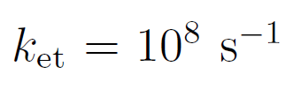






Rate constants
The rate constants for different processes are expected to be
Characteristic time of electron transfer in proteins is about 10 ns.
Characteristic time life time of a radical pair is about 1 μs.
oxygen diffusion coefficient in water
size of molecular pocket in cryptochrome
=3 nM typical concentration of superoxide in the cell
I.A. Solov‘yov and K. Schulten, Biophysical Journal 96, 4804 (2009)

Slide 31


Magnetic field effect in the dark reaction
Consider fixed orientation
reaction duration in zero field
Largest effect for the favorable rate constants
I.A. Solov‘yov and K. Schulten, Biophysical Journal 96, 4804 (2009)

Slide 32

Magnetic field effect due to reorientation of the applied field
Consider fixed field
reaction duration at θ=0°
→ provides an inclination compass, because the response at angles θ and 180- θ is equal.
The angular dependence of the reaction duration time satisfies the inclination compass conditions.
The maximal variation in <τ> is 17 %.
I.A. Solov‘yov and K. Schulten, Biophysical Journal 96, 4804 (2009)
I.A. Solov‘yov and K. Schulten, Biophys. J, submitted (2009)

Slide 33

The duration of the back reaction in cryptochrome
Magnetic field effects can be larger if a more realistic model is used (the suggested model is still qualitative).
Non monotonic behavior indicates that there exist a functionanality window (the compass changes its properties if the intensity of the magnetic field is changed)
I.A. Solov‘yov and K. Schulten, Biophysical Journal 96, 4804 (2009)

Slide 34

Vision based magnetoreception system
An eye percieves visual information, because rhodopsins form ordered arrays in the photoreceptor cells.
In order for cryptochrome (or any other magnetic field sensitive protein) to percieve magnetic field a certain ordering is neccessary.
I.A. Solov‘yov, H. Mouritsen, and K. Schulten, Biophys. J. 99, 40 (2010)

Slide 35


A view from bird‘s flight altitude
I.A. Solov‘yov, H. Mouritsen, and K. Schulten, Biophys. J. 99, 40 (2010)

Slide 36

Magnetic field mediated vision
Modulation patterns of the visual field of a bird calculated for different wiggling regimes of cryptochrome in the retina, characterized by the parameter ε₀
ε₀ = 100
ε₀ = 10
ε₀ = 3
ε₀ = 1
I.A. Solov‘yov, H. Mouritsen, and K. Schulten, Biophys. J. 99, 40 (2010)

Slide 37

Conclusion
Birds use Earth‘s magnetic field for navigation during the bianual migration periods
The magnetic field receptor is complicated and consist of two parts located in the beak and in the eye of a bird
The receptor in the beak is responsible for detecting variations of the magnetic field, i.e. rendering the magnetic map
The receptor in the eye provides a bird with a light-dependent magnetic compass

Slide 38











Magnetoreception mechanism should be universal!
Bacteria
Pigeons (Birds)
Bats
Drosophila
Fish
Robins (Birds)
Newts
Turtles
Cows
Deers
Bees

Slide 39







Acknowledgements
Prof. Dr. Klaus Schulten
Prof. Dr. Henrik Mouritsen
Prof. Dr. Walter Greiner
Prof. Dr. Andrey Solov‘yov
Dr. Alexander Yakubovich
Dr. Andrey Korol
Mrs. Vita Solovyeva

Slide 41

Influence of strong magnetic fields
B=0.46 G
B=0.92 G
Orientation of European robins during autumn migration.
The triangles at the periphery of the circles mark the mean headings of individual birds.
W. Wiltschko, K. Stapput, P. Thalau, R. Wiltschko, Naturwissenschaften 93, 300 (2006).

