Slide 1
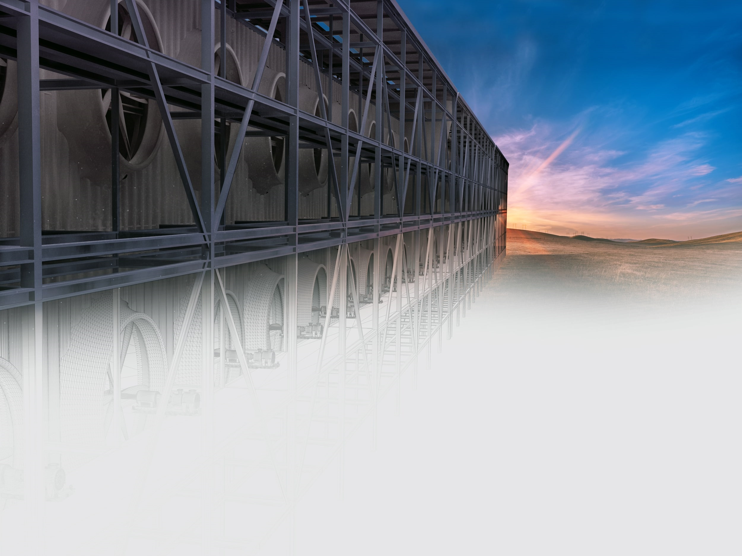

Air to FuelsTM and Negative Emissions
An Economic and Environmental Solution
Carbon Engineering Ltd.
Daniel Friedmann, Chairman
October 2019
Notes:
emerging opportunity that has the potential to transform the transportation fuels market
technology platform that combines abundant resources like sunlight, air, and water to produce carbon neutral synthetic fuels including diesel and jet fuel that are compatible with todays engines and infrastructure.
4 key things:
-Importance of problem and scale of the opportunity
-The leadership position we have in Direct Air Capture
-Convergence of factors which make this the right time to commercialize Air to Fuels
-Invitation to invest in CE and partner with us to bring Air to Fuels to China

Slide 2
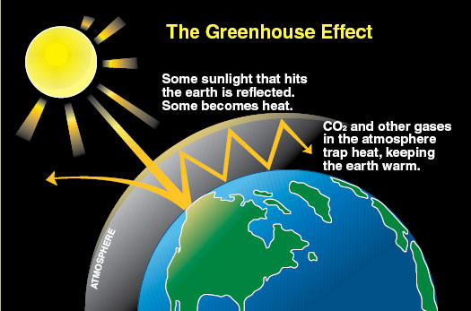

2

Slide 3
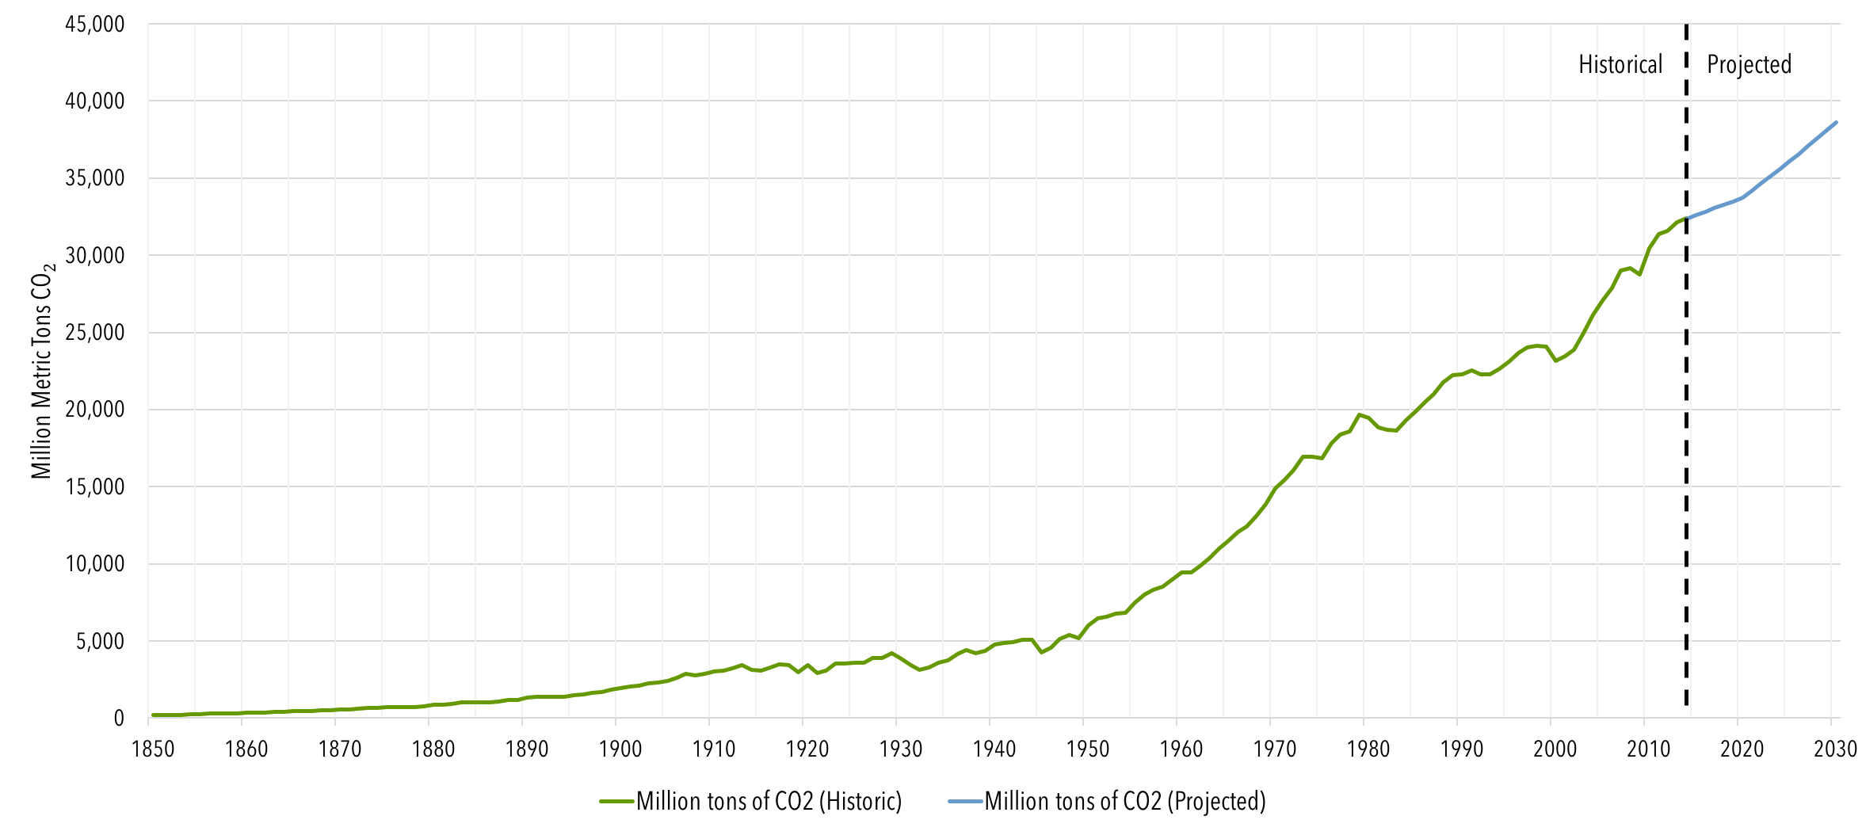
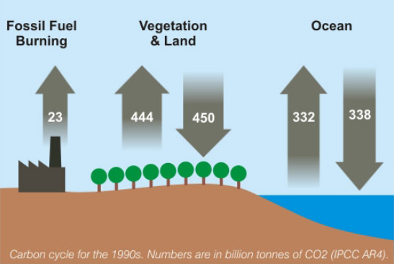
3
Global Carbon Dioxide (CO₂) Emission, 1850-2030

Slide 4
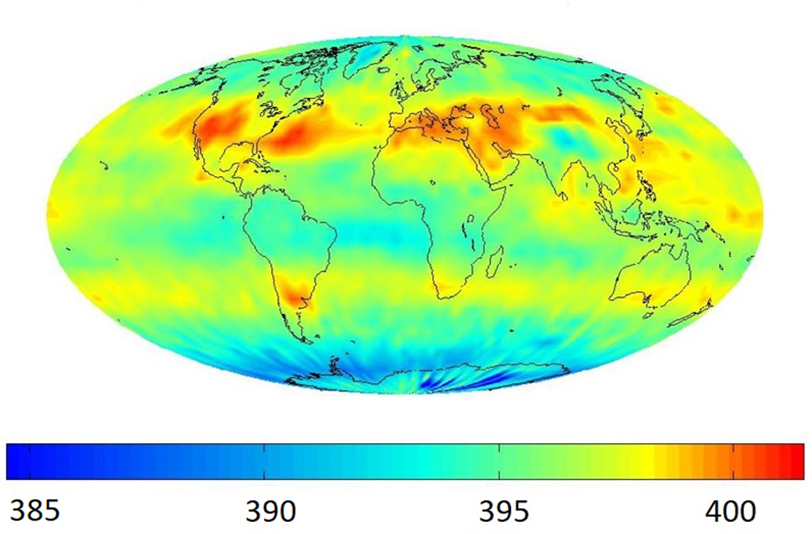
4
Carbon Dioxide (CO₂) in the Atmosphere (ppm i.e. 400 = 0.04%)

Slide 5
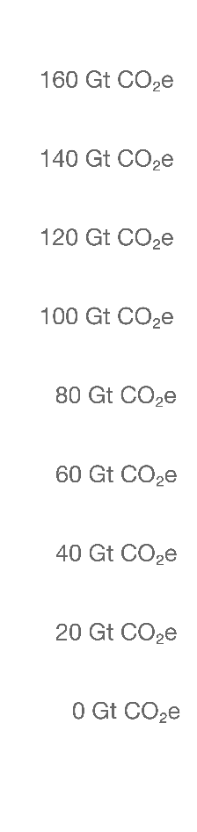
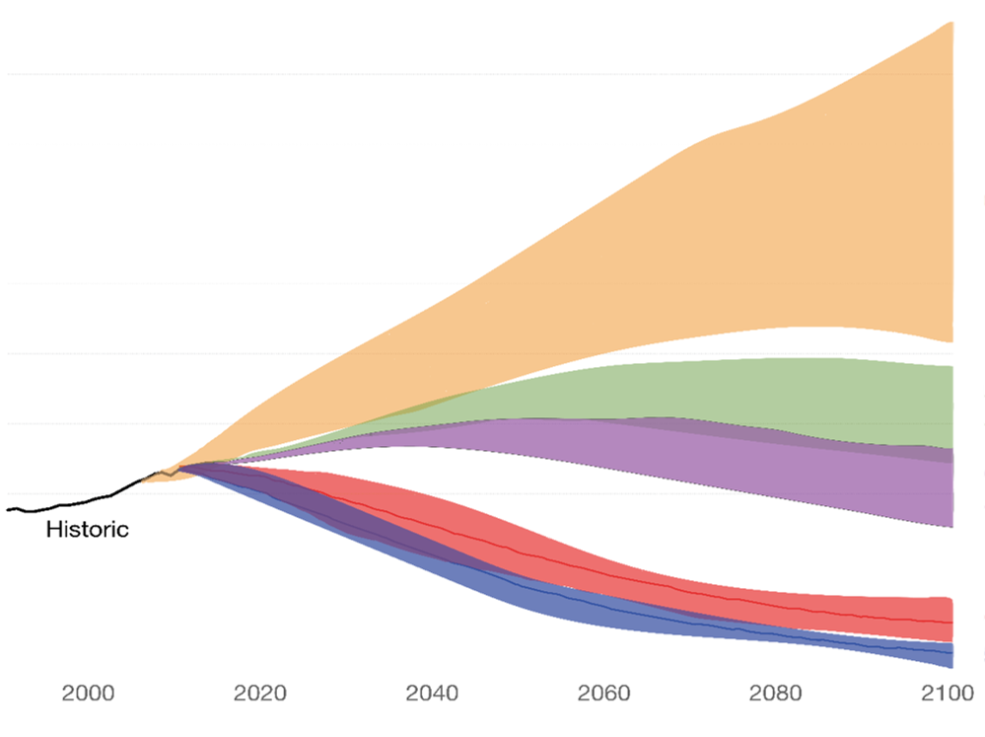
5
The Impact of CO₂ on Global Temperatures
No climate policies
(4.1-4.8ºC)
If current policies are met
(3.1-3.7ºC)
If Paris pledges are met
(2.6-3.2ºC)
2ºC pathways
1.5ºC pathways
1947
Even if we got to zero global emissions in 2100, we will warm beyond the 2 degrees safe range.
We are *not* on track to get to zero emissions by 2100…
Carbon Engineering Ltd.

Slide 6
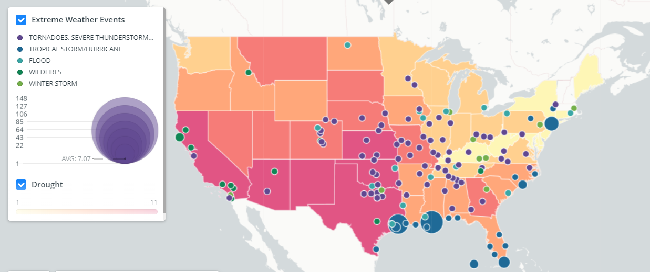
6
Not Just Global Warming, but also Severe Weather
One of the most visible consequences of a warming world is an increase in the intensity and frequency of extreme weather events.
For example, the number of heat waves, heavy downpours, and major hurricanes has increased in the US, and the strength of these events has increased, too.
EXTREME WEATHER EVENTS 2000-2019
Source: Center for Climate and Energy Solutions

Slide 7






7
Decarbonization- A Global Imperative
All mitigation scenarios require a solution to transportation and large-scale negative emissions
Transportation is mobile – very challenging to collect carbon emissions at source – and huge investment in existing infrastructure
Carbon Engineering Ltd.
It’s impossible to get to zero emissions ever and certainly not in time
If only we could put some atmospheric CO2 back underground
440 Bn gallons of Liquid Fuels used annually – a trillion $ market
Trillion dollar infrastructure providing fuel for transportation
If only we could make fuel out of thin air
Carbon Engineering Ltd.

Slide 8
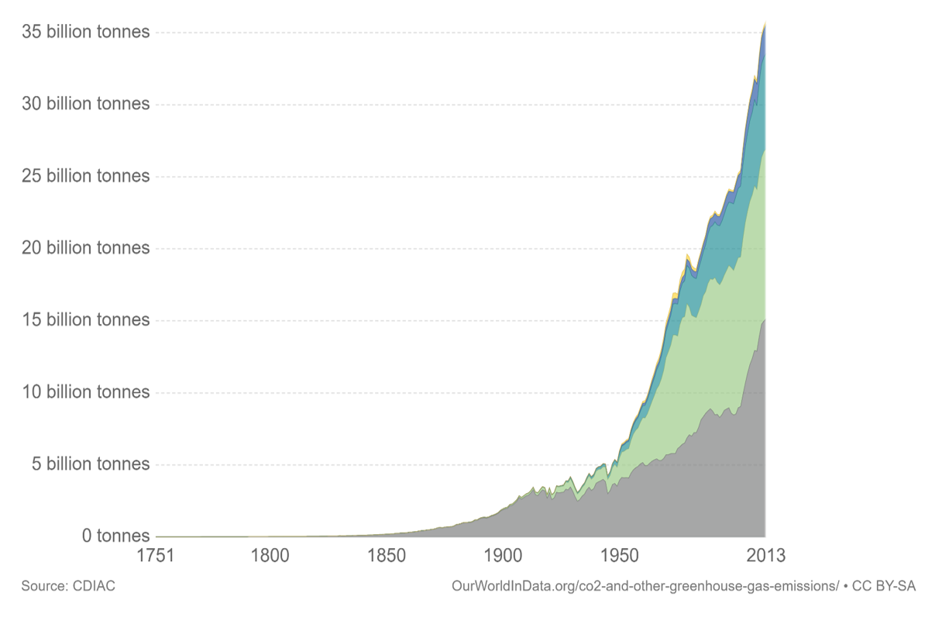
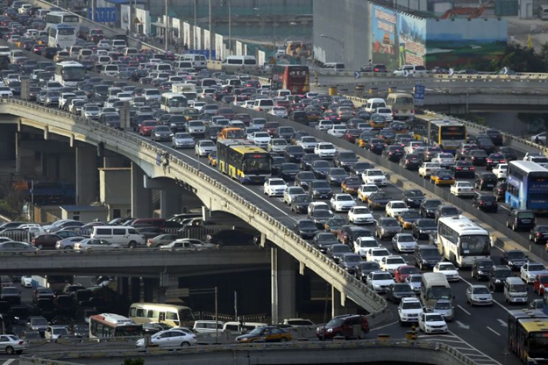
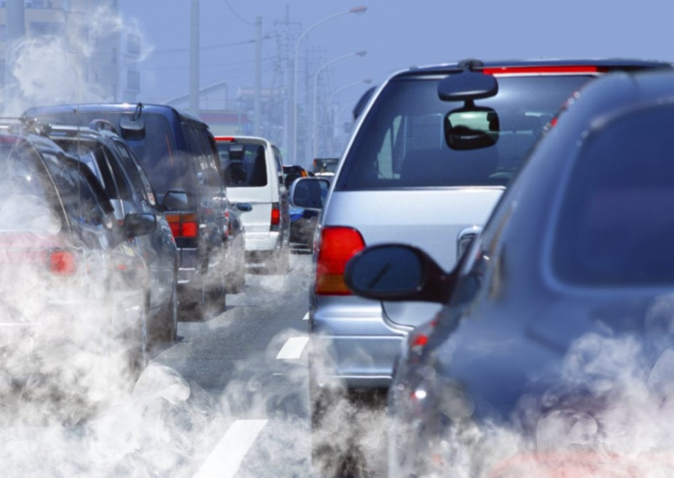
8
Transportation – A Growing Contributor to Global Warming
CO2 from liquid fuel
Carbon Engineering Ltd.
CO₂ from natural gas, CO₂ from liquid fuel, CO₂ from solid fuel (e.g., coal)

Slide 9
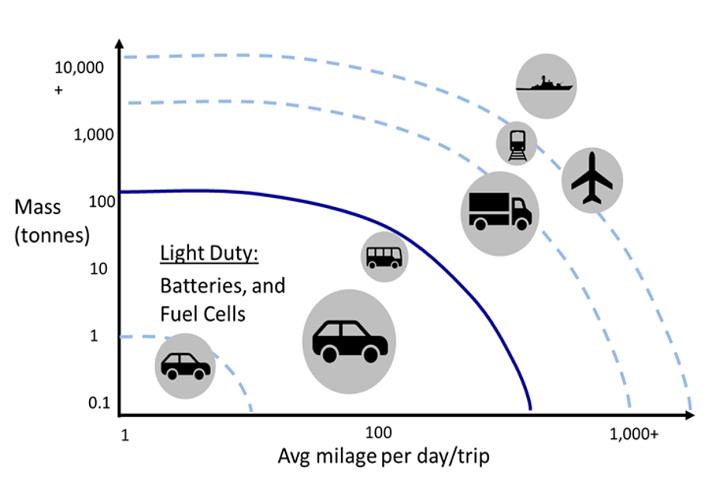
9
How to Address Transportation?
Carbon Engineering Ltd.
Heavy Duty Transportation represents ~50% of transportation emissions today and more in the future

Slide 10


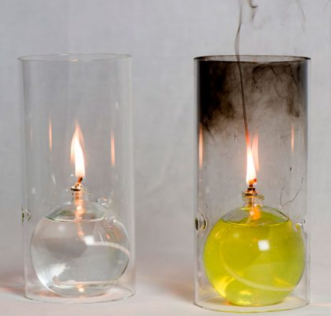


10
‘Air to Fuels’ and Sequestration Solution – A Convergence of Innovations
Key Enablers
CE AIR TO FUELS™ Platform
Sequester carbon
CE Direct Air Capture Technology
DAC
Fuel Synthesis
Abundant Low Cost, but
intermittent, Renewable Power
Electrolysis + H2 Storage
Advances in Electrolysis
Make clean fuel

Slide 11
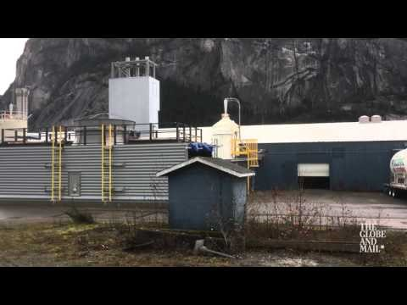
Carbon Engineering Ltd.

Slide 12
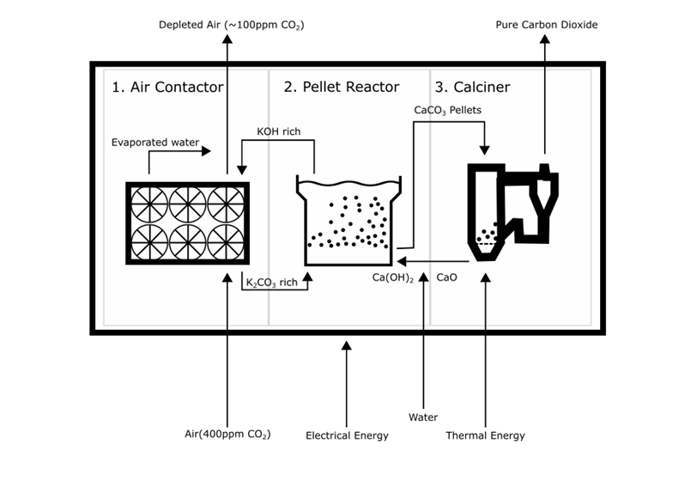
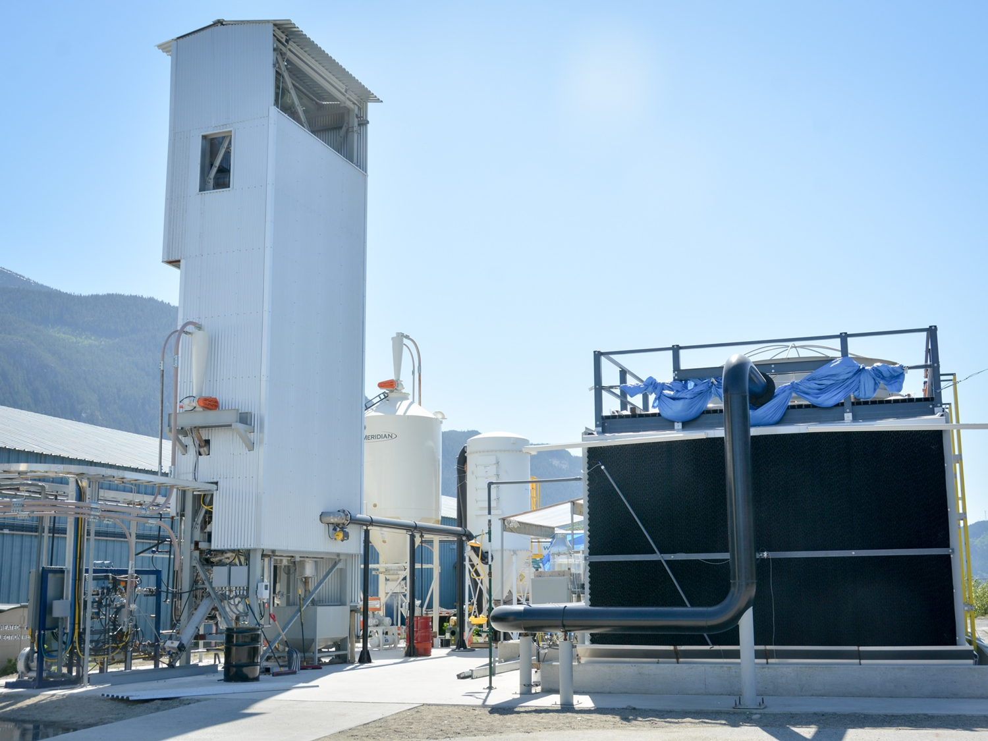
12
Direct Air Capture – the Key Capability

Slide 13
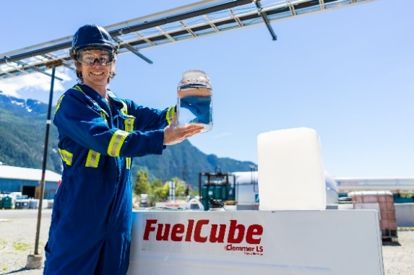
13
Our First Fuel – Spectrum of Hydrocarbons
Diesel
Gasoline
Jet-A
Waxes and other products

Slide 14
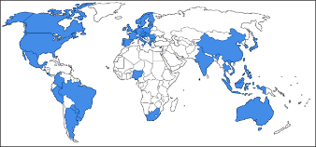
14
Government Policy Landscape Fuels
Over 25 countries now have clean fuel blending targets or regulations
  Existing regulations have created a renewable diesel market that has doubled in 5 years to 11 billion gallons/yr
  These regulations are intended to be perpetual, and generally increase in stringency over time
Established Credit-based Program / Market | Impact on CE price ¹
British Columbia Renewable & Low Carbon Fuel Requirement | $0.52
California Low Carbon Fuel Standard (LCFS) | $0.58
U.S. EPA Renewable Fuel Standard – D7 RIN | $1.06
U.S. 45Q Tax Credit– Sequestration Use Case Utilization Use Case | $0.15 $0.11
Wholesale Diesel Price | $0.53
CA:
$2.40
¹ 2018 values, except 45Q figures which based on 2026 schedule. With air as an eligible feedstock under RFS.

Slide 15
15
Government Policy Landscape Sequestration
Regulations are in place globally to govern safe and secure operation of CO₂ storage projects:
  North America and Australia have the most mature policies.
  New regulations and policies have been growing annually worldwide.
  California LCFS is the leading market for revenue.
Established Credit-based Program / Market | Impact on CE price ¹
US EPA 45Q Tax credit $50/t-CO2 for Sequestration | $50
California Low Carbon Fuel Standard (LCFS) 2019: California Air Resources Board included CO₂ sequestration in LCFS credit system Direct Air Capture has no geographic limitation LCFS price >$190/t-CO2, expected for foreseeable future | $190
CA:
$240
¹ 2019 values
“All pathways that limit global warming to 1.5°C... project the use of carbon dioxide removal on the order of 100–1000 GTCO₂ over the 21ST century.” – Intergovernmental Panel on Climate Change, 2018

Slide 16





16
Commercialization
Timeline
Plants
2009 – 2014
Plant | Fuel | Sequestration
Output | 2000 bbl/d | 1 million tons CO₂/yr
Cost | $350M | $800M
Power | 300 MW Renewable Power | 50 MW Renewable Power plus 15,000 GJ/d NG
Space | 30 acres | 150-300 acres
Technology Development
2015 – 2016
Direct Air Capture Pilot
AIR TO FUELS™ Feasibility
2016 – 2017
AIR TO FUELS™ Pilot
2018 – 2021
400,000 acres of trees sequester 1 million tons per year
Commercial Validation Plant
Customer Engagement
Commercial Plant design
2021 or earlier
Commercial Deployment
Plant sized for customer need

Slide 17
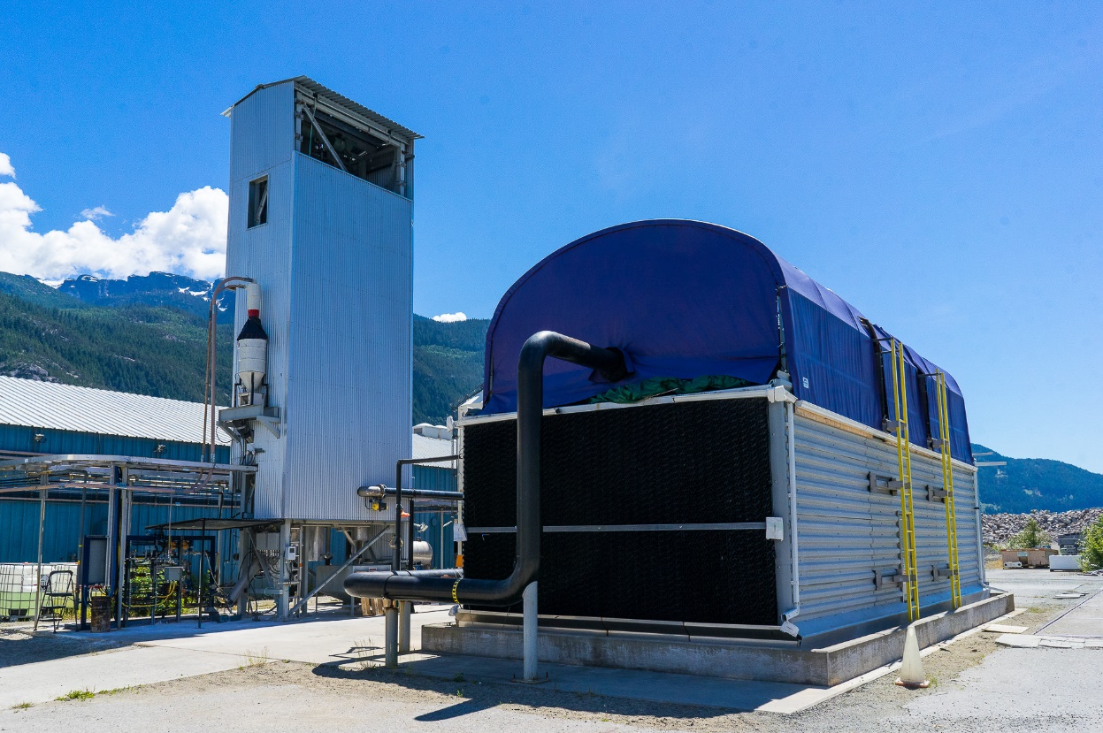
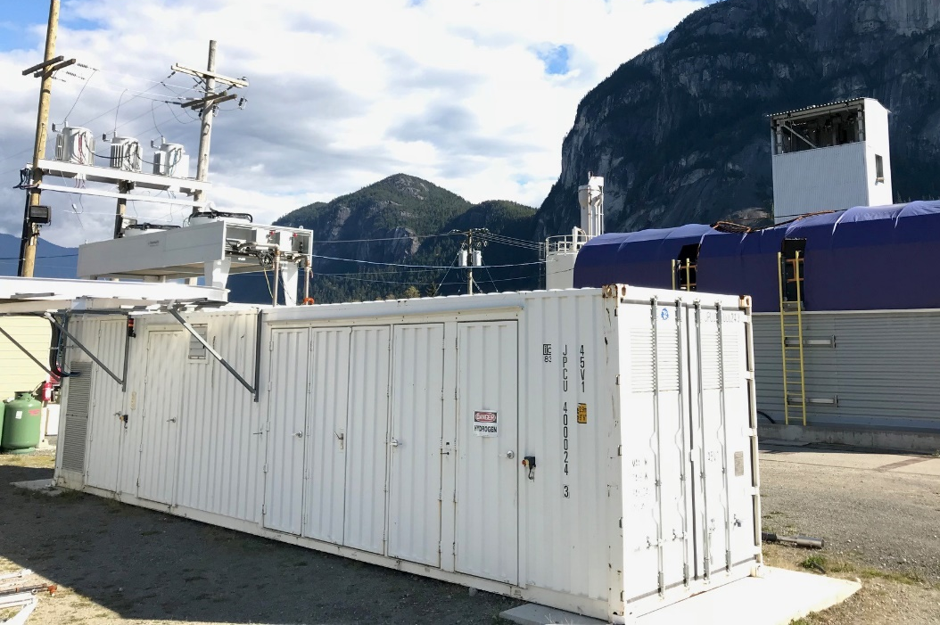
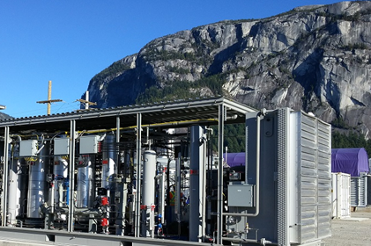
17
A BC-Based Growth Company
CE’s pilot plant electrolyzer.
CE’s Direct Air Capture pilot plant. Shown are the air contactor (right) and calciner (left).
CE’s pilot AIR TO FUELSTM system.
Notes:
CE has invested over 8 years in development of its DAC and A2F technology platforms and is now demonstrating the A2F technology platform at Pilot Scale.
CE’s next step is to build a Demonstration plant to prove commercial scale viability and be positioned to sell its first commercial plant license in 2020, for construction in 2021.
CE is currently raising capital to build the Demonstration plant and progress the sale of licenses to partners that will own and operate commercial plants worldwide.

Slide 18

18
A BC-Based Growth Company
AIR TO FUELSTM product benefits:
Ultra-low lifecycle carbon intensity, or fully carbon neutral
Drop-in compatible with today’s infrastructure and engines
Cleaner burning than fossil fuels, meaning they not only reduce GHG emissions, but contribute far less to local air pollution too
Less resource dependent than biofuels (can be produced with 100 times less land and significantly less water)
Can be blended with traditional fossil fuels, with no blending limit
Conventional diesel (left) compared to
CE’s clean-burning fuel (right)
Notes:
CE has invested over 8 years in development of its DAC and A2F technology platforms and is now demonstrating the A2F technology platform at Pilot Scale.
CE’s next step is to build a Demonstration plant to prove commercial scale viability and be positioned to sell its first commercial plant license in 2020, for construction in 2021.
CE is currently raising capital to build the Demonstration plant and progress the sale of licenses to partners that will own and operate commercial plants worldwide.

Slide 19
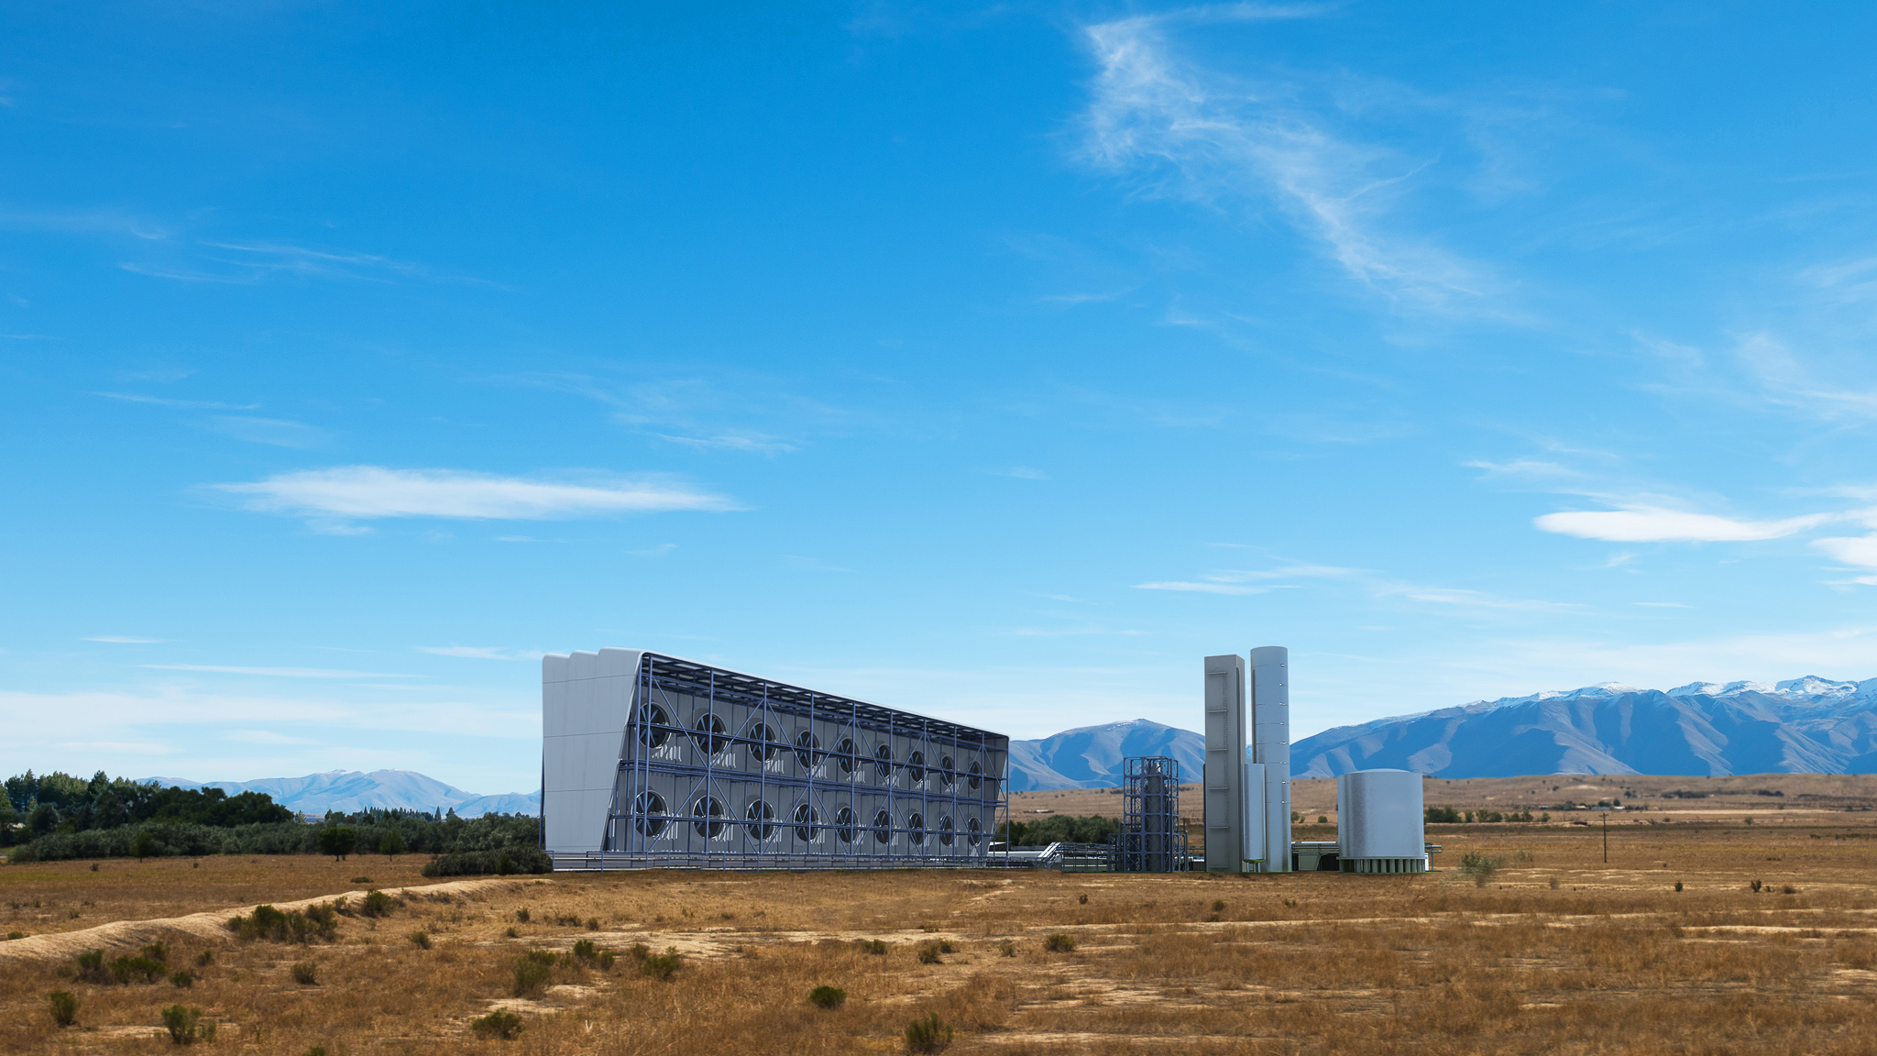

Thank You
Notes:
CE has invested over 8 years in development of its DAC and A2F technology platforms and is now demonstrating the A2F technology platform at Pilot Scale.
CE’s next step is to build a Demonstration plant to prove commercial scale viability and be positioned to sell its first commercial plant license in 2020, for construction in 2021.
CE is currently raising capital to build the Demonstration plant and progress the sale of licenses to partners that will own and operate commercial plants worldwide.

